Slide 1


Slide 2

¹⁰ According to the grace of God given to me, like a skilled master builder I laid a foundation, and someone else is building upon it. Let each one take care how he builds upon it. ¹¹ For no one can lay a foundation other than that which is laid, which is Jesus Christ. ¹² Now if anyone builds on the foundation with gold, silver, precious stones, wood, hay, straw— ¹³ each one's work will become manifest, for the Day will disclose it, because it will be revealed by fire, and the fire will test what sort of work each one has done. ¹⁴ If the work that anyone has built on the foundation survives, he will receive a reward. ¹⁵ If anyone's work is burned up, he will suffer loss, though he himself will be saved, but only as through fire.
1 Corinthians 3:10-15 ESV

Slide 3
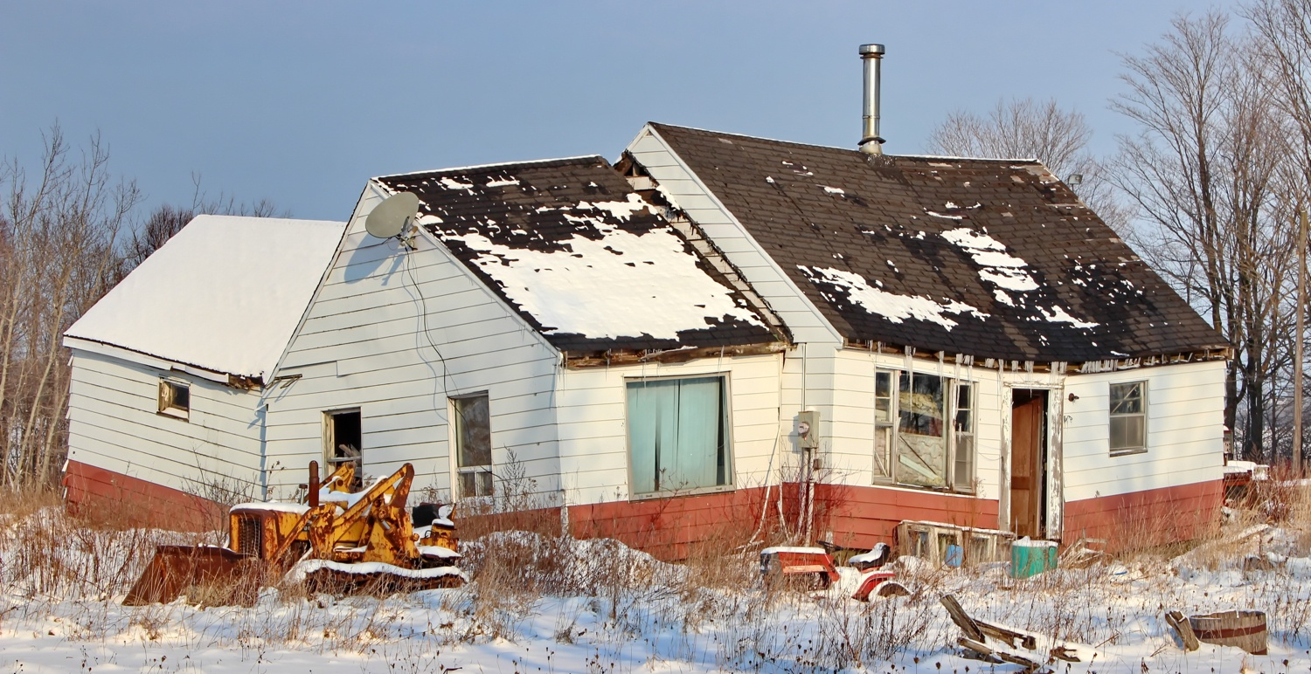
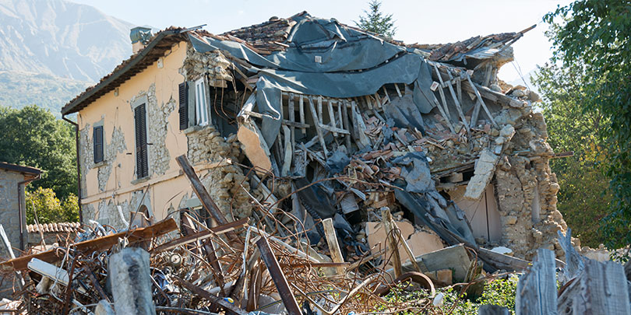

Slide 4
²⁴ “Everyone then who hears these words of mine and does them will be like a wise man who built his house on the rock. ²⁵ And the rain fell, and the floods came, and the winds blew and beat on that house, but it did not fall, because it had been founded on the rock. ²⁶ And everyone who hears these words of mine and does not do them will be like a foolish man who built his house on the sand. ²⁷ And the rain fell, and the floods came, and the winds blew and beat against that house, and it fell, and great was the fall of it.”
Matthew 7:24-27 ESV

Slide 5

⁷ for God gave us a spirit not of fear but of power and love and self-control.
2 Timothy 1:7 ESV
⁶ do not be anxious about anything, but in everything by prayer and supplication with thanksgiving let your requests be made known to God.
Philippians 4:6 ESV
⁹ Have I not commanded you? Be strong and courageous. Do not be frightened, and do not be dismayed, for the Lord your God is with you wherever you go.”
Joshua 1:9 ESV

