Slide 1


Slide 2

⁴ For whenever someone says, “I am with Paul,” or “I am with Apollos,” are you not merely human? ⁵ What is Apollos, really? Or what is Paul? Servants through whom you came to believe, and each of us in the ministry the Lord gave us. ⁶ I planted, Apollos watered, but God caused it to grow. ⁷ So neither the one who plants counts for anything, nor the one who waters, but God who causes the growth. ⁸ The one who plants and the one who waters work as one, but each will receive his reward according to his work. ⁹ We are coworkers belonging to God. You are God’s field, God’s building.
1 Corinthians 3:4-9 NET

Slide 3
⁴ For whenever someone says, “I am with Paul,” or “I am with Apollos,” are you not merely human? ⁵ What is Apollos, really? Or what is Paul? Servants through whom you came to believe, and each of us in the ministry the Lord gave us. ⁶ I planted, Apollos watered, but God caused it to grow. ⁷ So neither the one who plants counts for anything, nor the one who waters, but God who causes the growth. ⁸ The one who plants and the one who waters work as one, but each will receive his reward according to his work. ⁹ We are coworkers belonging to God. You are God’s field, God’s building.
1 Corinthians 3:4-9 NET

Slide 4

² For I decided to know nothing among you except Jesus Christ and him crucified.
1 Corinthians 2:6-7 ESV

Slide 5
⁴ For whenever someone says, “I am with Paul,” or “I am with Apollos,” are you not merely human? ⁵ What is Apollos, really? Or what is Paul? Servants through whom you came to believe, and each of us in the ministry the Lord gave us. ⁶ I planted, Apollos watered, but God caused it to grow. ⁷ So neither the one who plants counts for anything, nor the one who waters, but God who causes the growth. ⁸ The one who plants and the one who waters work as one, but each will receive his reward according to his work. ⁹ We are coworkers belonging to God. You are God’s field, God’s building.
1 Corinthians 3:4-9 NET

Slide 6
⁴ For whenever someone says, “I am with Paul,” or “I am with Apollos,” are you not merely human? ⁵ What is Apollos, really? Or what is Paul? Servants through whom you came to believe, and each of us in the ministry the Lord gave us. ⁶ I planted, Apollos watered, but God caused it to grow. ⁷ So neither the one who plants counts for anything, nor the one who waters, but God who causes the growth. ⁸ The one who plants and the one who waters work as one, but each will receive his reward according to his work. ⁹ We are coworkers belonging to God. You are God’s field, God’s building.
1 Corinthians 3:4-9 NET

Slide 7
⁴ For whenever someone says, “I am with Paul,” or “I am with Apollos,” are you not merely human? ⁵ What is Apollos, really? Or what is Paul? Servants through whom you came to believe, and each of us in the ministry the Lord gave us. ⁶ I planted, Apollos watered, but God caused it to grow. ⁷ So neither the one who plants counts for anything, nor the one who waters, but God who causes the growth. ⁸ The one who plants and the one who waters work as one, but each will receive his reward according to his work. ⁹ We are coworkers belonging to God. You are God’s field, God’s building.
1 Corinthians 3:4-9 NET

Slide 8

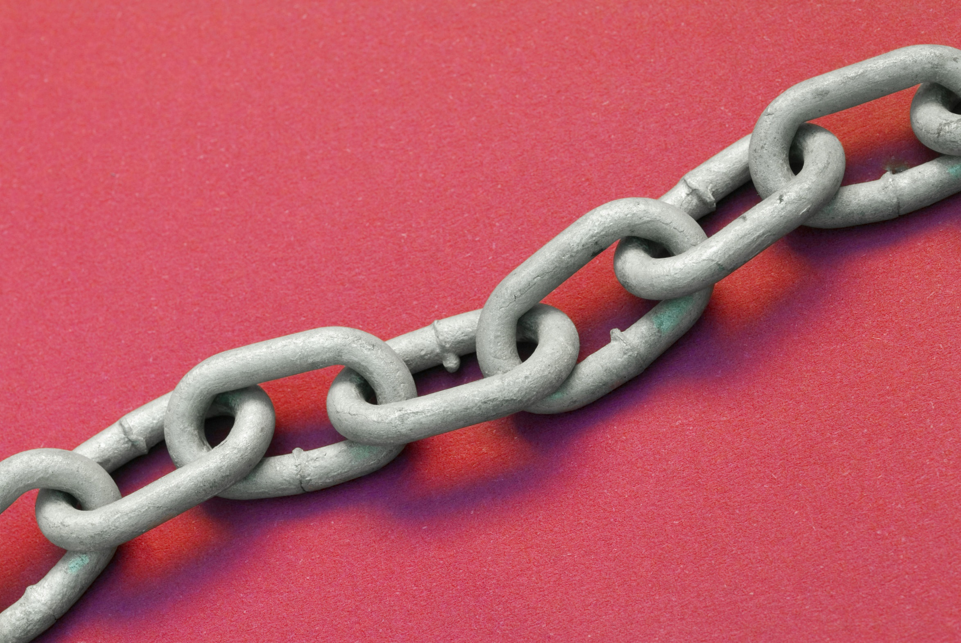

Slide 9




