Slide 1


Slide 2


Slide 3
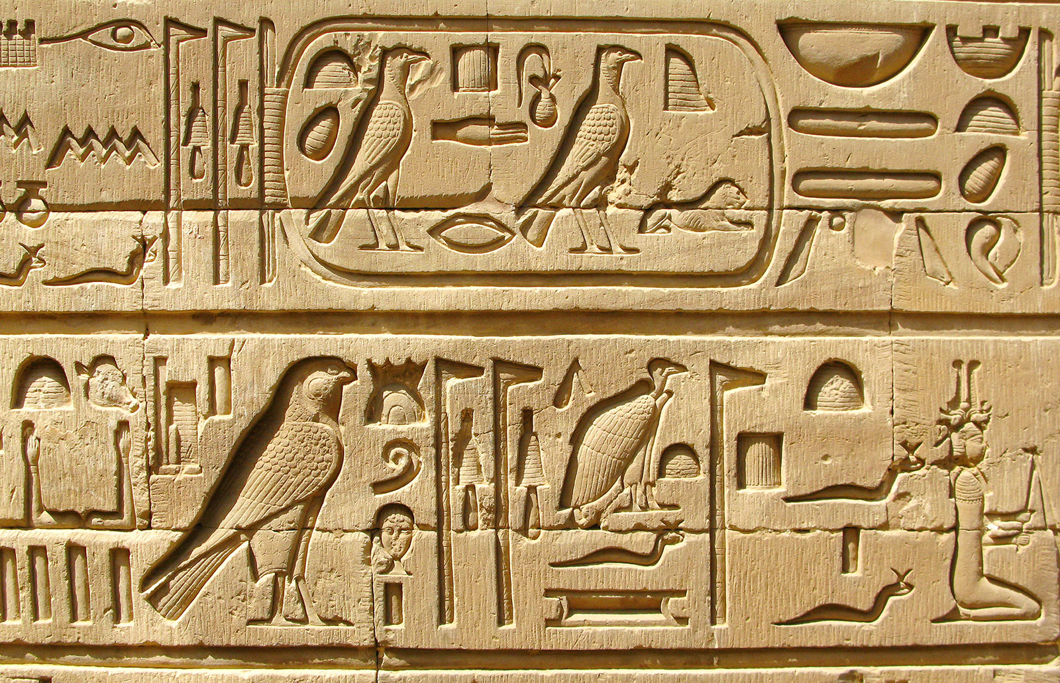

Slide 4
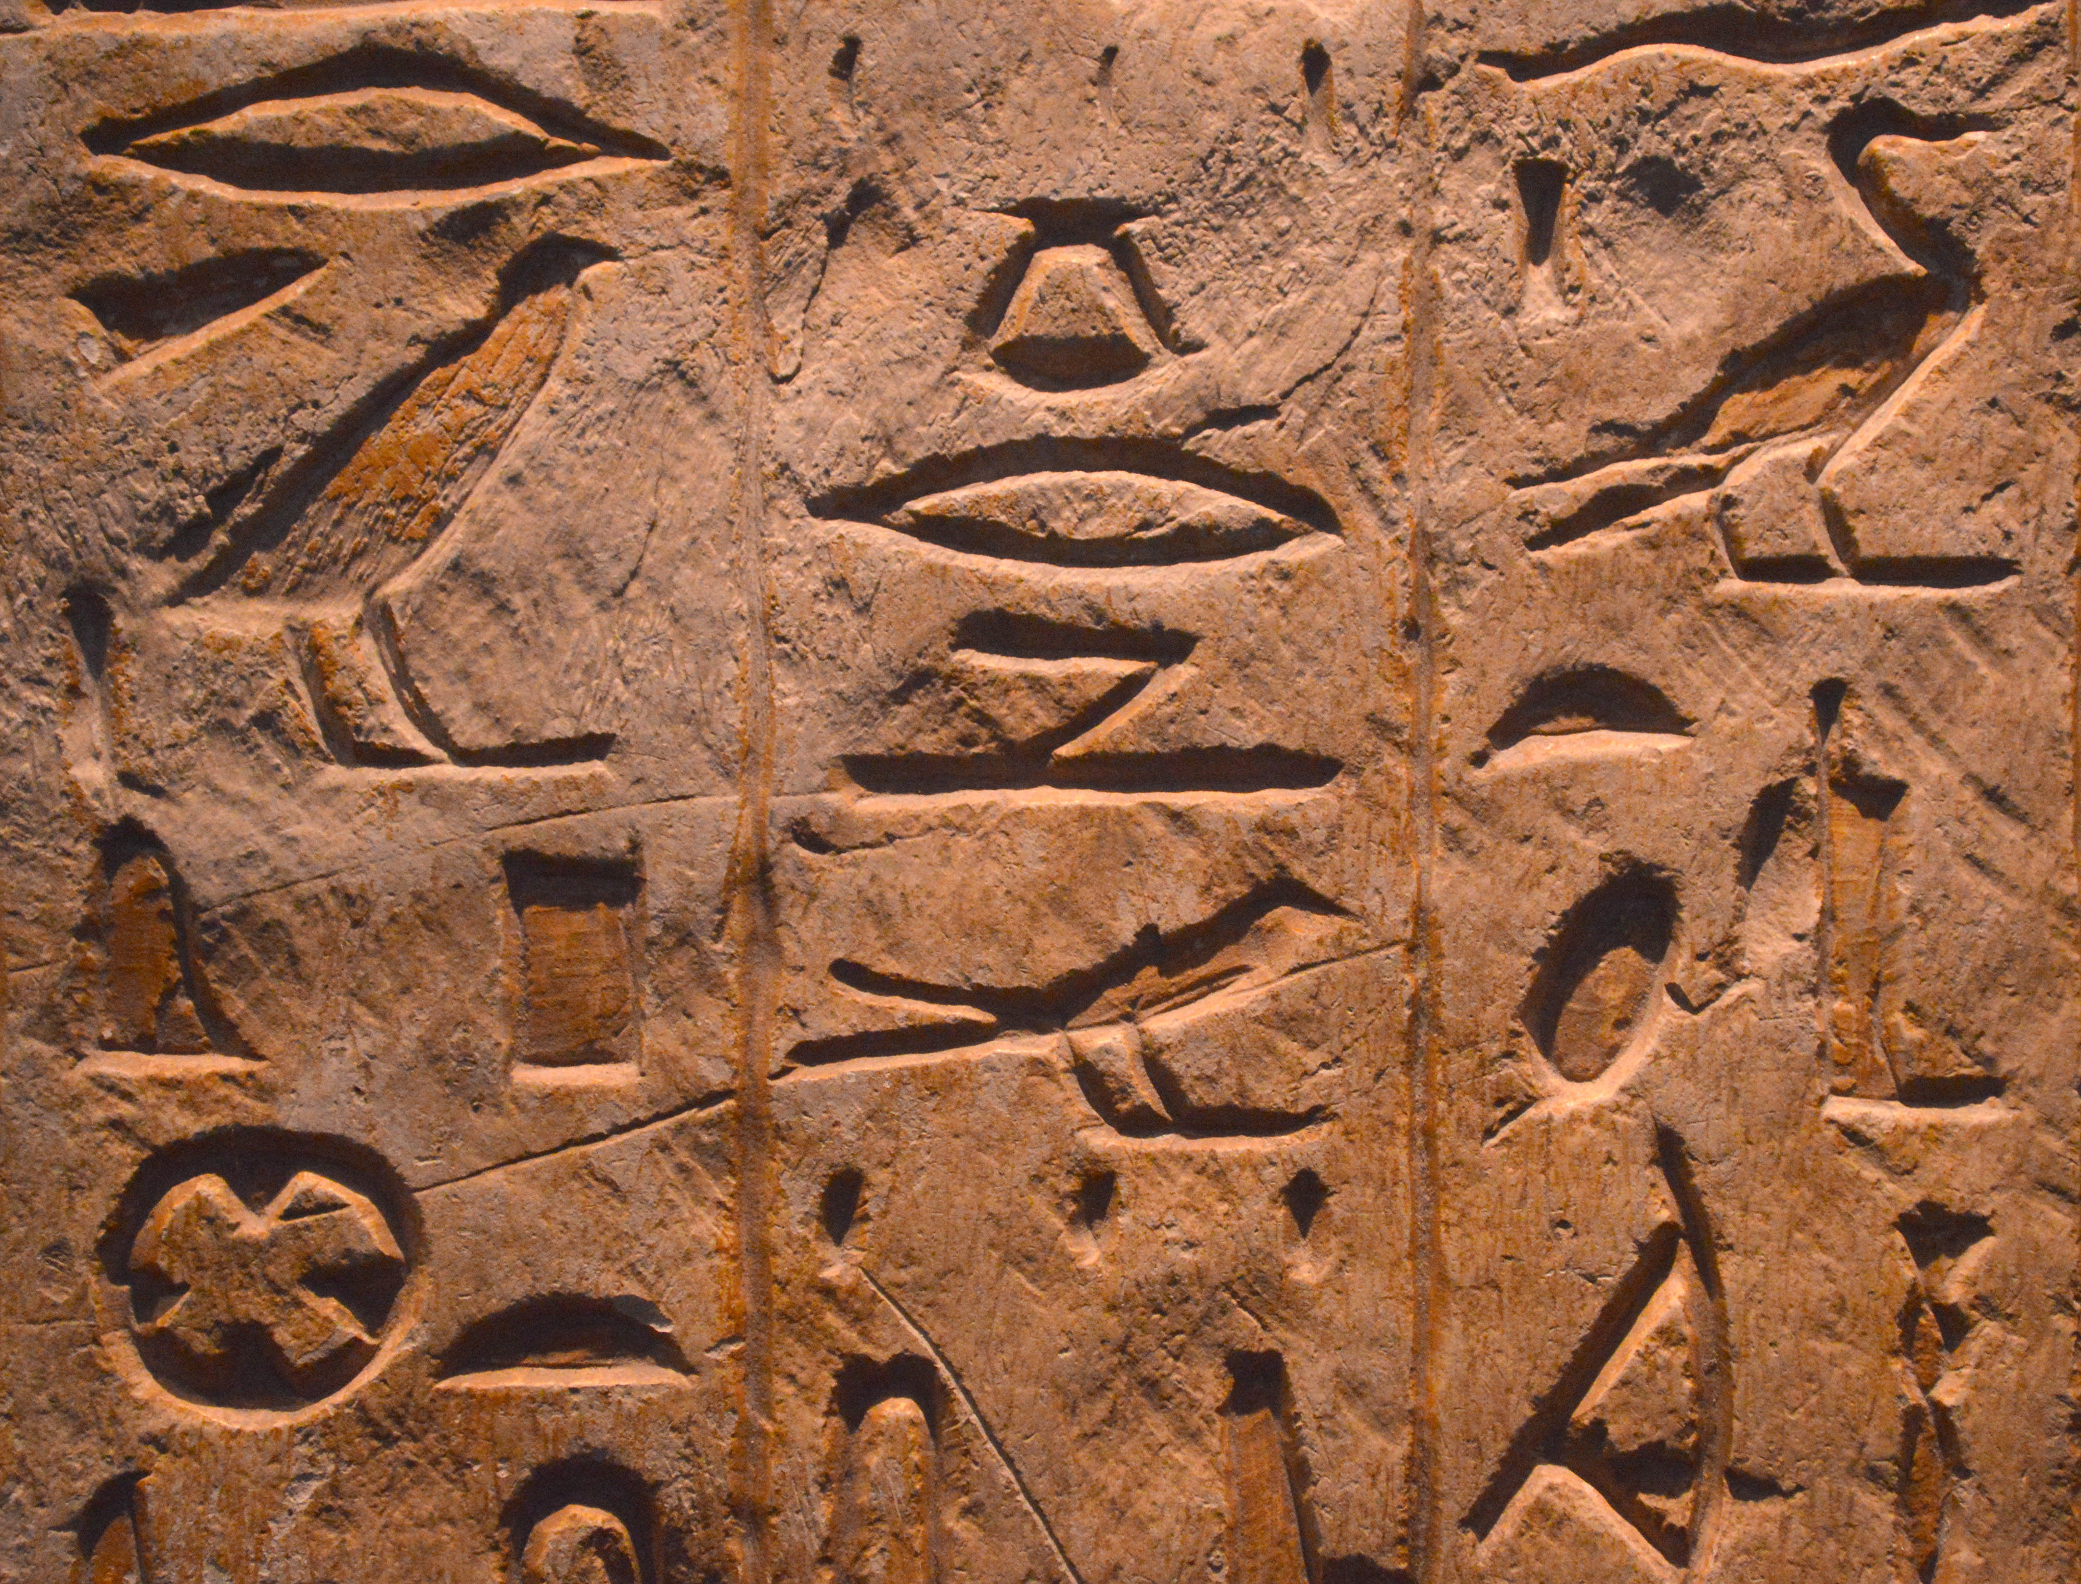

Slide 5
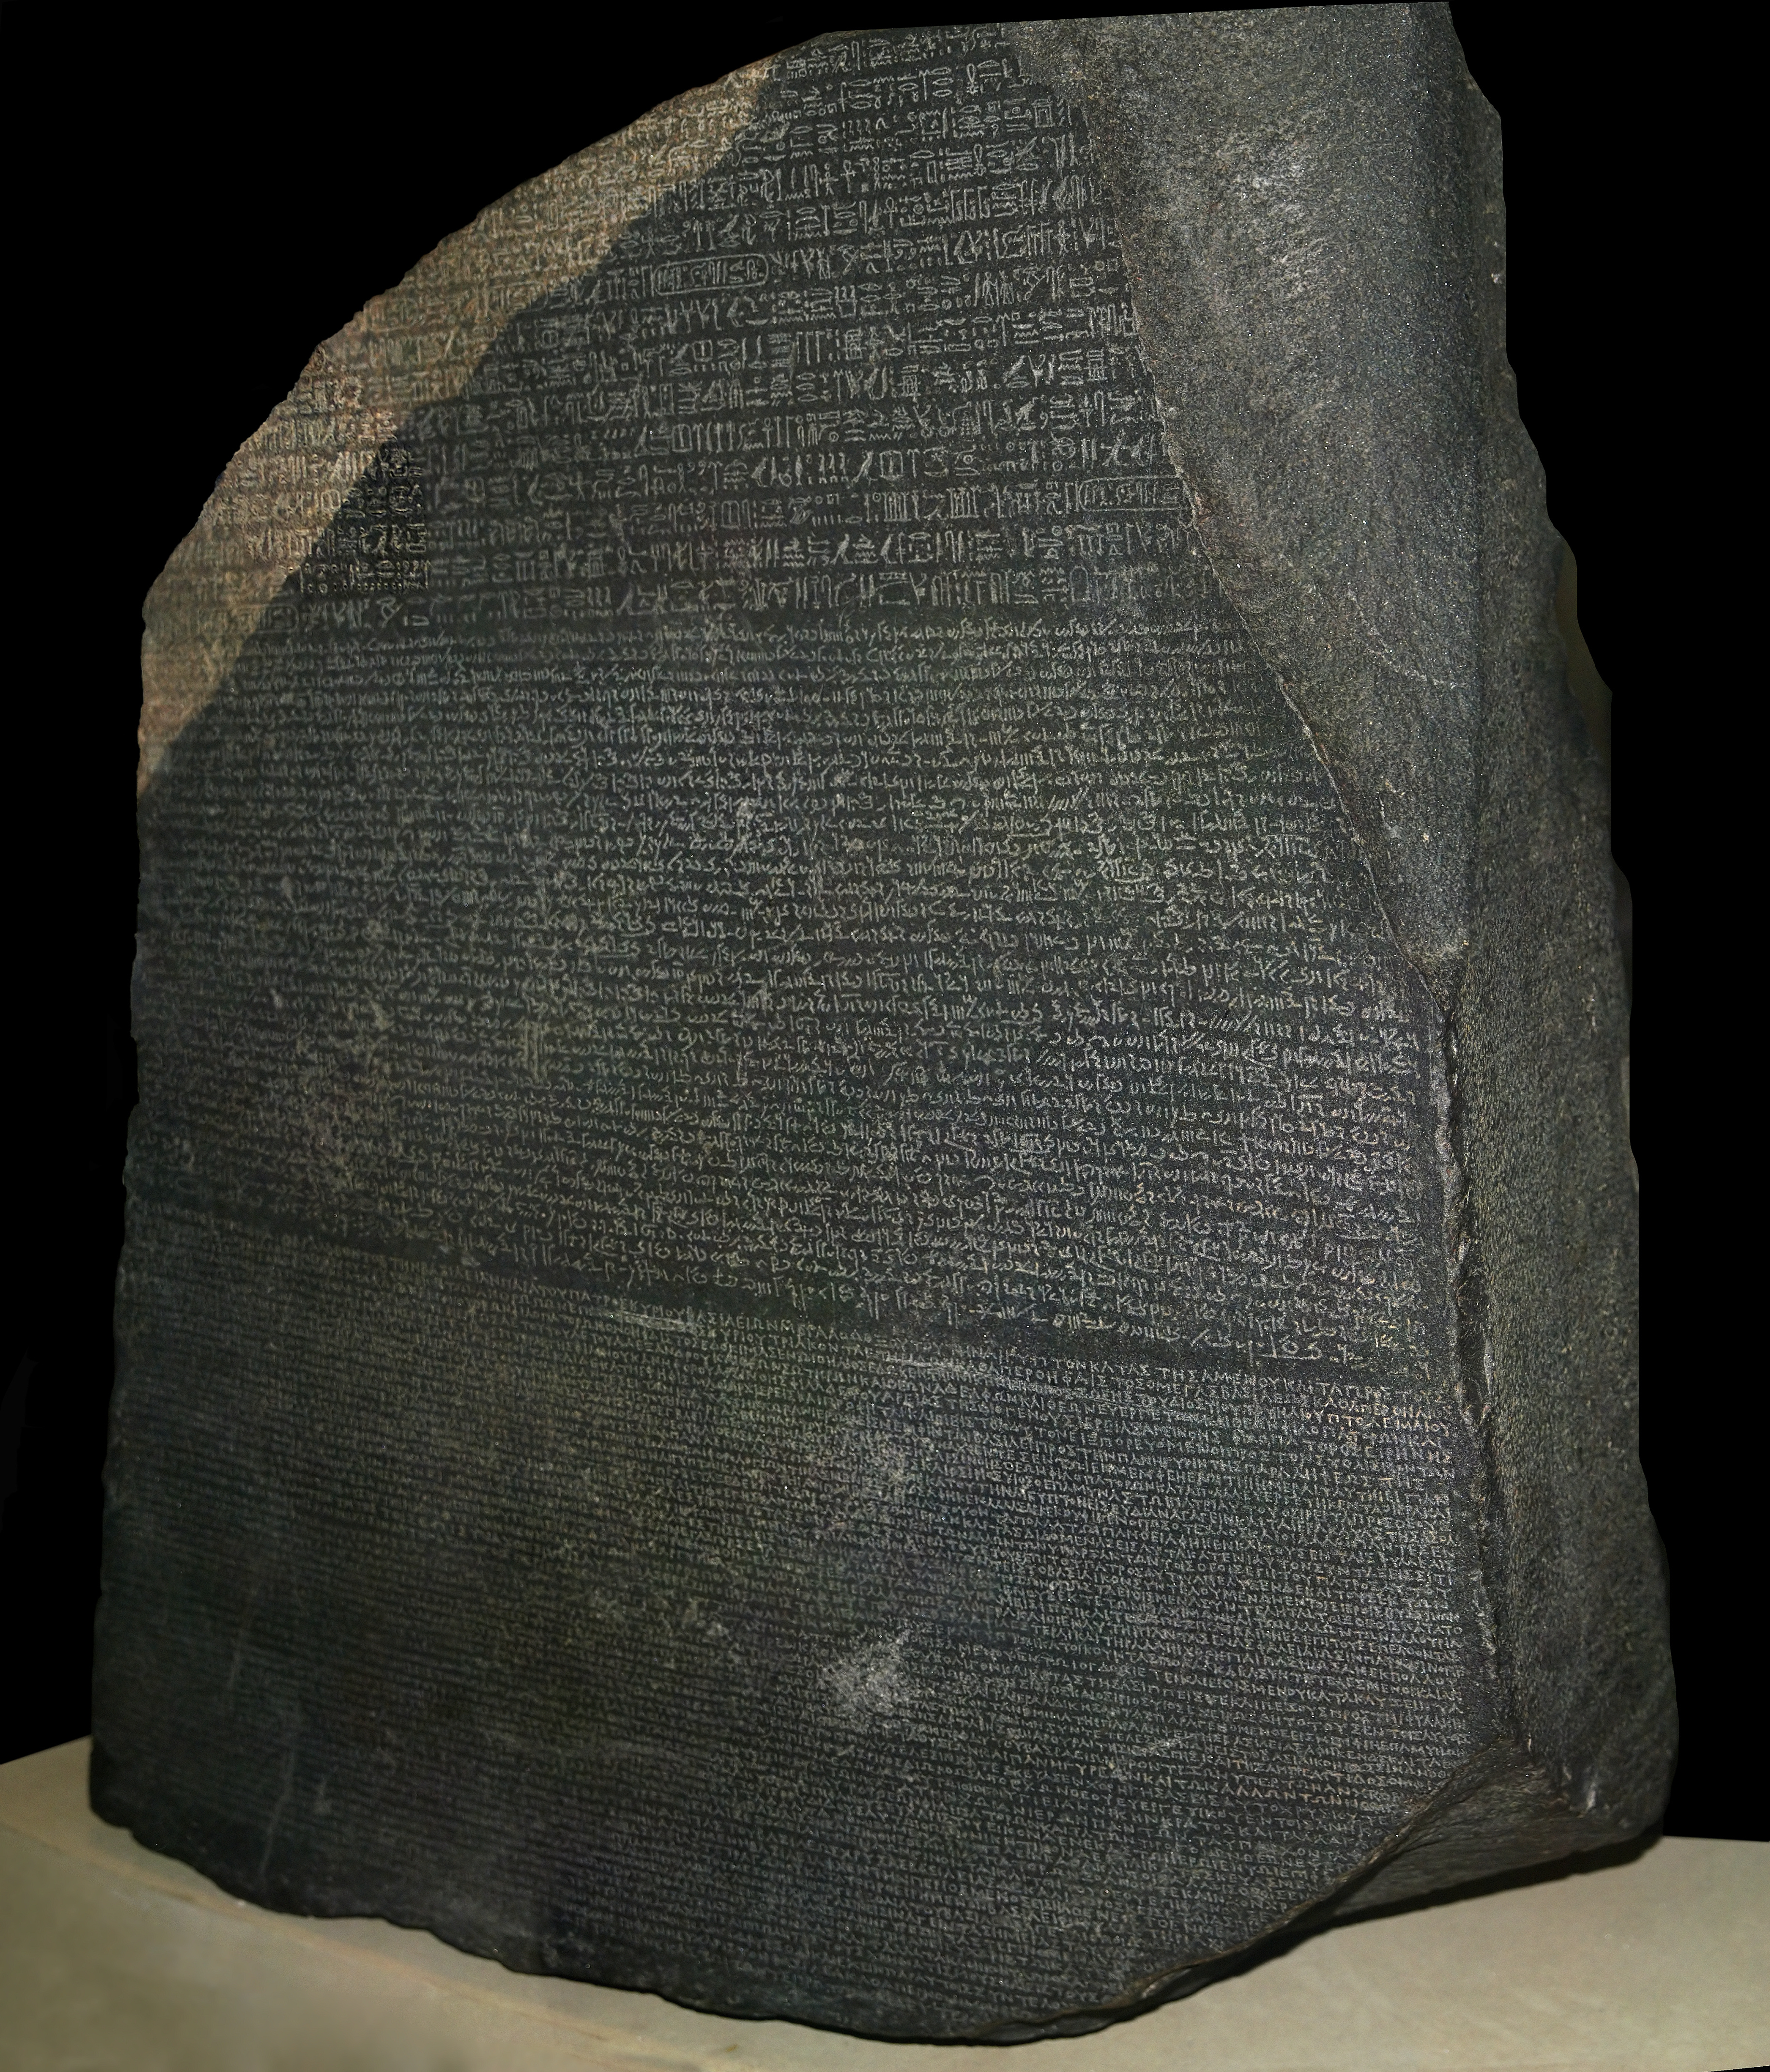

Slide 6

⁶ Now we do speak wisdom among the mature, but not a wisdom of this age or of the rulers of this age, who are perishing. ⁷ Instead we speak the wisdom of God, hidden in a mystery, that God determined before the ages for our glory. ⁸ None of the rulers of this age understood it. If they had known it, they would not have crucified the Lord of glory. ⁹ But just as it is written, “Things that no eye has seen, or ear heard, or mind imagined, are the things God has prepared for those who love him.” ¹⁰ God has revealed these to us by the Spirit. For the Spirit searches all things, even the deep things of God. ¹¹ For who among men knows the things of a man except the man’s spirit within him? So too, no one knows the things of God except the Spirit of God. ¹² Now we have not received the spirit of the world, but the Spirit who is from God, so that we may know the things that are freely given to us by God. ¹³ And we speak about these things, not with words taught us by human wisdom, but with those taught by the Spirit, explaining spiritual things to spiritual people. ¹⁴ The unbeliever does not receive the things of the Spirit of God, for they are foolishness to him. And he cannot understand them, because they are spiritually discerned. ¹⁵ The one who is spiritual discerns all things, yet he himself is understood by no one. ¹⁶ For who has known the mind of the Lord, so as to advise him? But we have the mind of Christ.
1 Corinthians 2:6-16 NET

Slide 7
⁶ Now we do speak wisdom among the mature, but not a wisdom of this age or of the rulers of this age, who are perishing. ⁷ Instead we speak the wisdom of God, hidden in a mystery, that God determined before the ages for our glory. ⁸ None of the rulers of this age understood it. If they had known it, they would not have crucified the Lord of glory. ⁹ But just as it is written, “Things that no eye has seen, or ear heard, or mind imagined, are the things God has prepared for those who love him.” ¹⁰ God has revealed these to us by the Spirit. For the Spirit searches all things, even the deep things of God. ¹¹ For who among men knows the things of a man except the man’s spirit within him? So too, no one knows the things of God except the Spirit of God. ¹² Now we have not received the spirit of the world, but the Spirit who is from God, so that we may know the things that are freely given to us by God. ¹³ And we speak about these things, not with words taught us by human wisdom, but with those taught by the Spirit, explaining spiritual things to spiritual people. ¹⁴ The unbeliever does not receive the things of the Spirit of God, for they are foolishness to him. And he cannot understand them, because they are spiritually discerned. ¹⁵ The one who is spiritual discerns all things, yet he himself is understood by no one. ¹⁶ For who has known the mind of the Lord, so as to advise him? But we have the mind of Christ.
1 Corinthians 2:6-16 NET

Slide 8
⁶ Now we do speak wisdom among the mature, but not a wisdom of this age or of the rulers of this age, who are perishing. ⁷ Instead we speak the wisdom of God, hidden in a mystery, that God determined before the ages for our glory. ⁸ None of the rulers of this age understood it. If they had known it, they would not have crucified the Lord of glory. ⁹ But just as it is written, “Things that no eye has seen, or ear heard, or mind imagined, are the things God has prepared for those who love him.” ¹⁰ God has revealed these to us by the Spirit. For the Spirit searches all things, even the deep things of God. ¹¹ For who among men knows the things of a man except the man’s spirit within him? So too, no one knows the things of God except the Spirit of God. ¹² Now we have not received the spirit of the world, but the Spirit who is from God, so that we may know the things that are freely given to us by God. ¹³ And we speak about these things, not with words taught us by human wisdom, but with those taught by the Spirit, explaining spiritual things to spiritual people. ¹⁴ The unbeliever does not receive the things of the Spirit of God, for they are foolishness to him. And he cannot understand them, because they are spiritually discerned. ¹⁵ The one who is spiritual discerns all things, yet he himself is understood by no one. ¹⁶ For who has known the mind of the Lord, so as to advise him? But we have the mind of Christ.
1 Corinthians 2:6-16 NET

Slide 9
⁶ Now we do speak wisdom among the mature, but not a wisdom of this age or of the rulers of this age, who are perishing. ⁷ Instead we speak the wisdom of God, hidden in a mystery, that God determined before the ages for our glory. ⁸ None of the rulers of this age understood it. If they had known it, they would not have crucified the Lord of glory. ⁹ But just as it is written, “Things that no eye has seen, or ear heard, or mind imagined, are the things God has prepared for those who love him.” ¹⁰ God has revealed these to us by the Spirit. For the Spirit searches all things, even the deep things of God. ¹¹ For who among men knows the things of a man except the man’s spirit within him? So too, no one knows the things of God except the Spirit of God. ¹² Now we have not received the spirit of the world, but the Spirit who is from God, so that we may know the things that are freely given to us by God. ¹³ And we speak about these things, not with words taught us by human wisdom, but with those taught by the Spirit, explaining spiritual things to spiritual people. ¹⁴ The unbeliever does not receive the things of the Spirit of God, for they are foolishness to him. And he cannot understand them, because they are spiritually discerned. ¹⁵ The one who is spiritual discerns all things, yet he himself is understood by no one. ¹⁶ For who has known the mind of the Lord, so as to advise him? But we have the mind of Christ.
1 Corinthians 2:6-16 NET

Slide 10
⁶ Now we do speak wisdom among the mature, but not a wisdom of this age or of the rulers of this age, who are perishing. ⁷ Instead we speak the wisdom of God, hidden in a mystery, that God determined before the ages for our glory. ⁸ None of the rulers of this age understood it. If they had known it, they would not have crucified the Lord of glory. ⁹ But just as it is written, “Things that no eye has seen, or ear heard, or mind imagined, are the things God has prepared for those who love him.” ¹⁰ God has revealed these to us by the Spirit. For the Spirit searches all things, even the deep things of God. ¹¹ For who among men knows the things of a man except the man’s spirit within him? So too, no one knows the things of God except the Spirit of God. ¹² Now we have not received the spirit of the world, but the Spirit who is from God, so that we may know the things that are freely given to us by God. ¹³ And we speak about these things, not with words taught us by human wisdom, but with those taught by the Spirit, explaining spiritual things to spiritual people. ¹⁴ The unbeliever does not receive the things of the Spirit of God, for they are foolishness to him. And he cannot understand them, because they are spiritually discerned. ¹⁵ The one who is spiritual discerns all things, yet he himself is understood by no one. ¹⁶ For who has known the mind of the Lord, so as to advise him? But we have the mind of Christ.
1 Corinthians 2:6-16 NET

Slide 11
⁶ Now we do speak wisdom among the mature, but not a wisdom of this age or of the rulers of this age, who are perishing. ⁷ Instead we speak the wisdom of God, hidden in a mystery, that God determined before the ages for our glory. ⁸ None of the rulers of this age understood it. If they had known it, they would not have crucified the Lord of glory. ⁹ But just as it is written, “Things that no eye has seen, or ear heard, or mind imagined, are the things God has prepared for those who love him.” ¹⁰ God has revealed these to us by the Spirit. For the Spirit searches all things, even the deep things of God. ¹¹ For who among men knows the things of a man except the man’s spirit within him? So too, no one knows the things of God except the Spirit of God. ¹² Now we have not received the spirit of the world, but the Spirit who is from God, so that we may know the things that are freely given to us by God. ¹³ And we speak about these things, not with words taught us by human wisdom, but with those taught by the Spirit, explaining spiritual things to spiritual people. ¹⁴ The unbeliever does not receive the things of the Spirit of God, for they are foolishness to him. And he cannot understand them, because they are spiritually discerned. ¹⁵ The one who is spiritual discerns all things, yet he himself is understood by no one. ¹⁶ For who has known the mind of the Lord, so as to advise him? But we have the mind of Christ.
1 Corinthians 2:6-16 NET

Slide 12
⁶ Now we do speak wisdom among the mature, but not a wisdom of this age or of the rulers of this age, who are perishing. ⁷ Instead we speak the wisdom of God, hidden in a mystery, that God determined before the ages for our glory. ⁸ None of the rulers of this age understood it. If they had known it, they would not have crucified the Lord of glory. ⁹ But just as it is written, “Things that no eye has seen, or ear heard, or mind imagined, are the things God has prepared for those who love him.” ¹⁰ God has revealed these to us by the Spirit. For the Spirit searches all things, even the deep things of God. ¹¹ For who among men knows the things of a man except the man’s spirit within him? So too, no one knows the things of God except the Spirit of God. ¹² Now we have not received the spirit of the world, but the Spirit who is from God, so that we may know the things that are freely given to us by God. ¹³ And we speak about these things, not with words taught us by human wisdom, but with those taught by the Spirit, explaining spiritual things to spiritual people. ¹⁴ The unbeliever does not receive the things of the Spirit of God, for they are foolishness to him. And he cannot understand them, because they are spiritually discerned. ¹⁵ The one who is spiritual discerns all things, yet he himself is understood by no one. ¹⁶ For who has known the mind of the Lord, so as to advise him? But we have the mind of Christ.
1 Corinthians 2:6-16 NET

Slide 13
⁶ Now we do speak wisdom among the mature, but not a wisdom of this age or of the rulers of this age, who are perishing. ⁷ Instead we speak the wisdom of God, hidden in a mystery, that God determined before the ages for our glory. ⁸ None of the rulers of this age understood it. If they had known it, they would not have crucified the Lord of glory. ⁹ But just as it is written, “Things that no eye has seen, or ear heard, or mind imagined, are the things God has prepared for those who love him.” ¹⁰ God has revealed these to us by the Spirit. For the Spirit searches all things, even the deep things of God. ¹¹ For who among men knows the things of a man except the man’s spirit within him? So too, no one knows the things of God except the Spirit of God. ¹² Now we have not received the spirit of the world, but the Spirit who is from God, so that we may know the things that are freely given to us by God. ¹³ And we speak about these things, not with words taught us by human wisdom, but with those taught by the Spirit, explaining spiritual things to spiritual people. ¹⁴ The unbeliever does not receive the things of the Spirit of God, for they are foolishness to him. And he cannot understand them, because they are spiritually discerned. ¹⁵ The one who is spiritual discerns all things, yet he himself is understood by no one. ¹⁶ For who has known the mind of the Lord, so as to advise him? But we have the mind of Christ.
1 Corinthians 2:6-16 NET

Slide 14
⁶ Now we do speak wisdom among the mature, but not a wisdom of this age or of the rulers of this age, who are perishing. ⁷ Instead we speak the wisdom of God, hidden in a mystery, that God determined before the ages for our glory. ⁸ None of the rulers of this age understood it. If they had known it, they would not have crucified the Lord of glory. ⁹ But just as it is written, “Things that no eye has seen, or ear heard, or mind imagined, are the things God has prepared for those who love him.” ¹⁰ God has revealed these to us by the Spirit. For the Spirit searches all things, even the deep things of God. ¹¹ For who among men knows the things of a man except the man’s spirit within him? So too, no one knows the things of God except the Spirit of God. ¹² Now we have not received the spirit of the world, but the Spirit who is from God, so that we may know the things that are freely given to us by God. ¹³ And we speak about these things, not with words taught us by human wisdom, but with those taught by the Spirit, explaining spiritual things to spiritual people. ¹⁴ The unbeliever does not receive the things of the Spirit of God, for they are foolishness to him. And he cannot understand them, because they are spiritually discerned. ¹⁵ The one who is spiritual discerns all things, yet he himself is understood by no one. ¹⁶ For who has known the mind of the Lord, so as to advise him? But we have the mind of Christ.
1 Corinthians 2:6-16 NET

Slide 15
⁶ Now we do speak wisdom among the mature, but not a wisdom of this age or of the rulers of this age, who are perishing. ⁷ Instead we speak the wisdom of God, hidden in a mystery, that God determined before the ages for our glory. ⁸ None of the rulers of this age understood it. If they had known it, they would not have crucified the Lord of glory. ⁹ But just as it is written, “Things that no eye has seen, or ear heard, or mind imagined, are the things God has prepared for those who love him.” ¹⁰ God has revealed these to us by the Spirit. For the Spirit searches all things, even the deep things of God. ¹¹ For who among men knows the things of a man except the man’s spirit within him? So too, no one knows the things of God except the Spirit of God. ¹² Now we have not received the spirit of the world, but the Spirit who is from God, so that we may know the things that are freely given to us by God. ¹³ And we speak about these things, not with words taught us by human wisdom, but with those taught by the Spirit, explaining spiritual things to spiritual people. ¹⁴ The unbeliever does not receive the things of the Spirit of God, for they are foolishness to him. And he cannot understand them, because they are spiritually discerned. ¹⁵ The one who is spiritual discerns all things, yet he himself is understood by no one. ¹⁶ For who has known the mind of the Lord, so as to advise him? But we have the mind of Christ.
1 Corinthians 2:6-16 NET

