Slide 1
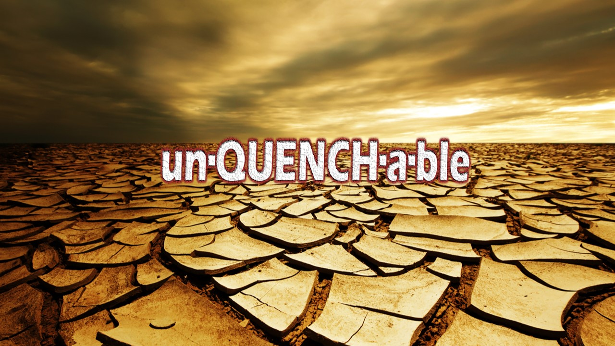

Slide 2
O God, you are my God; earnestly I seek you; my soul thirsts for you; my flesh faints for you, as in a dry and weary land where there is no water. ² So I have looked upon you in the sanctuary, beholding your power and glory. ³ Because your steadfast love is better than life, my lips will praise you. ⁴ So I will bless you as long as I live; in your name I will lift up my hands.
Psalm 63:1-4 ESV

Slide 3
¹⁰ Jesus answered her, “If you knew the gift of God, and who it is that is saying to you, ‘Give me a drink,’ you would have asked him, and he would have given you living water.”
John 4:10 ESV

Slide 4
¹³ Jesus said to her, “Everyone who drinks of this water will be thirsty again, ¹⁴ but whoever drinks of the water that I will give him will never be thirsty again. The water that I will give him will become in him a spring of water welling up to eternal life.”
John 4:13-14 ESV

Slide 5
²⁸ So the woman left her water jar and went away into town
John 4:28 ESV

Slide 6
Acts 17:26-27 ESV - ²⁶ And he made from one man every nation of mankind to live on all the face of the earth, having determined allotted periods and the boundaries of their dwelling place, ²⁷ that they should seek God, and perhaps feel their way toward him and find him. Yet he is actually not far from each one of us
Jeremiah 29:13 ESV - ¹³ You will seek me and find me, when you seek me with all your heart.

Slide 7
Isaiah 55:1 ESV - “Come, everyone who thirsts, come to the waters; and he who has no money, come, buy and eat! Come, buy wine and milk without money and without price.
John 7:37-38 ESV - ³⁷ On the last day of the feast, the great day, Jesus stood up and cried out, “If anyone thirsts, let him come to me and drink. ³⁸ Whoever believes in me, as the Scripture has said, ‘Out of his heart will flow rivers of living water.’”
Isaiah 55:6-7 ESV - ⁶ “Seek the Lord while he may be found; call upon him while he is near; ⁷ let the wicked forsake his way, and the unrighteous man his thoughts; let him return to the Lord, that he may have compassion on him, and to our God, for he will abundantly pardon.

