Slide 1


Slide 2
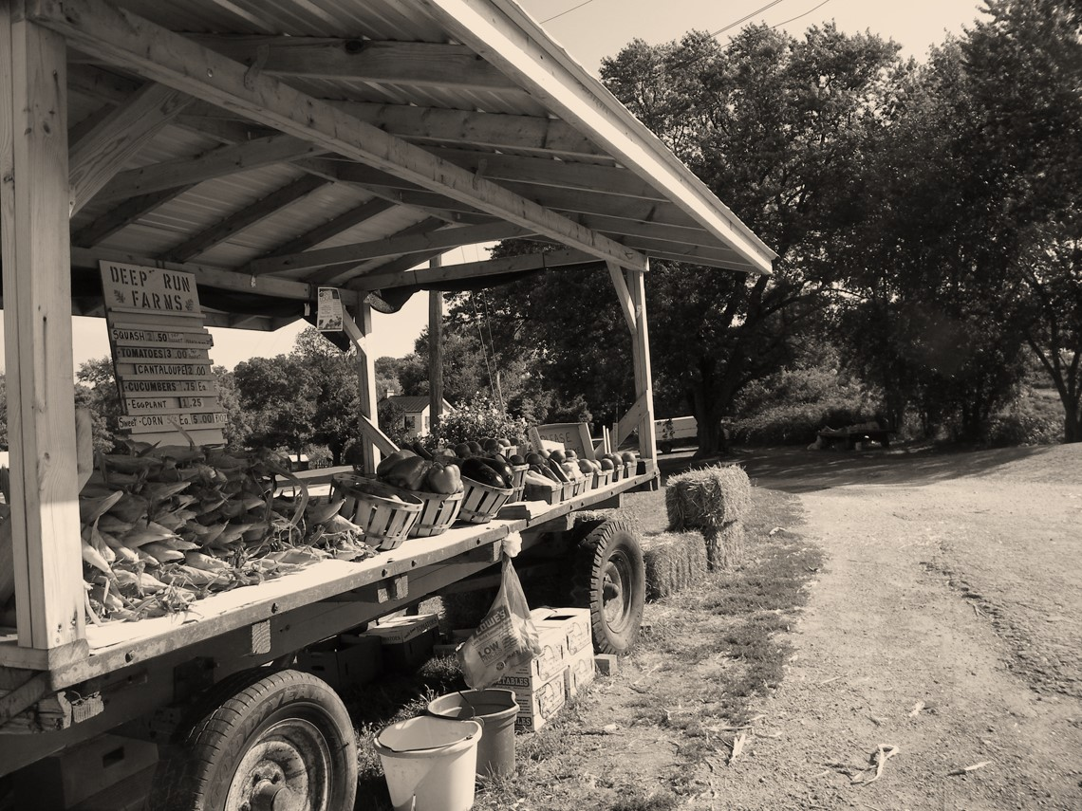


²² But the fruit of the Spirit is love, joy, peace, patience, kindness, goodness, faithfulness, ²³ gentleness, self-control; against such things there is no law. ²⁴ And those who belong to Christ Jesus have crucified the flesh with its passions and desires.
Galatians 5:22-24 ESV

Slide 3

1 Cor 14:33 - ³³ For God is not a God of confusion but of peace.
Romans 15:33 - ³³ May the God of peace be with you all.
Ephesians 2:14 - ¹⁴ For he himself is our peace, who has made us both one and has broken down in his flesh the dividing wall of hostility
Psalms 121:4 - Behold, he who keeps Israel will neither slumber nor sleep.

Slide 4
¹⁰ And the Philistine said, “I defy the ranks of Israel this day. Give me a man, that we may fight together.” ¹¹ When Saul and all Israel heard these words of the Philistine, they were dismayed and greatly afraid.
1 Samuel 17:10-11 ESV

Slide 5
³⁹ and David strapped his sword over his armor. And he tried in vain to go, for he had not tested them. Then David said to Saul, “I cannot go with these, for I have not tested them.” So David put them off.
1 Samuel 17:39 ESV

Slide 6
⁹ That same night the Lord said to him, “Arise, go down against the camp, for I have given it into your hand.
Judges 7:9 ESV

Slide 7
Now Jericho was shut up inside and outside because of the people of Israel. None went out, and none came in. ² And the Lord said to Joshua, “See, I have given Jericho into your hand, with its king and mighty men of valor.
Joshua 6:1-2 ESV

Slide 8
²⁰ So the people shouted, and the trumpets were blown. As soon as the people heard the sound of the trumpet, the people shouted a great shout, and the wall fell down flat, so that the people went up into the city, every man straight before him, and they captured the city.
Joshua 6:20 ESV

Slide 9
³³ I have said these things to you, that in me you may have peace. In the world you will have tribulation. But take heart; I have overcome the world.”
John 16:33 ESV

Slide 10
²⁵ “These things I have spoken to you while I am still with you. ²⁶ But the Helper, the Holy Spirit, whom the Father will send in my name, he will teach you all things and bring to your remembrance all that I have said to you. ²⁷ Peace I leave with you; my peace I give to you. Not as the world gives do I give to you. Let not your hearts be troubled, neither let them be afraid. ²⁸ You heard me say to you, ‘I am going away, and I will come to you.’ If you loved me, you would have rejoiced, because I am going to the Father, for the Father is greater than I. ²⁹ And now I have told you before it takes place, so that when it does take place you may believe. ³⁰ I will no longer talk much with you, for the ruler of this world is coming. He has no claim on me, ³¹ but I do as the Father has commanded me, so that the world may know that I love the Father. Rise, let us go from here.
John 14:25-31 ESV

Slide 11
²⁵ “These things I have spoken to you while I am still with you. ²⁶ But the Helper, the Holy Spirit, whom the Father will send in my name, he will teach you all things and bring to your remembrance all that I have said to you. ²⁷ Peace I leave with you; my peace I give to you. Not as the world gives do I give to you. Let not your hearts be troubled, neither let them be afraid. ²⁸ You heard me say to you, ‘I am going away, and I will come to you.’ If you loved me, you would have rejoiced, because I am going to the Father, for the Father is greater than I. ²⁹ And now I have told you before it takes place, so that when it does take place you may believe. ³⁰ I will no longer talk much with you, for the ruler of this world is coming. He has no claim on me, ³¹ but I do as the Father has commanded me, so that the world may know that I love the Father. Rise, let us go from here.
John 14:25-31 ESV

Slide 12
²⁵ “These things I have spoken to you while I am still with you. ²⁶ But the Helper, the Holy Spirit, whom the Father will send in my name, he will teach you all things and bring to your remembrance all that I have said to you. ²⁷ Peace I leave with you; my peace I give to you. Not as the world gives do I give to you. Let not your hearts be troubled, neither let them be afraid. ²⁸ You heard me say to you, ‘I am going away, and I will come to you.’ If you loved me, you would have rejoiced, because I am going to the Father, for the Father is greater than I. ²⁹ And now I have told you before it takes place, so that when it does take place you may believe. ³⁰ I will no longer talk much with you, for the ruler of this world is coming. He has no claim on me, ³¹ but I do as the Father has commanded me, so that the world may know that I love the Father. Rise, let us go from here.
John 14:25-31 ESV

Slide 13
²⁵ “These things I have spoken to you while I am still with you. ²⁶ But the Helper, the Holy Spirit, whom the Father will send in my name, he will teach you all things and bring to your remembrance all that I have said to you. ²⁷ Peace I leave with you; my peace I give to you. Not as the world gives do I give to you. Let not your hearts be troubled, neither let them be afraid. ²⁸ You heard me say to you, ‘I am going away, and I will come to you.’ If you loved me, you would have rejoiced, because I am going to the Father, for the Father is greater than I. ²⁹ And now I have told you before it takes place, so that when it does take place you may believe. ³⁰ I will no longer talk much with you, for the ruler of this world is coming. He has no claim on me, ³¹ but I do as the Father has commanded me, so that the world may know that I love the Father. Rise, let us go from here.
John 14:25-31 ESV

Slide 14
²⁵ “These things I have spoken to you while I am still with you. ²⁶ But the Helper, the Holy Spirit, whom the Father will send in my name, he will teach you all things and bring to your remembrance all that I have said to you. ²⁷ Peace I leave with you; my peace I give to you. Not as the world gives do I give to you. Let not your hearts be troubled, neither let them be afraid. ²⁸ You heard me say to you, ‘I am going away, and I will come to you.’ If you loved me, you would have rejoiced, because I am going to the Father, for the Father is greater than I. ²⁹ And now I have told you before it takes place, so that when it does take place you may believe. ³⁰ I will no longer talk much with you, for the ruler of this world is coming. He has no claim on me, ³¹ but I do as the Father has commanded me, so that the world may know that I love the Father. Rise, let us go from here.
John 14:25-31 ESV

Slide 15
²⁵ “These things I have spoken to you while I am still with you. ²⁶ But the Helper, the Holy Spirit, whom the Father will send in my name, he will teach you all things and bring to your remembrance all that I have said to you. ²⁷ Peace I leave with you; my peace I give to you. Not as the world gives do I give to you. Let not your hearts be troubled, neither let them be afraid. ²⁸ You heard me say to you, ‘I am going away, and I will come to you.’ If you loved me, you would have rejoiced, because I am going to the Father, for the Father is greater than I. ²⁹ And now I have told you before it takes place, so that when it does take place you may believe. ³⁰ I will no longer talk much with you, for the ruler of this world is coming. He has no claim on me, ³¹ but I do as the Father has commanded me, so that the world may know that I love the Father. Rise, let us go from here.
John 14:25-31 ESV

Slide 16
In that day this song will be sung in the land of Judah: “We have a strong city; he sets up salvation as walls and bulwarks. ² Open the gates, that the righteous nation that keeps faith may enter in. ³ You keep him in perfect peace whose mind is stayed on you, because he trusts in you. ⁴ Trust in the Lord forever, for the Lord God is an everlasting rock.
Isaiah 26:1-4 ESV

Slide 17
¹² O Lord, you will ordain peace for us, for you have indeed done for us all our works.
Isaiah 26:12 ESV

Slide 18
¹⁵ And let the peace of Christ rule in your hearts, to which indeed you were called in one body. And be thankful. ¹⁶ Let the word of Christ dwell in you richly, teaching and admonishing one another in all wisdom, singing psalms and hymns and spiritual songs, with thankfulness in your hearts to God.
Colossians 3:15-16 ESV

