Slide 1


Slide 2
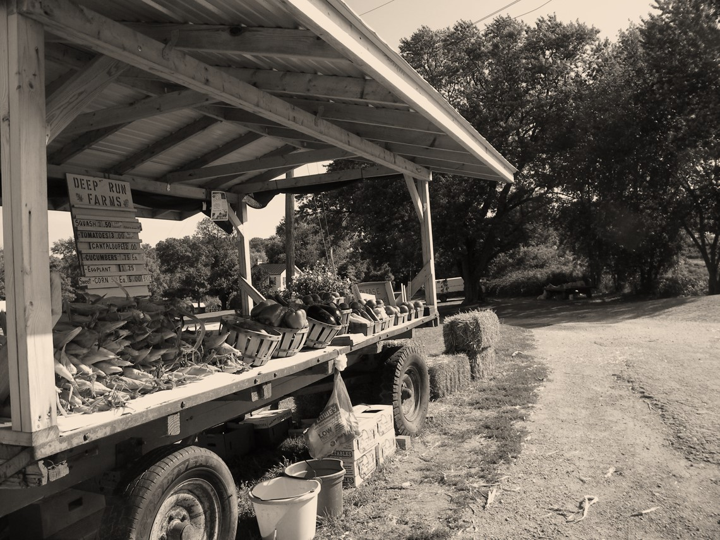


²² But the fruit of the Spirit is love, joy, peace, patience, kindness, goodness, faithfulness, ²³ gentleness, self-control; against such things there is no law. ²⁴ And those who belong to Christ Jesus have crucified the flesh with its passions and desires.
Galatians 5:22-24 ESV

Slide 3
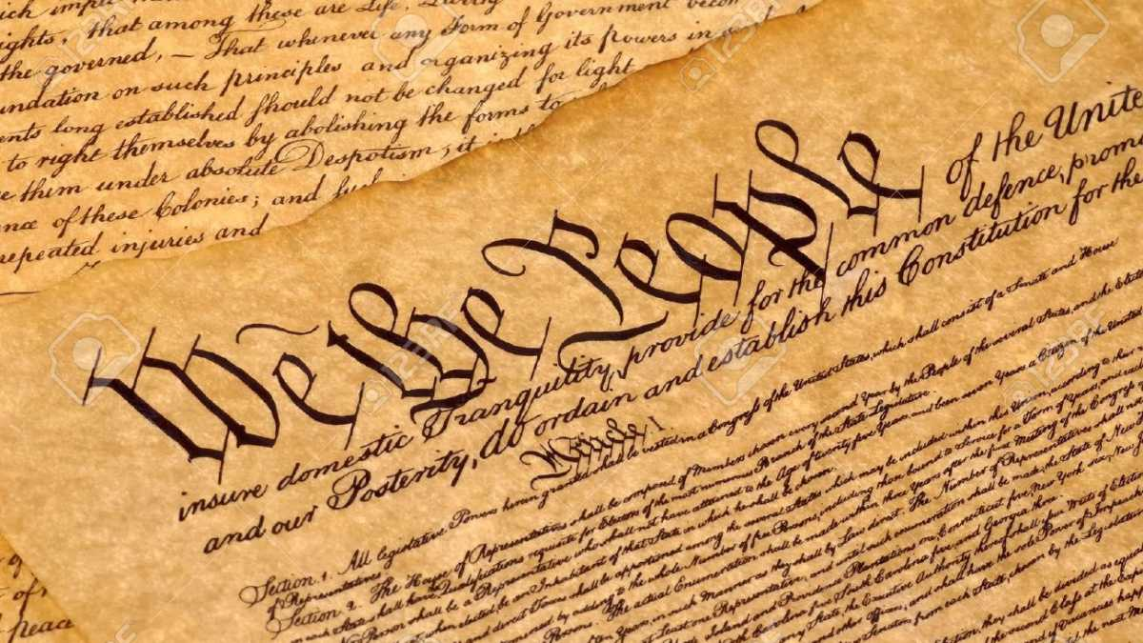

Slide 4
John 16:33b - In the world you will have tribulation.
1 Peter 4:12 - ¹² Beloved, do not be surprised at the fiery trial when it comes upon you to test you, as though something strange were happening to you.
John 15:20a - ²⁰ Remember the word that I said to you: ‘A servant is not greater than his master.’ If they persecuted me, they will also persecute you.
James 1:2 - Count it all joy, my brothers, when you meet trials of various kinds
Acts 14:22 - ²² They strengthened the souls of the disciples and encouraged them to continue in the faith, saying, “We must enter the kingdom of God through many persecutions.” NET

Slide 5
Blessed is the one whose transgression is forgiven, whose sin is covered. ² Blessed is the man against whom the Lord counts no iniquity, and in whose spirit there is no deceit.
Psalm 32:1-2 ESV

Slide 6
¹⁶ The Spirit himself bears witness with our spirit that we are children of God
Romans 8:16 ESV

Slide 7
¹⁸ For I consider that the sufferings of this present time are not worth comparing with the glory that is to be revealed to us.
Romans 8:18 ESV

Slide 8
⁸ I have set the Lord always before me; because he is at my right hand, I shall not be shaken. ⁹ Therefore my heart is glad, and my whole being rejoices; my flesh also dwells secure. ¹⁰ For you will not abandon my soul to Sheol, or let your holy one see corruption. ¹¹ You make known to me the path of life; in your presence there is fullness of joy; at your right hand are pleasures forevermore.
Psalm 16:8-11 ESV

Slide 9

Philippians 4:4 - ⁴ Rejoice in the Lord always; again I will say, rejoice.
Deut. 28:47-48 - ⁴⁷ Because you did not serve the Lord your God with joyfulness and gladness of heart, because of the abundance of all things, ⁴⁸ therefore you shall serve your enemies whom the Lord will send against you, in hunger and thirst, in nakedness, and lacking everything

Slide 10
⁹ As the Father has loved me, so have I loved you. Abide in my love. ¹⁰ If you keep my commandments, you will abide in my love, just as I have kept my Father's commandments and abide in his love. ¹¹ These things I have spoken to you, that my joy may be in you, and that your joy may be full.
John 15:9-11 ESV

Slide 11
¹⁰ Many are the sorrows of the wicked, but steadfast love surrounds the one who trusts in the Lord. ¹¹ Be glad in the Lord, and rejoice, O righteous, and shout for joy, all you upright in heart!
Psalm 32:10-11 ESV

