Slide 1


Slide 2
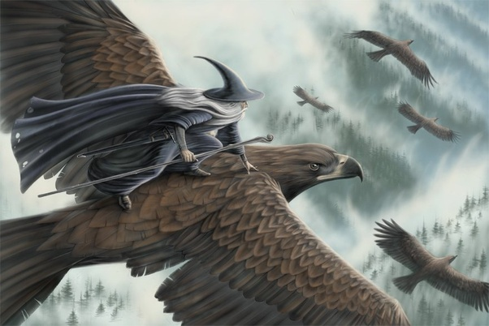

Slide 3
On the Sabbath they rested according to the commandment
Luke 23:56b ESV

Slide 4
¹³ That very day two of them were going to a village named Emmaus, about seven miles from Jerusalem, ¹⁴ and they were talking with each other about all these things that had happened. ¹⁵ While they were talking and discussing together, Jesus himself drew near and went with them. ¹⁶ But their eyes were kept from recognizing him.
Luke 24:13-16 ESV

Slide 5
¹⁷ And he said to them, “What is this conversation that you are holding with each other as you walk?” And they stood still, looking sad.
Luke 24:17 ESV

Slide 6
¹⁸ Then one of them, named Cleopas, answered him, “Are you the only visitor to Jerusalem who does not know the things that have happened there in these days?”
Luke 24:18 ESV

Slide 7
¹⁹ And he said to them, “What things?”
Luke 24:19a ESV

Slide 8
¹⁹ And he said to them, “What things?” And they said to him, “Concerning Jesus of Nazareth, a man who was a prophet mighty in deed and word before God and all the people, ²⁰ and how our chief priests and rulers delivered him up to be condemned to death, and crucified him.
Luke 24:19-20 ESV

Slide 9
²¹ But we had hoped that he was the one to redeem Israel. Yes, and besides all this, it is now the third day since these things happened.
Luke 24:21 ESV

Slide 10
⁶ He is not here, but has risen. Remember how he told you, while he was still in Galilee, ⁷ that the Son of Man must be delivered into the hands of sinful men and be crucified and on the third day rise.”
Luke 24:6-7 ESV

Slide 11
²⁵ And he said to them, “O foolish ones, and slow of heart to believe all that the prophets have spoken!
Luke 24:25 ESV

Slide 12
²⁶ Was it not necessary that the Christ should suffer these things and enter into his glory?”
Luke 24:26 ESV

Slide 13
²⁷ And beginning with Moses and all the Prophets, he interpreted to them in all the Scriptures the things concerning himself.
Luke 24:27 ESV

Slide 14
³⁰ When he was at table with them, he took the bread and blessed and broke it and gave it to them. ³¹ And their eyes were opened, and they recognized him. And he vanished from their sight.
Luke 24:30-31 ESV

Slide 15
³² They said to each other, “Did not our hearts burn within us while he talked to us on the road, while he opened to us the Scriptures?”
Luke 24:32 ESV

Slide 16
⁴⁴ Then he said to them, “These are my words that I spoke to you while I was still with you, that everything written about me in the Law of Moses and the Prophets and the Psalms must be fulfilled.” ⁴⁵ Then he opened their minds to understand the Scriptures, ⁴⁶ and said to them, “Thus it is written, that the Christ should suffer and on the third day rise from the dead, ⁴⁷ and that repentance for the forgiveness of sins should be proclaimed in his name to all nations, beginning from Jerusalem.
Luke 24:44-47 ESV

Slide 17
But he was pierced for our transgressions; he was crushed for our iniquities; upon him was the chastisement that brought us peace, and with his wounds we are healed.
Isaiah 53:5 ESV

Slide 18
³ For I delivered to you as of first importance what I also received: that Christ died for our sins in accordance with the Scriptures, ⁴ that he was buried, that he was raised on the third day in accordance with the Scriptures
1 Corinthians 15:3-4 ESV

Slide 19
