Slide 1
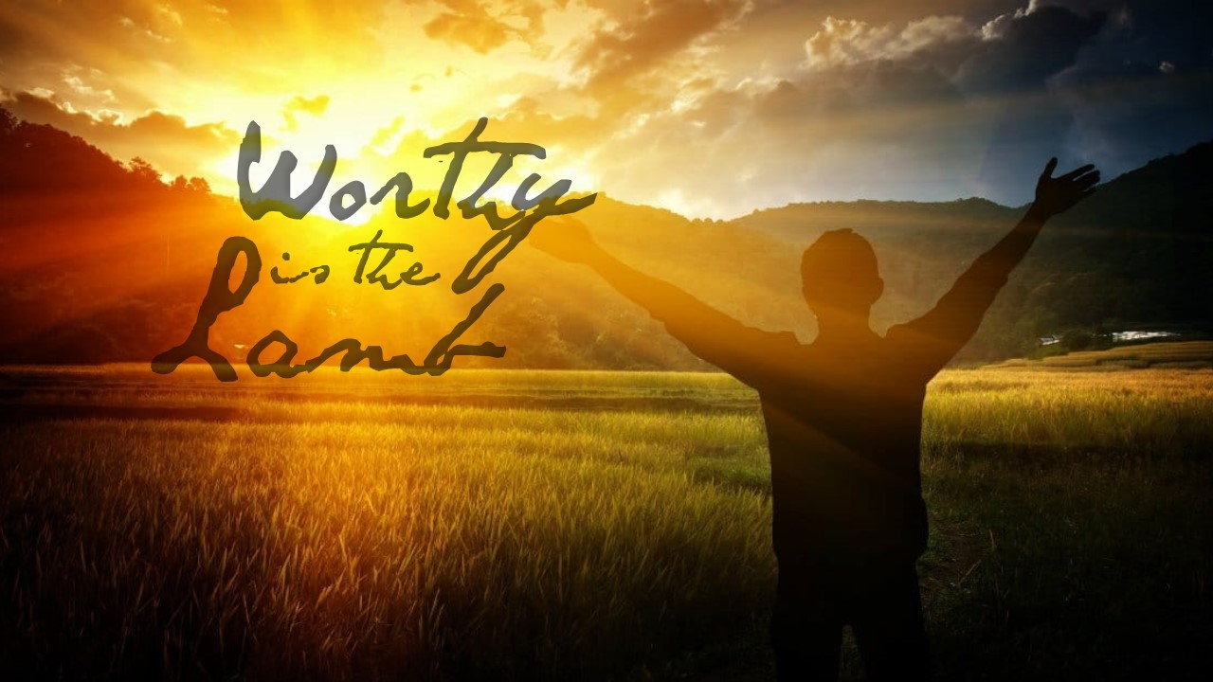

Slide 2
¹ And I saw in the right hand of Him who sat on the throne a scroll written inside and on the back, sealed with seven seals. ² Then I saw a strong angel proclaiming with a loud voice, “Who is worthy to open the scroll and to loose its seals?” ³ And no one in heaven or on the earth or under the earth was able to open the scroll, or to look at it. ⁴ So I wept much, because no one was found worthy to open and read the scroll, or to look at it. ⁵ But one of the elders said to me, “Do not weep. Behold, the Lion of the tribe of Judah, the Root of David, has prevailed to open the scroll and to loose its seven seals.” ⁶ And I looked, and behold, in the midst of the throne and of the four living creatures, and in the midst of the elders, stood a Lamb as though it had been slain, having seven horns and seven eyes, which are the seven Spirits of God sent out into all the earth. ⁷ Then He came and took the scroll out of the right hand of Him who sat on the throne.

Slide 3
⁸ Now when He had taken the scroll, the four living creatures and the twenty-four elders fell down before the Lamb, each having a harp, and golden bowls full of incense, which are the prayers of the saints. ⁹ And they sang a new song, saying: “You are worthy to take the scroll, And to open its seals; For You were slain, And have redeemed us to God by Your blood Out of every tribe and tongue and people and nation, ¹⁰ And have made us kings and priests to our God; And we shall reign on the earth.” ¹¹ Then I looked, and I heard the voice of many angels around the throne, the living creatures, and the elders; and the number of them was ten thousand times ten thousand, and thousands of thousands, ¹² saying with a loud voice: “Worthy is the Lamb who was slain To receive power and riches and wisdom, And strength and honor and glory and blessing!” ¹³ And every creature which is in heaven and on the earth and under the earth and such as are in the sea, and all that are in them, I heard saying: “Blessing and honor and glory and power Be to Him who sits on the throne, And to the Lamb, forever and ever!”

Slide 4
“The apostle observes the universal joy and thanksgiving that filled heaven and earth upon this transaction. No sooner had Christ received this book out of the Father's hand than he received the applauses and adorations of angels and men, yea, of every creature. And, indeed, it is just matter of joy to all the world to see that God does not deal with men in a way of absolute power and strict justice, but in a way of grace and mercy through the Redeemer. He governs the world, not merely as a Creator and Lawgiver, but as our God and Saviour. All the world has reason to rejoice in this.”
Commentator Matthew Henry

Slide 5
⁸ in flaming fire taking vengeance on those who do not know God, and on those who do not obey the gospel of our Lord Jesus Christ. ⁹ These shall be punished with everlasting destruction from the presence of the Lord and from the glory of His power
2 Thessalonians 1:8-9 NKJV

