Slide 1
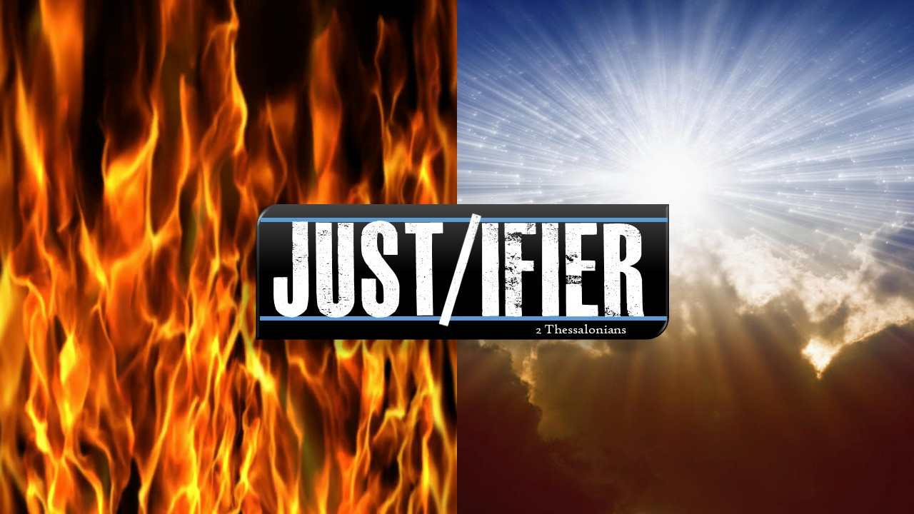

Slide 2
⁵ This is evidence of God’s righteous judgment, to make you worthy of the kingdom of God, for which in fact you are suffering. ⁶ For it is right for God to repay with affliction those who afflict you, ⁷ and to you who are being afflicted to give rest together with us when the Lord Jesus is revealed from heaven with his mighty angels. ⁸ With flaming fire he will mete out punishment on those who do not know God and do not obey the gospel of our Lord Jesus. ⁹ They will undergo the penalty of eternal destruction, away from the presence of the Lord and from the glory of his strength, ¹⁰ when he comes to be glorified among his saints and admired on that day among all who have believed—and you did in fact believe our testimony.
2 Thessalonians 1:5-10 NET

Slide 3
⁵ This is evidence of God’s righteous judgment, to make you worthy of the kingdom of God, for which in fact you are suffering. ⁶ For it is right for God to repay with affliction those who afflict you, ⁷ and to you who are being afflicted to give rest together with us when the Lord Jesus is revealed from heaven with his mighty angels. ⁸ With flaming fire he will mete out punishment on those who do not know God and do not obey the gospel of our Lord Jesus. ⁹ They will undergo the penalty of eternal destruction, away from the presence of the Lord and from the glory of his strength, ¹⁰ when he comes to be glorified among his saints and admired on that day among all who have believed—and you did in fact believe our testimony.
2 Thessalonians 1:5-10 NET

Slide 4
⁵ This is evidence of God’s righteous judgment, to make you worthy of the kingdom of God, for which in fact you are suffering. ⁶ For it is right for God to repay with affliction those who afflict you, ⁷ and to you who are being afflicted to give rest together with us when the Lord Jesus is revealed from heaven with his mighty angels. ⁸ With flaming fire he will mete out punishment on those who do not know God and do not obey the gospel of our Lord Jesus. ⁹ They will undergo the penalty of eternal destruction, away from the presence of the Lord and from the glory of his strength, ¹⁰ when he comes to be glorified among his saints and admired on that day among all who have believed—and you did in fact believe our testimony.
2 Thessalonians 1:5-10 NET

Slide 5
⁵ This is evidence of God’s righteous judgment, to make you worthy of the kingdom of God, for which in fact you are suffering. ⁶ For it is right for God to repay with affliction those who afflict you, ⁷ and to you who are being afflicted to give rest together with us when the Lord Jesus is revealed from heaven with his mighty angels. ⁸ With flaming fire he will mete out punishment on those who do not know God and do not obey the gospel of our Lord Jesus. ⁹ They will undergo the penalty of eternal destruction, away from the presence of the Lord and from the glory of his strength, ¹⁰ when he comes to be glorified among his saints and admired on that day among all who have believed—and you did in fact believe our testimony.
2 Thessalonians 1:5-10 NET

Slide 6
You make known to me the path of life; in your presence there is fullness of joy; at your right hand are pleasures forevermore.
Psalm16:11 ESV

Slide 7
²⁷ And just as people are appointed to die once, and then to face judgment
Hebrews 9:27 NET

Slide 8
²³ for all have sinned and fall short of the glory of God, ²⁴ and are justified by his grace as a gift, through the redemption that is in Christ Jesus, ²⁵ whom God put forward as a propitiation by his blood, to be received by faith. This was to show God's righteousness, because in his divine forbearance he had passed over former sins. ²⁶ It was to show his righteousness at the present time, so that he might be just and the justifier of the one who has faith in Jesus.
Romans 3:23-26 ESV

Slide 9
⁵ This is evidence of God’s righteous judgment, to make you worthy of the kingdom of God, for which in fact you are suffering. ⁶ For it is right for God to repay with affliction those who afflict you, ⁷ and to you who are being afflicted to give rest together with us when the Lord Jesus is revealed from heaven with his mighty angels. ⁸ With flaming fire he will mete out punishment on those who do not know God and do not obey the gospel of our Lord Jesus. ⁹ They will undergo the penalty of eternal destruction, away from the presence of the Lord and from the glory of his strength, ¹⁰ when he comes to be glorified among his saints and admired on that day among all who have believed—and you did in fact believe our testimony.
2 Thessalonians 1:5-10 NET

Slide 10
⁵ This is evidence of God’s righteous judgment, to make you worthy of the kingdom of God, for which in fact you are suffering. ⁶ For it is right for God to repay with affliction those who afflict you, ⁷ and to you who are being afflicted to give rest together with us when the Lord Jesus is revealed from heaven with his mighty angels. ⁸ With flaming fire he will mete out punishment on those who do not know God and do not obey the gospel of our Lord Jesus. ⁹ They will undergo the penalty of eternal destruction, away from the presence of the Lord and from the glory of his strength, ¹⁰ when he comes to be glorified among his saints and admired on that day among all who have believed—and you did in fact believe our testimony.
2 Thessalonians 1:5-10 NET

