Slide 1
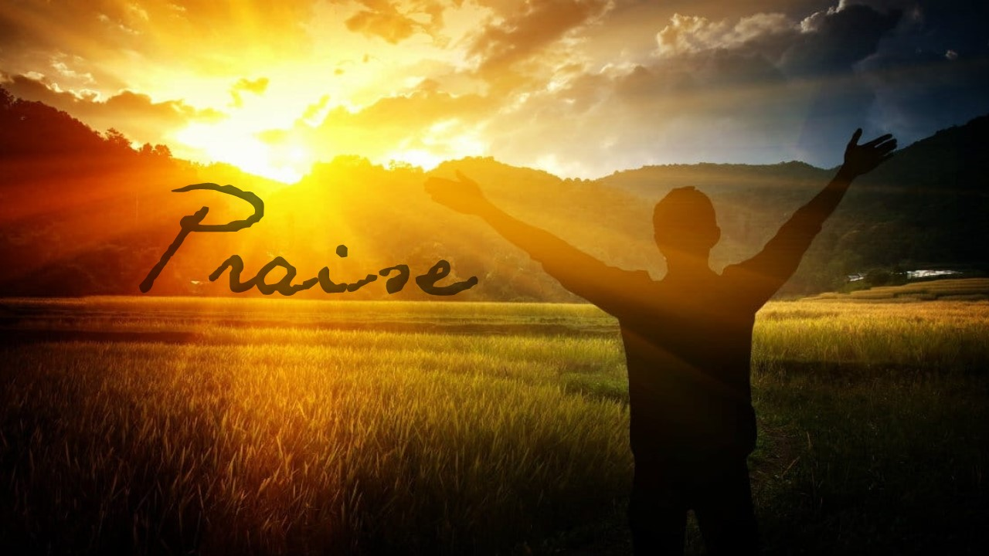

Slide 2
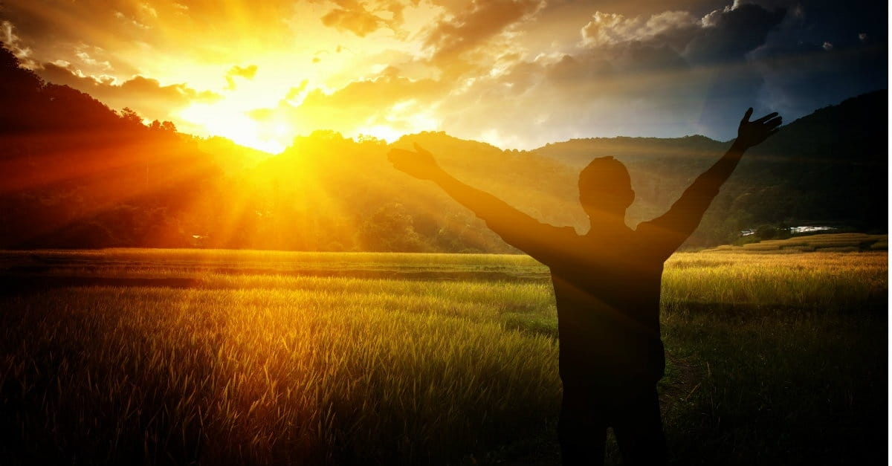
² We thank God always for all of you as we mention you constantly in our prayers, ³ because we recall in the presence of our God and Father your work of faith and labor of love and endurance of hope in our Lord Jesus Christ. ⁴ We know, brothers and sisters loved by God, that he has chosen you
1 Thessalonians 1:2-4 NET

