Slide 1


Slide 2
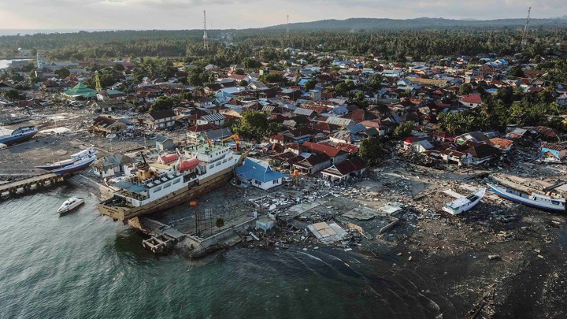
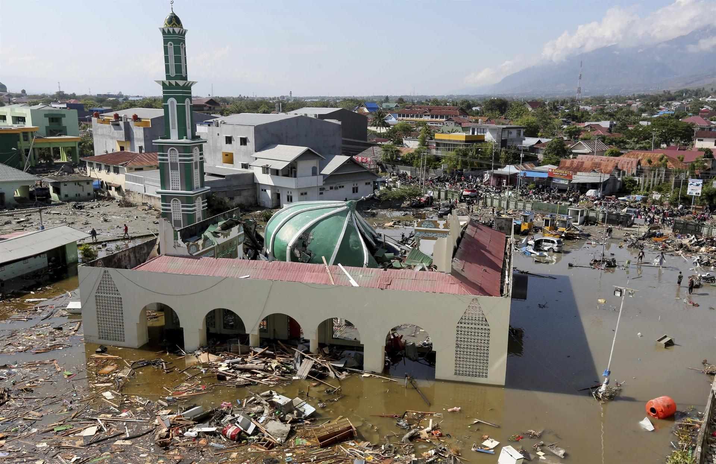
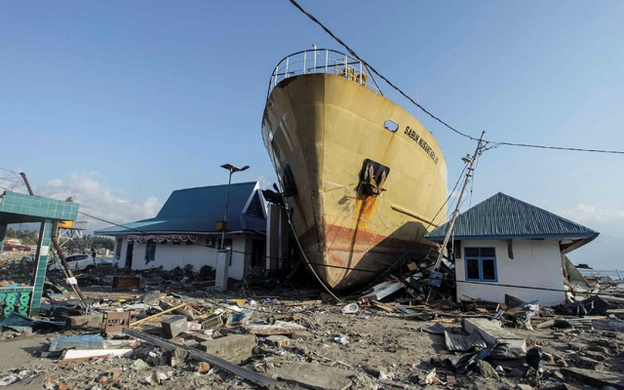

Slide 3
¹ Now on the topic of times and seasons, brothers and sisters, you have no need for anything to be written to you. ² For you know quite well that the day of the Lord will come in the same way as a thief in the night. ³ Now when they are saying, “There is peace and security,” then sudden destruction comes on them, like labor pains on a pregnant woman, and they will surely not escape. ⁴ But you, brothers and sisters, are not in the darkness for the day to overtake you like a thief would. ⁵ For you all are sons of the light and sons of the day. We are not of the night nor of the darkness. ⁶ So then we must not sleep as the rest, but must stay alert and sober. ⁷ For those who sleep, sleep at night and those who get drunk are drunk at night. ⁸ But since we are of the day, we must stay sober by putting on the breastplate of faith and love and as a helmet our hope for salvation. ⁹ For God did not destine us for wrath but for gaining salvation through our Lord Jesus Christ. ¹⁰ He died for us so that whether we are alert or asleep we will come to life together with him. ¹¹ Therefore encourage one another and build up each other, just as you are in fact doing.
1 Thessalonians 5:1-11 NET

Slide 4
¹⁶ All Scripture is breathed out by God and profitable for teaching, for reproof, for correction, and for training in righteousness, ¹⁷ that the man of God may be complete, equipped for every good work.
2 Timothy 3:16-17 ESV

Slide 5
¹ Now on the topic of times and seasons, brothers and sisters, you have no need for anything to be written to you. ² For you know quite well that the day of the Lord will come in the same way as a thief in the night. ³ Now when they are saying, “There is peace and security,” then sudden destruction comes on them, like labor pains on a pregnant woman, and they will surely not escape. ⁴ But you, brothers and sisters, are not in the darkness for the day to overtake you like a thief would. ⁵ For you all are sons of the light and sons of the day. We are not of the night nor of the darkness. ⁶ So then we must not sleep as the rest, but must stay alert and sober. ⁷ For those who sleep, sleep at night and those who get drunk are drunk at night. ⁸ But since we are of the day, we must stay sober by putting on the breastplate of faith and love and as a helmet our hope for salvation. ⁹ For God did not destine us for wrath but for gaining salvation through our Lord Jesus Christ. ¹⁰ He died for us so that whether we are alert or asleep we will come to life together with him. ¹¹ Therefore encourage one another and build up each other, just as you are in fact doing.
1 Thessalonians 5:1-11 NET

Slide 6
No Excuses
Romans 1:18-21 NET - ¹⁸ For the wrath of God is revealed from heaven against all ungodliness and unrighteousness of people who suppress the truth by their unrighteousness, ¹⁹ because what can be known about God is plain to them, because God has made it plain to them. ²⁰ For since the creation of the world his invisible attributes—his eternal power and divine nature—have been clearly seen, because they are understood through what has been made. So people are without excuse. ²¹ For although they knew God, they did not glorify him as God or give him thanks, but they became futile in their thoughts and their senseless hearts were darkened.
Romans 1:32 NET - ³² Although they fully know God’s righteous decree that those who practice such things deserve to die, they not only do them but also approve of those who practice them.

Slide 7
¹ Now on the topic of times and seasons, brothers and sisters, you have no need for anything to be written to you. ² For you know quite well that the day of the Lord will come in the same way as a thief in the night. ³ Now when they are saying, “There is peace and security,” then sudden destruction comes on them, like labor pains on a pregnant woman, and they will surely not escape. ⁴ But you, brothers and sisters, are not in the darkness for the day to overtake you like a thief would. ⁵ For you all are sons of the light and sons of the day. We are not of the night nor of the darkness. ⁶ So then we must not sleep as the rest, but must stay alert and sober. ⁷ For those who sleep, sleep at night and those who get drunk are drunk at night. ⁸ But since we are of the day, we must stay sober by putting on the breastplate of faith and love and as a helmet our hope for salvation. ⁹ For God did not destine us for wrath but for gaining salvation through our Lord Jesus Christ. ¹⁰ He died for us so that whether we are alert or asleep we will come to life together with him. ¹¹ Therefore encourage one another and build up each other, just as you are in fact doing.
1 Thessalonians 5:1-11 NET

Slide 8
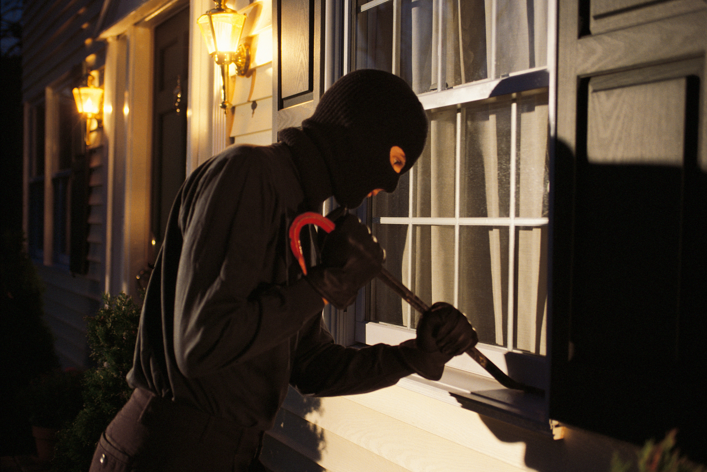
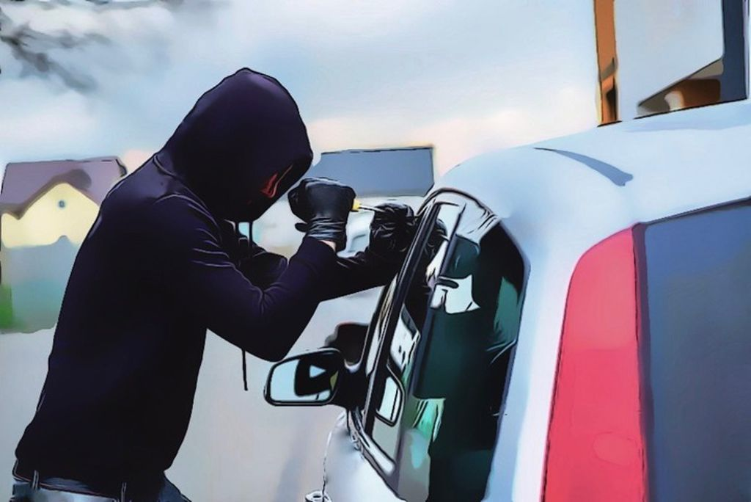

Slide 9
¹ Now on the topic of times and seasons, brothers and sisters, you have no need for anything to be written to you. ² For you know quite well that the day of the Lord will come in the same way as a thief in the night. ³ Now when they are saying, “There is peace and security,” then sudden destruction comes on them, like labor pains on a pregnant woman, and they will surely not escape. ⁴ But you, brothers and sisters, are not in the darkness for the day to overtake you like a thief would. ⁵ For you all are sons of the light and sons of the day. We are not of the night nor of the darkness. ⁶ So then we must not sleep as the rest, but must stay alert and sober. ⁷ For those who sleep, sleep at night and those who get drunk are drunk at night. ⁸ But since we are of the day, we must stay sober by putting on the breastplate of faith and love and as a helmet our hope for salvation. ⁹ For God did not destine us for wrath but for gaining salvation through our Lord Jesus Christ. ¹⁰ He died for us so that whether we are alert or asleep we will come to life together with him. ¹¹ Therefore encourage one another and build up each other, just as you are in fact doing.
1 Thessalonians 5:1-11 NET

Slide 10
¹ Now on the topic of times and seasons, brothers and sisters, you have no need for anything to be written to you. ² For you know quite well that the day of the Lord will come in the same way as a thief in the night. ³ Now when they are saying, “There is peace and security,” then sudden destruction comes on them, like labor pains on a pregnant woman, and they will surely not escape. ⁴ But you, brothers and sisters, are not in the darkness for the day to overtake you like a thief would. ⁵ For you all are sons of the light and sons of the day. We are not of the night nor of the darkness. ⁶ So then we must not sleep as the rest, but must stay alert and sober. ⁷ For those who sleep, sleep at night and those who get drunk are drunk at night. ⁸ But since we are of the day, we must stay sober by putting on the breastplate of faith and love and as a helmet our hope for salvation. ⁹ For God did not destine us for wrath but for gaining salvation through our Lord Jesus Christ. ¹⁰ He died for us so that whether we are alert or asleep we will come to life together with him. ¹¹ Therefore encourage one another and build up each other, just as you are in fact doing.
1 Thessalonians 5:1-11 NET

Slide 11
¹ Now on the topic of times and seasons, brothers and sisters, you have no need for anything to be written to you. ² For you know quite well that the day of the Lord will come in the same way as a thief in the night. ³ Now when they are saying, “There is peace and security,” then sudden destruction comes on them, like labor pains on a pregnant woman, and they will surely not escape. ⁴ But you, brothers and sisters, are not in the darkness for the day to overtake you like a thief would. ⁵ For you all are sons of the light and sons of the day. We are not of the night nor of the darkness. ⁶ So then we must not sleep as the rest, but must stay alert and sober. ⁷ For those who sleep, sleep at night and those who get drunk are drunk at night. ⁸ But since we are of the day, we must stay sober by putting on the breastplate of faith and love and as a helmet our hope for salvation. ⁹ For God did not destine us for wrath but for gaining salvation through our Lord Jesus Christ. ¹⁰ He died for us so that whether we are alert or asleep we will come to life together with him. ¹¹ Therefore encourage one another and build up each other, just as you are in fact doing.
1 Thessalonians 5:1-11 NET

Slide 12
²⁴ But they are justified freely by his grace through the redemption that is in Christ Jesus. ²⁵ God publicly displayed him at his death as the mercy seat accessible through faith. This was to demonstrate his righteousness, because God in his forbearance had passed over the sins previously committed. ²⁶ This was also to demonstrate his righteousness in the present time, so that he would be just and the justifier of the one who lives because of Jesus’ faithfulness.
Romans 3:24-26 NET

Slide 13
⁴ We know, brothers and sisters loved by God, that he has chosen you
1 Thessalonians 1:4 NET

Slide 14
¹ Now on the topic of times and seasons, brothers and sisters, you have no need for anything to be written to you. ² For you know quite well that the day of the Lord will come in the same way as a thief in the night. ³ Now when they are saying, “There is peace and security,” then sudden destruction comes on them, like labor pains on a pregnant woman, and they will surely not escape. ⁴ But you, brothers and sisters, are not in the darkness for the day to overtake you like a thief would. ⁵ For you all are sons of the light and sons of the day. We are not of the night nor of the darkness. ⁶ So then we must not sleep as the rest, but must stay alert and sober. ⁷ For those who sleep, sleep at night and those who get drunk are drunk at night. ⁸ But since we are of the day, we must stay sober by putting on the breastplate of faith and love and as a helmet our hope for salvation. ⁹ For God did not destine us for wrath but for gaining salvation through our Lord Jesus Christ. ¹⁰ He died for us so that whether we are alert or asleep we will come to life together with him. ¹¹ Therefore encourage one another and build up each other, just as you are in fact doing.
1 Thessalonians 5:1-11 NET

Slide 15
¹ Now on the topic of times and seasons, brothers and sisters, you have no need for anything to be written to you. ² For you know quite well that the day of the Lord will come in the same way as a thief in the night. ³ Now when they are saying, “There is peace and security,” then sudden destruction comes on them, like labor pains on a pregnant woman, and they will surely not escape. ⁴ But you, brothers and sisters, are not in the darkness for the day to overtake you like a thief would. ⁵ For you all are sons of the light and sons of the day. We are not of the night nor of the darkness. ⁶ So then we must not sleep as the rest, but must stay alert and sober. ⁷ For those who sleep, sleep at night and those who get drunk are drunk at night. ⁸ But since we are of the day, we must stay sober by putting on the breastplate of faith and love and as a helmet our hope for salvation. ⁹ For God did not destine us for wrath but for gaining salvation through our Lord Jesus Christ. ¹⁰ He died for us so that whether we are alert or asleep we will come to life together with him. ¹¹ Therefore encourage one another and build up each other, just as you are in fact doing.
1 Thessalonians 5:1-11 NET

