Slide 1


Slide 2
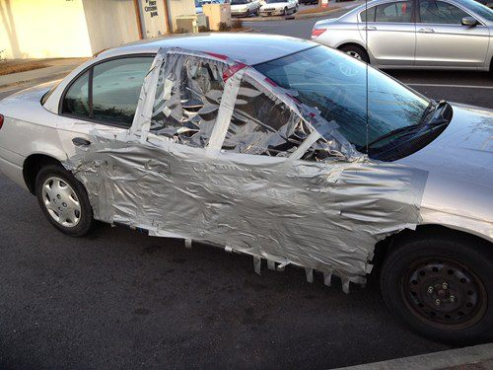
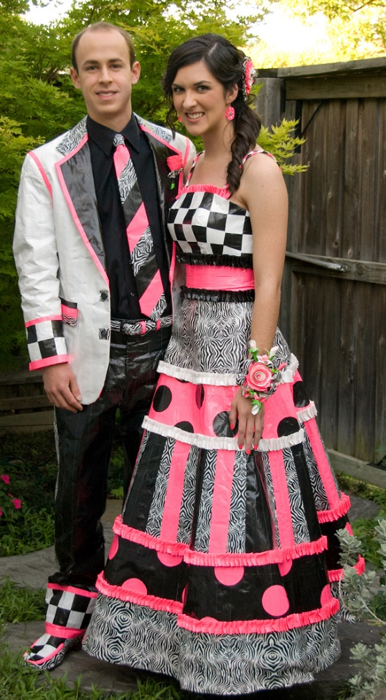
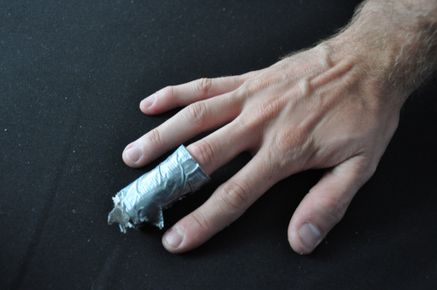
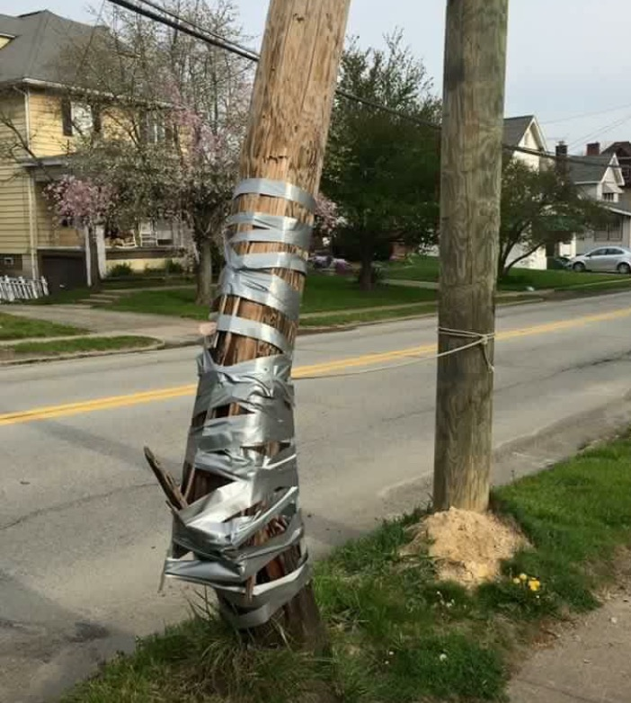
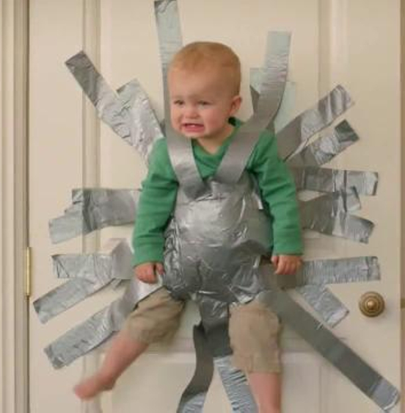

Slide 3
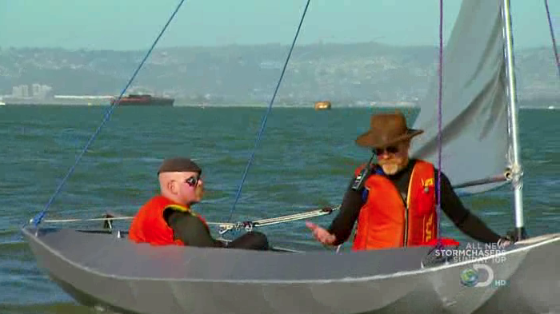

Slide 4
¹³ Now when Jesus came into the district of Caesarea Philippi, he asked his disciples, “Who do people say that the Son of Man is?” ¹⁴ And they said, “Some say John the Baptist, others say Elijah, and others Jeremiah or one of the prophets.”
Matthew 16:13-14 ESV

Slide 5
After this Jesus went about in Galilee. He would not go about in Judea, because the Jews were seeking to kill him. ² Now the Jews' Feast of Booths was at hand. ³ So his brothers said to him, “Leave here and go to Judea, that your disciples also may see the works you are doing. ⁴ For no one works in secret if he seeks to be known openly. If you do these things, show yourself to the world.” ⁵ For not even his brothers believed in him. ⁶ Jesus said to them, “My time has not yet come…
John 7:1-6a ESV

Slide 6
¹² The next day the large crowd that had come to the feast heard that Jesus was coming to Jerusalem. ¹³ So they took branches of palm trees and went out to meet him, crying out, “Hosanna! Blessed is he who comes in the name of the Lord, even the King of Israel!” ¹⁴ And Jesus found a young donkey and sat on it, just as it is written, ¹⁵ “Fear not, daughter of Zion; behold, your king is coming, sitting on a donkey's colt!” ¹⁶ His disciples did not understand these things at first, but when Jesus was glorified, then they remembered that these things had been written about him and had been done to him.
John 12:12-16 ESV

Slide 7
¹² The next day the large crowd that had come to the feast heard that Jesus was coming to Jerusalem. ¹³ So they took branches of palm trees and went out to meet him, crying out, “Hosanna! Blessed is he who comes in the name of the Lord, even the King of Israel!” ¹⁴ And Jesus found a young donkey and sat on it, just as it is written, ¹⁵ “Fear not, daughter of Zion; behold, your king is coming, sitting on a donkey's colt!” ¹⁶ His disciples did not understand these things at first, but when Jesus was glorified, then they remembered that these things had been written about him and had been done to him.
John 12:12-16 ESV

Slide 8
⁴⁰ And you shall take on the first day the fruit of splendid trees, branches of palm trees and boughs of leafy trees and willows of the brook, and you shall rejoice before the Lord your God seven days.
Leviticus 23:40 ESV

Slide 9
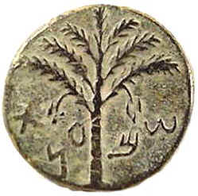

Slide 10
¹² The next day the large crowd that had come to the feast heard that Jesus was coming to Jerusalem. ¹³ So they took branches of palm trees and went out to meet him, crying out, “Hosanna! Blessed is he who comes in the name of the Lord, even the King of Israel!” ¹⁴ And Jesus found a young donkey and sat on it, just as it is written, ¹⁵ “Fear not, daughter of Zion; behold, your king is coming, sitting on a donkey's colt!” ¹⁶ His disciples did not understand these things at first, but when Jesus was glorified, then they remembered that these things had been written about him and had been done to him.
John 12:12-16 ESV

Slide 11
¹⁹ Open to me the gates of righteousness, that I may enter through them and give thanks to the Lord. ²⁰ This is the gate of the Lord; the righteous shall enter through it. ²¹ I thank you that you have answered me and have become my salvation. ²² The stone that the builders rejected has become the cornerstone. ²³ This is the Lord's doing; it is marvelous in our eyes. ²⁴ This is the day that the Lord has made; let us rejoice and be glad in it. ²⁵ Save us, we pray, O Lord! O Lord, we pray, give us success! ²⁶ Blessed is he who comes in the name of the Lord! We bless you from the house of the Lord. ²⁷ The Lord is God, and he has made his light to shine upon us.
Psalm 118:19-27a ESV

Slide 12
⁹ And those who went before and those who followed were shouting, “Hosanna! Blessed is he who comes in the name of the Lord! ¹⁰ Blessed is the coming kingdom of our father David! Hosanna in the highest!”
Mark 11:9-10 ESV

Slide 13
¹² When your days are fulfilled and you lie down with your fathers, I will raise up your offspring after you, who shall come from your body, and I will establish his kingdom. ¹³ He shall build a house for my name, and I will establish the throne of his kingdom forever. ¹⁴ I will be to him a father, and he shall be to me a son. When he commits iniquity, I will discipline him with the rod of men, with the stripes of the sons of men, ¹⁵ but my steadfast love will not depart from him, as I took it from Saul, whom I put away from before you. ¹⁶ And your house and your kingdom shall be made sure forever before me. Your throne shall be established forever.’” ¹⁷ In accordance with all these words, and in accordance with all this vision, Nathan spoke to David.
2 Samuel 7:12-17 ESV

Slide 14
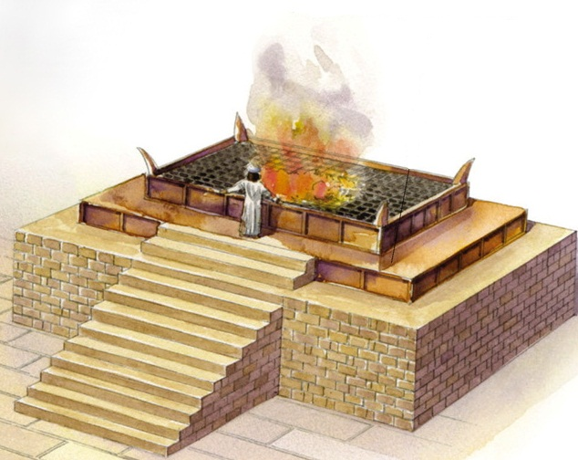
²⁵ Save us, we pray, O Lord! O Lord, we pray, give us success! ²⁶ Blessed is he who comes in the name of the Lord! We bless you from the house of the Lord. ²⁷ The Lord is God, and he has made his light to shine upon us. Bind the festal sacrifice with cords, up to the horns of the altar!
Psalm 118:25-27 ESV
¹⁰ Aaron shall make atonement on its horns once a year. With the blood of the sin offering of atonement he shall make atonement for it once in the year throughout your generations. It is most holy to the Lord.”
Exodus 30:12

Slide 15
⁴¹ And when he drew near and saw the city, he wept over it, ⁴² saying, “Would that you, even you, had known on this day the things that make for peace! But now they are hidden from your eyes.
Luke 19:41-42 ESV

