Slide 1
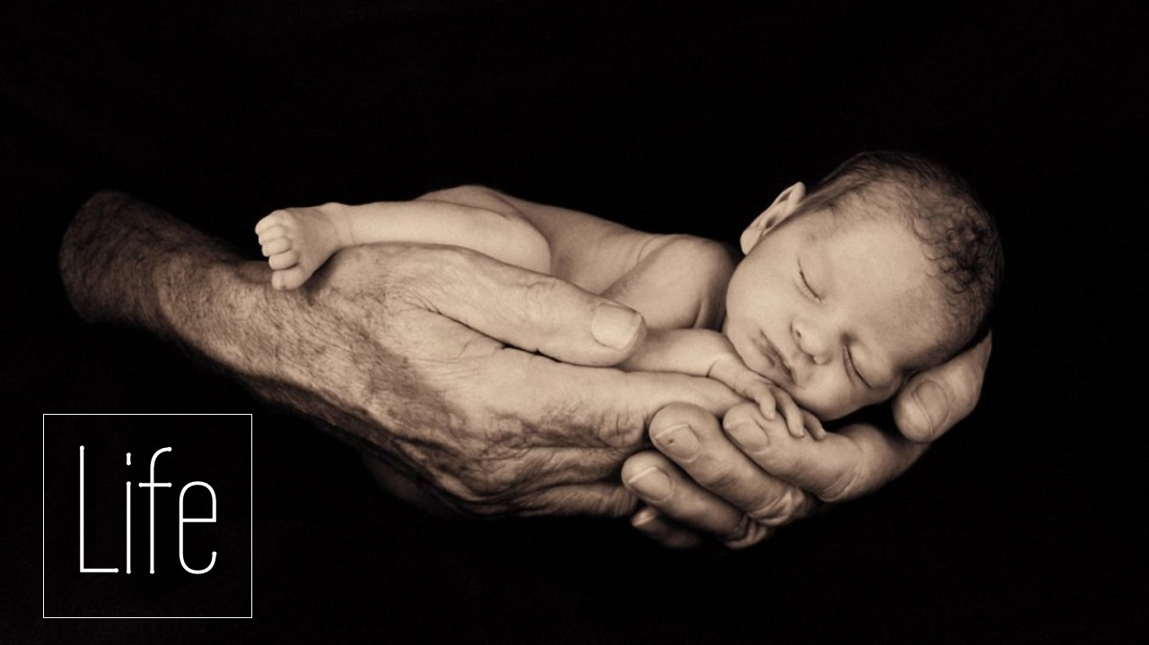

Slide 2
¹³ For you formed my inward parts; you knitted me together in my mother's womb. ¹⁴ I praise you, for I am fearfully and wonderfully made. Wonderful are your works; my soul knows it very well. ¹⁵ My frame was not hidden from you, when I was being made in secret, intricately woven in the depths of the earth. ¹⁶ Your eyes saw my unformed substance; in your book were written, every one of them, the days that were formed for me, when as yet there was none of them.
Psalm 139:13-16 ESV

Slide 3
Know that the Lord, he is God! It is he who made us, and we are his; we are his people, and the sheep of his pasture.
Psalm 100:3 ESV

Slide 4
²⁴ The God who made the world and everything in it, being Lord of heaven and earth, does not live in temples made by man, ²⁵ nor is he served by human hands, as though he needed anything, since he himself gives to all mankind life and breath and everything.
Acts 17:24-25 ESV

Slide 5
So God created man in his own image, in the image of God he created him; male and female he created them.
Genesis 1:27 ESV

Slide 6
I will say to the north, Give up, and to the south, Do not withhold; bring my sons from afar and my daughters from the end of the earth, ⁷ everyone who is called by my name, whom I created for my glory, whom I formed and made.”
Isaiah 43:6-7 ESV

Slide 7
They exchanged the truth of God for a lie and worshiped and served the creation rather than the Creator, who is blessed forever! Amen.
Romans 1:25 NET

Slide 8
¹¹ And such were some of you. But you were washed, you were sanctified, you were justified in the name of the Lord Jesus Christ and by the Spirit of our God.
1 Corinthians 6:11 ESV

Slide 9
There is therefore now no condemnation for those who are in Christ Jesus.
Romans 8:1 ESV

