Slide 1
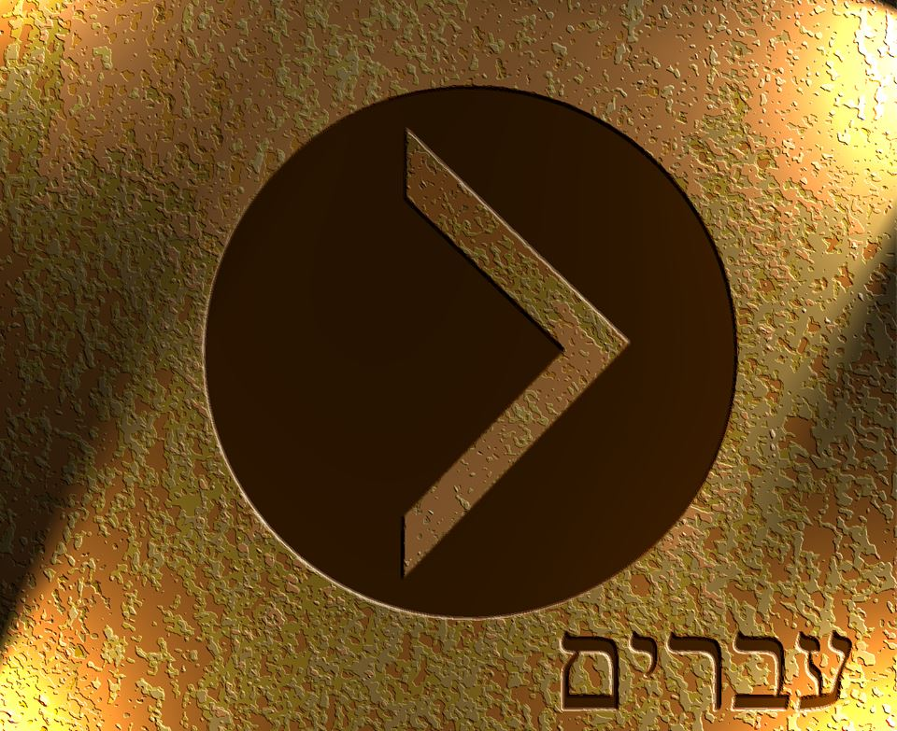

Slide 2
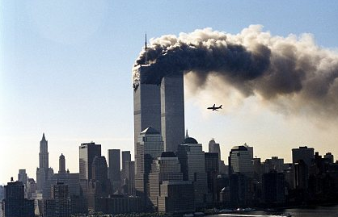
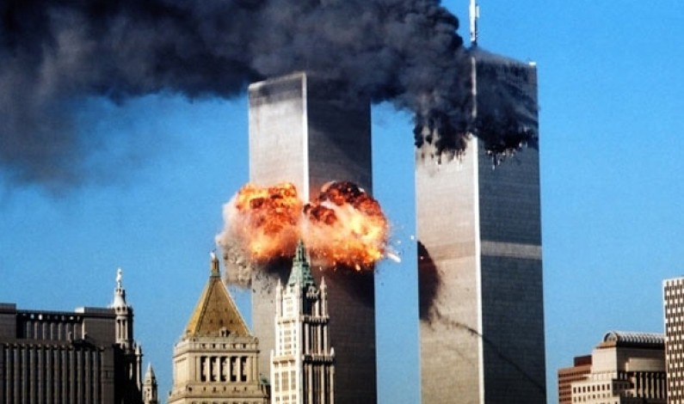
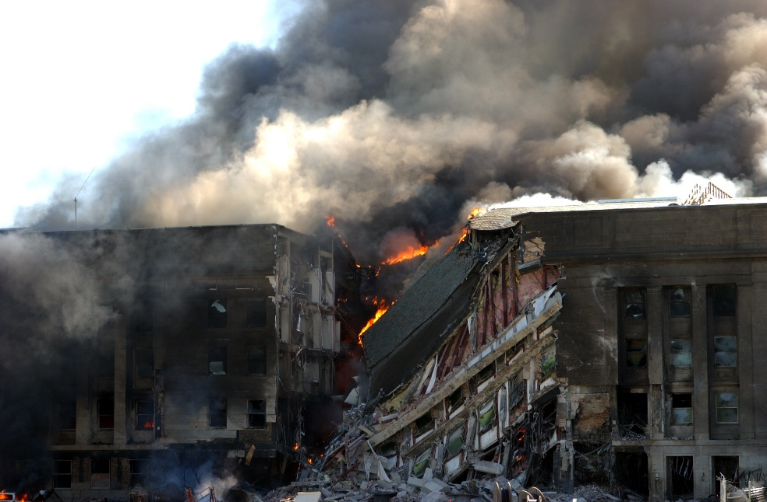

Slide 3
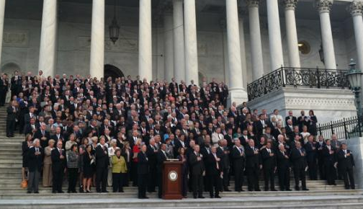
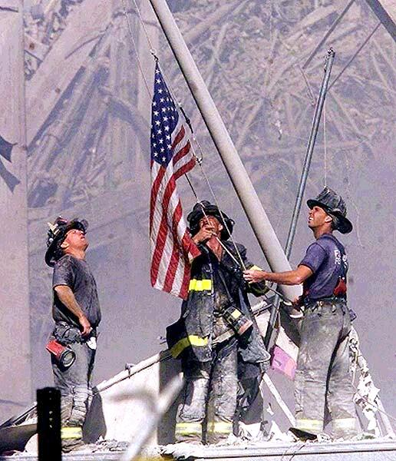

Slide 4


Slide 5
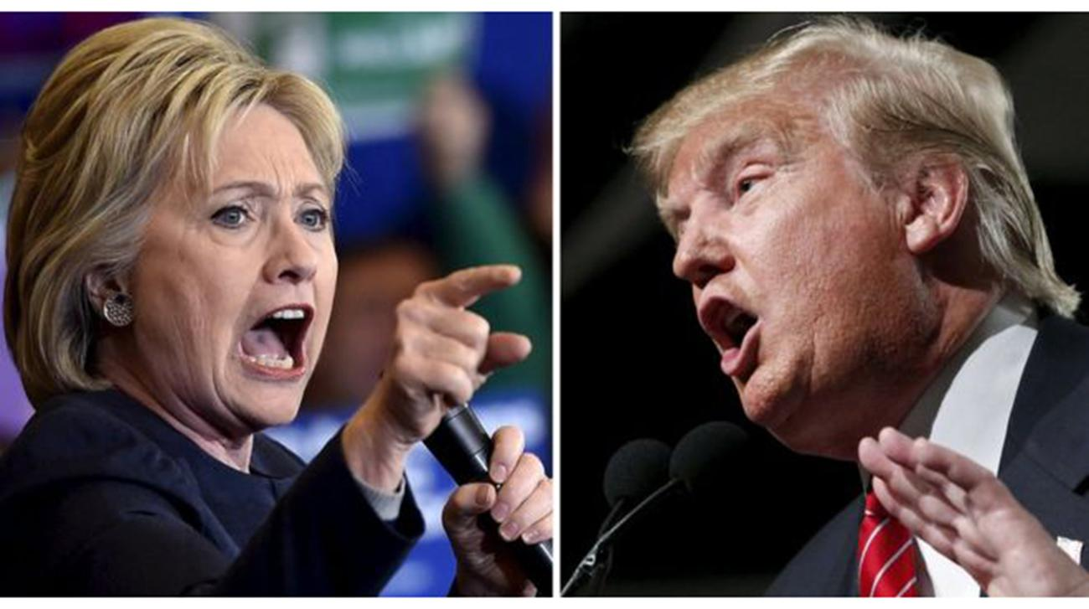
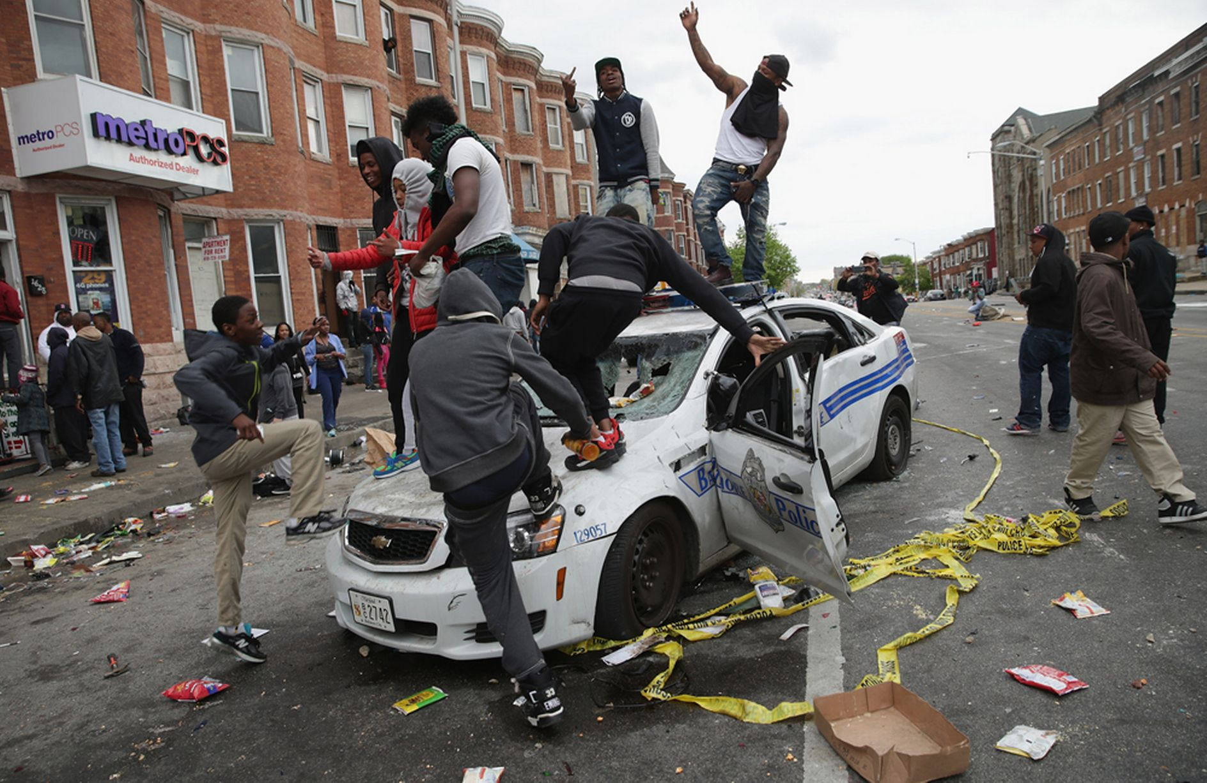
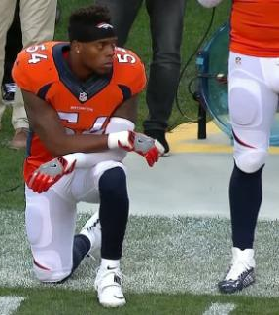
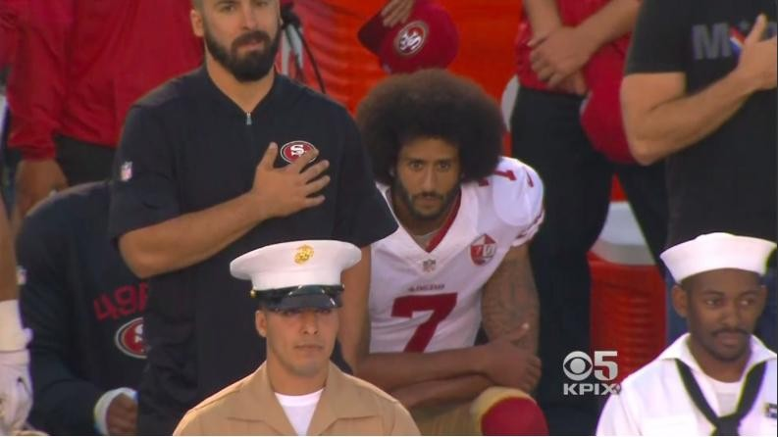

Slide 6
⁷ Therefore, as the Holy Spirit says, “Today, if you hear his voice, ⁸ do not harden your hearts as in the rebellion, on the day of testing in the wilderness, ⁹ where your fathers put me to the test and saw my works for forty years. ¹⁰ Therefore I was provoked with that generation, and said, ‘They always go astray in their heart; they have not known my ways.’ ¹¹ As I swore in my wrath, ‘They shall not enter my rest.’” ¹² Take care, brothers, lest there be in any of you an evil, unbelieving heart, leading you to fall away from the living God. ¹³ But exhort one another every day, as long as it is called “today,” that none of you may be hardened by the deceitfulness of sin. ¹⁴ For we have come to share in Christ, if indeed we hold our original confidence firm to the end. ¹⁵ As it is said, “Today, if you hear his voice, do not harden your hearts as in the rebellion.” ¹⁶ For who were those who heard and yet rebelled? Was it not all those who left Egypt led by Moses? ¹⁷ And with whom was he provoked for forty years? Was it not with those who sinned, whose bodies fell in the wilderness? ¹⁸ And to whom did he swear that they would not enter his rest, but to those who were disobedient? ¹⁹ So we see that they were unable to enter because of unbelief.
Hebrews 3:7-19 ESV

Slide 7
Oh come, let us sing to the Lord; let us make a joyful noise to the rock of our salvation! ² Let us come into his presence with thanksgiving; let us make a joyful noise to him with songs of praise! ³ For the Lord is a great God, and a great King above all gods. ⁴ In his hand are the depths of the earth; the heights of the mountains are his also. ⁵ The sea is his, for he made it, and his hands formed the dry land. ⁶ Oh come, let us worship and bow down; let us kneel before the Lord, our Maker! ⁷ For he is our God, and we are the people of his pasture, and the sheep of his hand. Today, if you hear his voice, ⁸ do not harden your hearts, as at Meribah, as on the day at Massah in the wilderness, ⁹ when your fathers put me to the test and put me to the proof, though they had seen my work. ¹⁰ For forty years I loathed that generation and said, “They are a people who go astray in their heart, and they have not known my ways.” ¹¹ Therefore I swore in my wrath, “They shall not enter my rest.”
Psalm 95 ESV

Slide 8
⁵ And the LORD said to Moses, “Pass on before the people, taking with you some of the elders of Israel, and take in your hand the staff with which you struck the Nile, and go. ⁶ Behold, I will stand before you there on the rock at Horeb, and you shall strike the rock, and water shall come out of it, and the people will drink.” And Moses did so, in the sight of the elders of Israel. ⁷ And he called the name of the place Massah and Meribah, because of the quarreling of the people of Israel, and because they tested the LORD by saying, “Is the LORD among us or not?”
Exodus 17:5-7 ESV

Slide 9
And the people of Israel, the whole congregation, came into the wilderness of Zin in the first month, and the people stayed in Kadesh. And Miriam died there and was buried there. ² Now there was no water for the congregation. And they assembled themselves together against Moses and against Aaron. ³ And the people quarreled with Moses and said, “Would that we had perished when our brothers perished before the Lord! ⁴ Why have you brought the assembly of the Lord into this wilderness, that we should die here, both we and our cattle? ⁵ And why have you made us come up out of Egypt to bring us to this evil place? It is no place for grain or figs or vines or pomegranates, and there is no water to drink.” ⁶ Then Moses and Aaron went from the presence of the assembly to the entrance of the tent of meeting and fell on their faces. And the glory of the Lord appeared to them, ⁷ and the Lord spoke to Moses, saying, ⁸ “Take the staff, and assemble the congregation, you and Aaron your brother, and tell the rock before their eyes to yield its water. So you shall bring water out of the rock for them and give drink to the congregation and their cattle.”⁹ And Moses took the staff from before the Lord, as he commanded him. ¹⁰ Then Moses and Aaron gathered the assembly together before the rock, and he said to them, “Hear now, you rebels: shall we bring water for you out of this rock?” ¹¹ And Moses lifted up his hand and struck the rock with his staff twice, and water came out abundantly, and the congregation drank, and their livestock. ¹² And the Lord said to Moses and Aaron, “Because you did not believe in me, to uphold me as holy in the eyes of the people of Israel, therefore you shall not bring this assembly into the land that I have given them.” ¹³ These are the waters of Meribah, where the people of Israel quarreled with the Lord, and through them he showed himself holy.

Slide 10
Trust in the Lord with all your heart, and do not lean on your own understanding. ⁶ In all your ways acknowledge him, and he will make straight your paths.
Proverbs 3:5-6 ESV

Slide 11
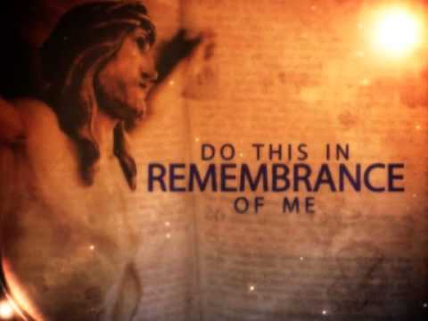

Slide 12
Oh come, let us sing to the LORD; let us make a joyful noise to the rock of our salvation! ² Let us come into his presence with thanksgiving; let us make a joyful noise to him with songs of praise!
³ For the LORD is a great God, and a great King above all gods. ⁴ In his hand are the depths of the earth; the heights of the mountains are his also.
⁵ The sea is his, for he made it, and his hands formed the dry land.
⁶ Oh come, let us worship and bow down; let us kneel before the LORD, our Maker!
⁷ For he is our God, and we are the people of his pasture, and the sheep of his hand.

