Slide 1
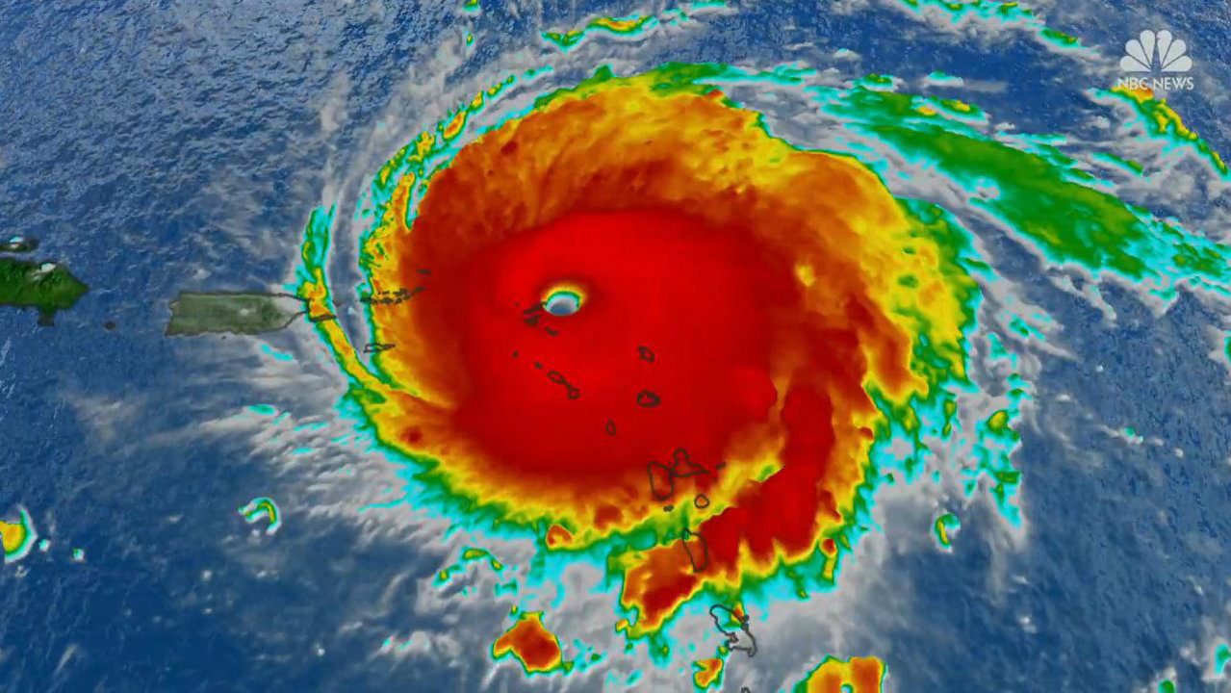
Shaken, and Stirred

Slide 2
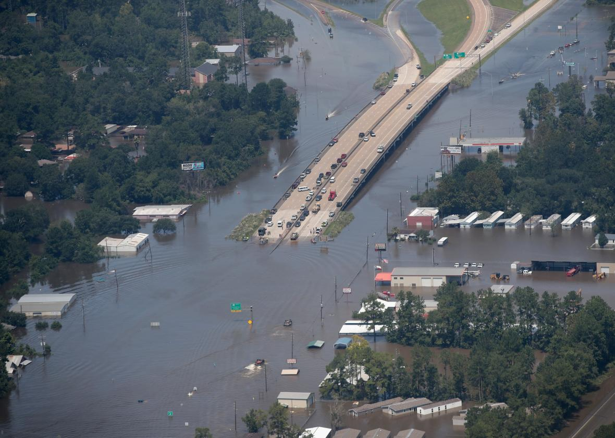
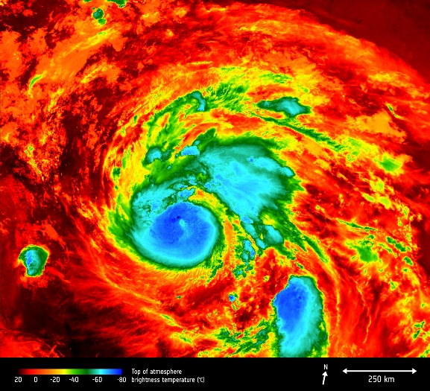
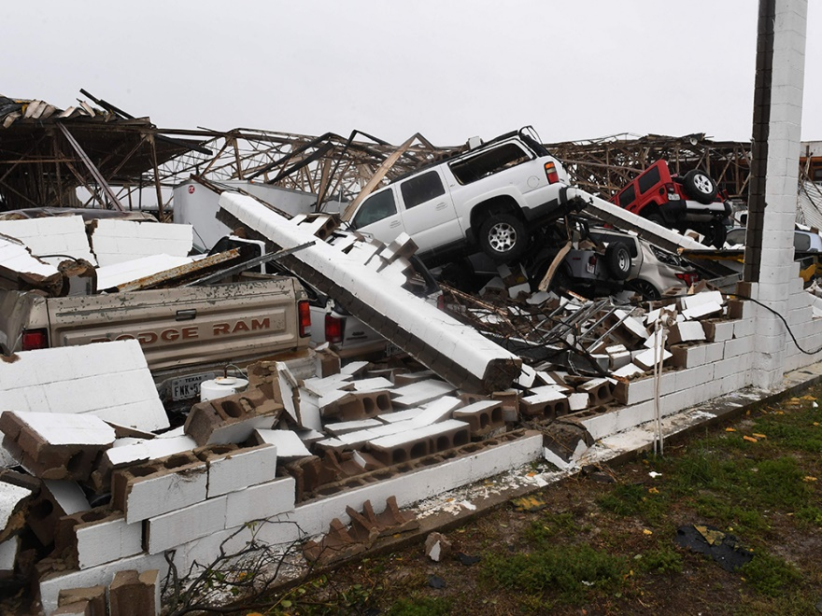
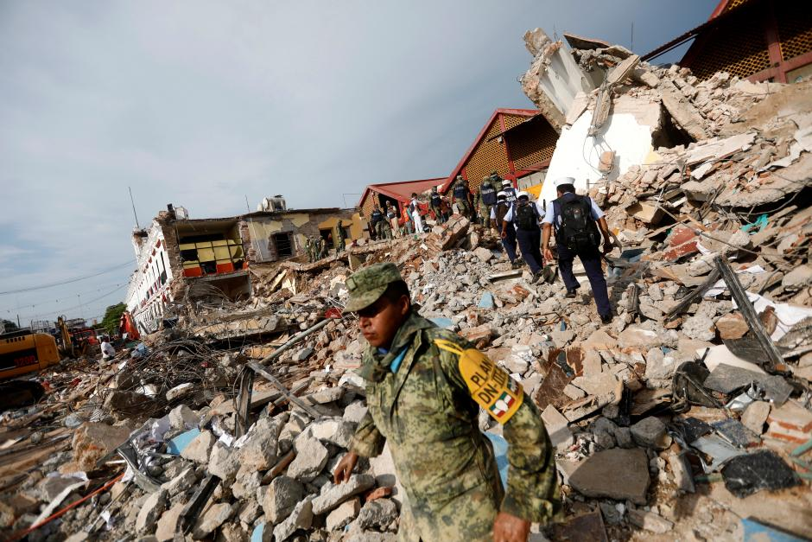
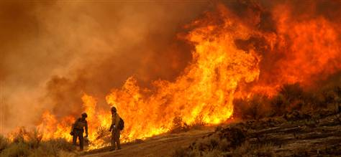
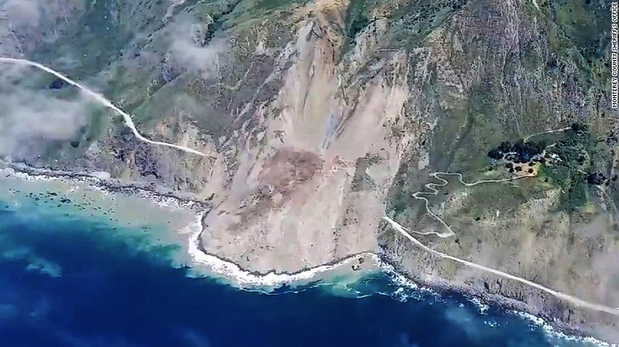
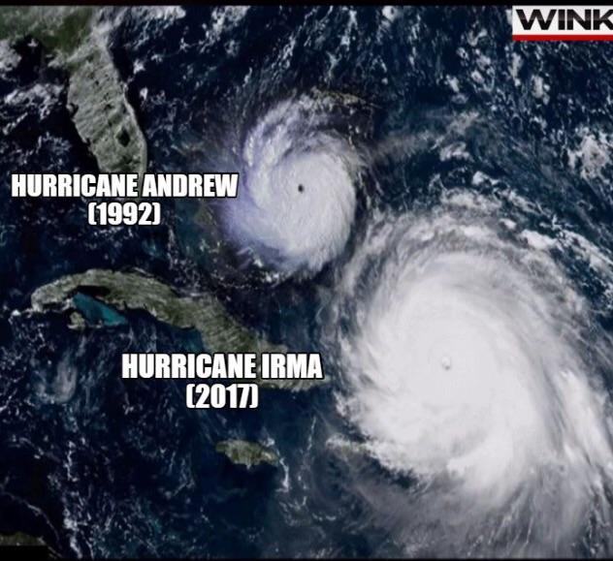
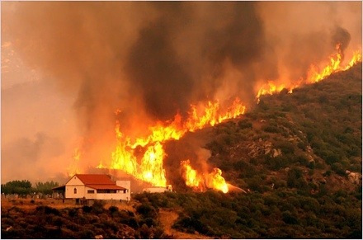

Slide 3
  ¹⁸ For you have not come to what may be touched, a blazing fire and darkness and gloom and a tempest ¹⁹ and the sound of a trumpet and a voice whose words made the hearers beg that no further messages be spoken to them. ²⁰ For they could not endure the order that was given, “If even a beast touches the mountain, it shall be stoned.” ²¹ Indeed, so terrifying was the sight that Moses said, “I tremble with fear.” ²² But you have come to Mount Zion and to the city of the living God, the heavenly Jerusalem, and to innumerable angels in festal gathering, ²³ and to the assembly of the firstborn who are enrolled in heaven, and to God, the judge of all, and to the spirits of the righteous made perfect, ²⁴ and to Jesus, the mediator of a new covenant, and to the sprinkled blood that speaks a better word than the blood of Abel. ²⁵ See that you do not refuse him who is speaking. For if they did not escape when they refused him who warned them on earth, much less will we escape if we reject him who warns from heaven. ²⁶ At that time his voice shook the earth, but now he has promised, “Yet once more I will shake not only the earth but also the heavens.” ²⁷ This phrase, “Yet once more,” indicates the removal of things that are shaken—that is, things that have been made—in order that the things that cannot be shaken may remain. ²⁸ Therefore let us be grateful for receiving a kingdom that cannot be shaken, and thus let us offer to God acceptable worship, with reverence and awe, ²⁹ for our God is a consuming fire.
Hebrews 12:18-29 ESV

Slide 4
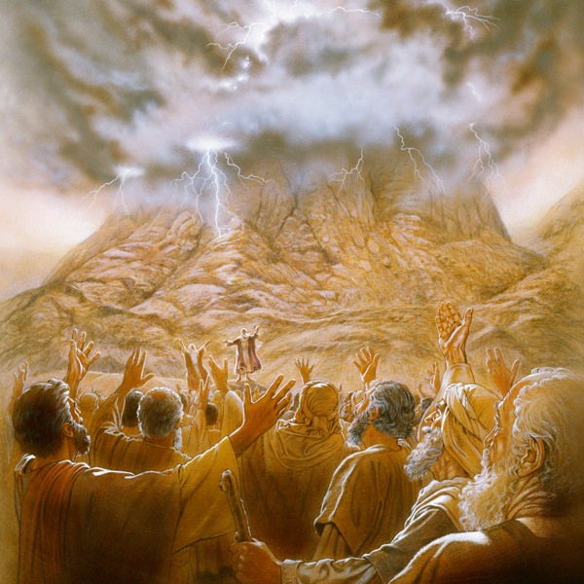
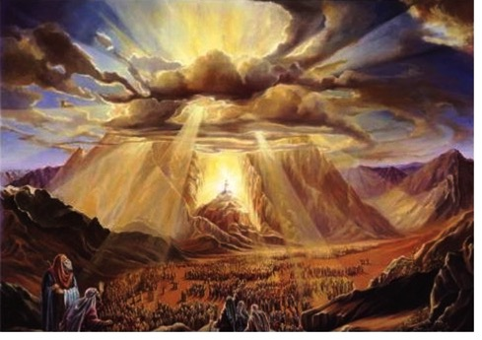
  Do not let God speak to us or we shall die
  Exodus 20:19 ESV

Slide 5
  ¹⁸ For you have not come to what may be touched, a blazing fire and darkness and gloom and a tempest ¹⁹ and the sound of a trumpet and a voice whose words made the hearers beg that no further messages be spoken to them. ²⁰ For they could not endure the order that was given, “If even a beast touches the mountain, it shall be stoned.” ²¹ Indeed, so terrifying was the sight that Moses said, “I tremble with fear.” ²² But you have come to Mount Zion and to the city of the living God, the heavenly Jerusalem, and to innumerable angels in festal gathering, ²³ and to the assembly of the firstborn who are enrolled in heaven, and to God, the judge of all, and to the spirits of the righteous made perfect, ²⁴ and to Jesus, the mediator of a new covenant, and to the sprinkled blood that speaks a better word than the blood of Abel. ²⁵ See that you do not refuse him who is speaking. For if they did not escape when they refused him who warned them on earth, much less will we escape if we reject him who warns from heaven. ²⁶ At that time his voice shook the earth, but now he has promised, “Yet once more I will shake not only the earth but also the heavens.” ²⁷ This phrase, “Yet once more,” indicates the removal of things that are shaken—that is, things that have been made—in order that the things that cannot be shaken may remain. ²⁸ Therefore let us be grateful for receiving a kingdom that cannot be shaken, and thus let us offer to God acceptable worship, with reverence and awe, ²⁹ for our God is a consuming fire.
Hebrews 12:18-29 ESV

Slide 6
  ¹⁸ For you have not come to what may be touched, a blazing fire and darkness and gloom and a tempest ¹⁹ and the sound of a trumpet and a voice whose words made the hearers beg that no further messages be spoken to them. ²⁰ For they could not endure the order that was given, “If even a beast touches the mountain, it shall be stoned.” ²¹ Indeed, so terrifying was the sight that Moses said, “I tremble with fear.” ²² But you have come to Mount Zion and to the city of the living God, the heavenly Jerusalem, and to innumerable angels in festal gathering, ²³ and to the assembly of the firstborn who are enrolled in heaven, and to God, the judge of all, and to the spirits of the righteous made perfect, ²⁴ and to Jesus, the mediator of a new covenant, and to the sprinkled blood that speaks a better word than the blood of Abel. ²⁵ See that you do not refuse him who is speaking. For if they did not escape when they refused him who warned them on earth, much less will we escape if we reject him who warns from heaven. ²⁶ At that time his voice shook the earth, but now he has promised, “Yet once more I will shake not only the earth but also the heavens.” ²⁷ This phrase, “Yet once more,” indicates the removal of things that are shaken—that is, things that have been made—in order that the things that cannot be shaken may remain. ²⁸ Therefore let us be grateful for receiving a kingdom that cannot be shaken, and thus let us offer to God acceptable worship, with reverence and awe, ²⁹ for our God is a consuming fire.
Hebrews 12:18-29 ESV

Slide 7
  ¹⁸ For you have not come to what may be touched, a blazing fire and darkness and gloom and a tempest ¹⁹ and the sound of a trumpet and a voice whose words made the hearers beg that no further messages be spoken to them. ²⁰ For they could not endure the order that was given, “If even a beast touches the mountain, it shall be stoned.” ²¹ Indeed, so terrifying was the sight that Moses said, “I tremble with fear.” ²² But you have come to Mount Zion and to the city of the living God, the heavenly Jerusalem, and to innumerable angels in festal gathering, ²³ and to the assembly of the firstborn who are enrolled in heaven, and to God, the judge of all, and to the spirits of the righteous made perfect, ²⁴ and to Jesus, the mediator of a new covenant, and to the sprinkled blood that speaks a better word than the blood of Abel. ²⁵ See that you do not refuse him who is speaking. For if they did not escape when they refused him who warned them on earth, much less will we escape if we reject him who warns from heaven. ²⁶ At that time his voice shook the earth, but now he has promised, “Yet once more I will shake not only the earth but also the heavens.” ²⁷ This phrase, “Yet once more,” indicates the removal of things that are shaken—that is, things that have been made—in order that the things that cannot be shaken may remain. ²⁸ Therefore let us be grateful for receiving a kingdom that cannot be shaken, and thus let us offer to God acceptable worship, with reverence and awe, ²⁹ for our God is a consuming fire.
Hebrews 12:18-29 ESV

Slide 8
  …it is appointed for man to die once, and after that comes judgment
  Hebrews 9:27 ESV

Slide 9
  ¹⁸ For you have not come to what may be touched, a blazing fire and darkness and gloom and a tempest ¹⁹ and the sound of a trumpet and a voice whose words made the hearers beg that no further messages be spoken to them. ²⁰ For they could not endure the order that was given, “If even a beast touches the mountain, it shall be stoned.” ²¹ Indeed, so terrifying was the sight that Moses said, “I tremble with fear.” ²² But you have come to Mount Zion and to the city of the living God, the heavenly Jerusalem, and to innumerable angels in festal gathering, ²³ and to the assembly of the firstborn who are enrolled in heaven, and to God, the judge of all, and to the spirits of the righteous made perfect, ²⁴ and to Jesus, the mediator of a new covenant, and to the sprinkled blood that speaks a better word than the blood of Abel. ²⁵ See that you do not refuse him who is speaking. For if they did not escape when they refused him who warned them on earth, much less will we escape if we reject him who warns from heaven. ²⁶ At that time his voice shook the earth, but now he has promised, “Yet once more I will shake not only the earth but also the heavens.” ²⁷ This phrase, “Yet once more,” indicates the removal of things that are shaken—that is, things that have been made—in order that the things that cannot be shaken may remain. ²⁸ Therefore let us be grateful for receiving a kingdom that cannot be shaken, and thus let us offer to God acceptable worship, with reverence and awe, ²⁹ for our God is a consuming fire.
Hebrews 12:18-29 ESV

Slide 10
  Therefore I exhort you, brothers and sisters, by the mercies of God, to present your bodies as a sacrifice—alive, holy, and pleasing to God—which is your reasonable service. ² Do not be conformed to this present world, but be transformed by the renewing of your mind, so that you may test and approve what is the will of God—what is good and well-pleasing and perfect.
  Romans 12:1-2 NET

Slide 11
  ¹⁸ For you have not come to what may be touched, a blazing fire and darkness and gloom and a tempest ¹⁹ and the sound of a trumpet and a voice whose words made the hearers beg that no further messages be spoken to them. ²⁰ For they could not endure the order that was given, “If even a beast touches the mountain, it shall be stoned.” ²¹ Indeed, so terrifying was the sight that Moses said, “I tremble with fear.” ²² But you have come to Mount Zion and to the city of the living God, the heavenly Jerusalem, and to innumerable angels in festal gathering, ²³ and to the assembly of the firstborn who are enrolled in heaven, and to God, the judge of all, and to the spirits of the righteous made perfect, ²⁴ and to Jesus, the mediator of a new covenant, and to the sprinkled blood that speaks a better word than the blood of Abel. ²⁵ See that you do not refuse him who is speaking. For if they did not escape when they refused him who warned them on earth, much less will we escape if we reject him who warns from heaven. ²⁶ At that time his voice shook the earth, but now he has promised, “Yet once more I will shake not only the earth but also the heavens.” ²⁷ This phrase, “Yet once more,” indicates the removal of things that are shaken—that is, things that have been made—in order that the things that cannot be shaken may remain. ²⁸ Therefore let us be grateful for receiving a kingdom that cannot be shaken, and thus let us offer to God acceptable worship, with reverence and awe, ²⁹ for our God is a consuming fire.
Hebrews 12:18-29 ESV

