Slide 1


Slide 2
  ³⁰ By faith the walls of Jericho fell after the people marched around them for seven days. ³¹ By faith Rahab the prostitute escaped the destruction of the disobedient, because she welcomed the spies in peace.
  Hebrews 11:29 ESV

Slide 3
  ³ Moses went up to God, and the Lord called to him from the mountain, “Thus you will tell the house of Jacob, and declare to the people of Israel: ⁴ ‘You yourselves have seen what I did to Egypt and how I lifted you on eagles’ wings and brought you to myself. ⁵ And now, if you will diligently listen to me and keep my covenant, then you will be my special possession out of all the nations, for all the earth is mine, ⁶ and you will be to me a kingdom of priests and a holy nation.’ These are the words that you will speak to the Israelites.”
  Exodus 19:3-6 ESV

Slide 4
  ⁸ and all the people answered together, “All that the Lord has commanded we will do!” So Moses brought the words of the people back to the Lord.
  Exodus 19:8 ESV

Slide 5
Exodus 23:22-23 ESV - ²² But if you diligently obey him and do all that I command, then I will be an enemy to your enemies, and I will be an adversary to your adversaries. ²³ For my angel will go before you and bring you to the Amorites, the Hittites, the Perizzites, the Canaanites, the Hivites, and the Jebusites, and I will destroy them completely.
Exodus 23:27 -31 ESV - ²⁷ “I will send my terror before you, and I will destroy all the people whom you encounter; I will make all your enemies turn their backs to you. ²⁸ I will send hornets before you that will drive out the Hivite, the Canaanite, and the Hittite before you. ²⁹ I will not drive them out before you in one year, lest the land become desolate and the wild animals multiply against you. ³⁰ Little by little I will drive them out before you, until you become fruitful and inherit the land. ³¹ I will set your boundaries from the Red Sea to the sea of the Philistines, and from the desert to the River, for I will deliver the inhabitants of the land into your hand, and you will drive them out before you.

Slide 6
  ³⁰ Then Caleb silenced the people before Moses, saying, “Let us go up and occupy it, for we are well able to conquer it.”
  Numbers 13:30 ESV

Slide 7
Numbers 13:28-29 ESV - ²⁸ But the inhabitants are strong, and the cities are fortified and very large. Moreover we saw the descendants of Anak there. ²⁹ The Amalekites live in the land of the Negev; the Hittites, Jebusites, and Amorites live in the hill country; and the Canaanites live by the sea and along the banks of the Jordan.”
Numbers 13:31-33 ESV - ³¹ But the men who had gone up with him said, “We are not able to go up against these people, because they are stronger than we are!” ³² Then they presented the Israelites with a discouraging report of the land they had investigated, saying, “The land that we passed through to investigate is a land that devours its inhabitants. All the people we saw there are of great stature. ³³ We even saw the Nephilim there (the descendants of Anak came from the Nephilim), and we seemed like grasshoppers both to ourselves and to them.”

Slide 8
  ⁷ They said to the whole community of the Israelites, “The land we passed through to investigate is an exceedingly good land. ⁸ If the Lord delights in us, then he will bring us into this land and give it to us—a land that is flowing with milk and honey. ⁹ Only do not rebel against the Lord, and do not fear the people of the land, for they are bread for us. Their protection has turned aside from them, but the Lord is with us. Do not fear them!” ¹⁰ However, the whole community threatened to stone them.
  Numbers 14:7-10a ESV

Slide 9
  ⁹ She said to the men, “I know the Lord is handing this land over to you. We are absolutely terrified of you, and all who live in the land are cringing before you. ¹⁰ For we heard how the Lord dried up the water of the Red Sea before you when you left Egypt and how you annihilated the two Amorite kings, Sihon and Og, on the other side of the Jordan. ¹¹ When we heard the news we lost our courage and no one could even breathe for fear of you. For the Lord your God is God in heaven above and on earth below!
  Joshua 2:9-11 ESV

Slide 10
  ²⁴ They told Joshua, “Surely the Lord is handing over all the land to us! All who live in the land are cringing before us!”
  Joshua 2:24 ESV

Slide 11
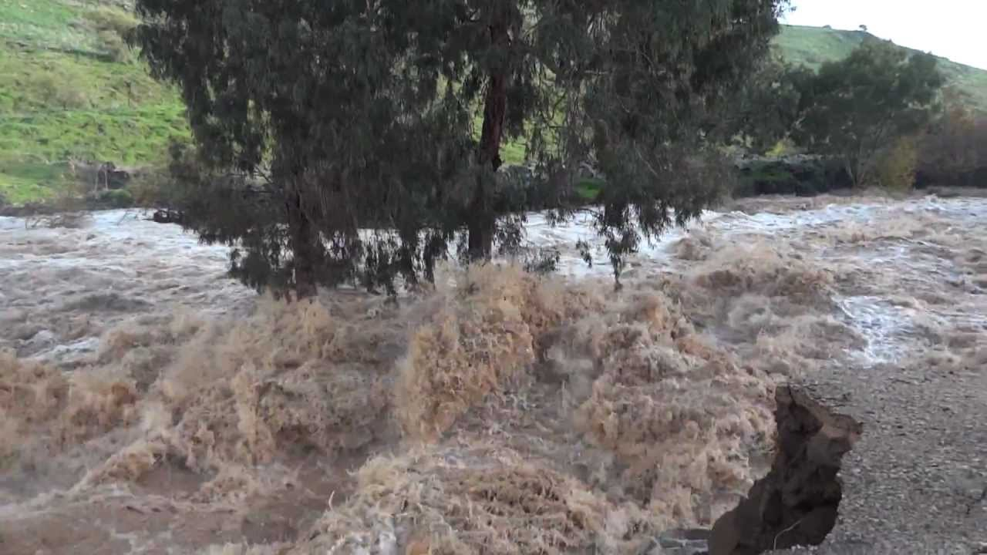

Slide 12
  When all the Amorite kings on the west side of the Jordan and all the Canaanite kings along the seacoast heard how the Lord had dried up the water of the Jordan before the Israelites while they crossed, they lost their courage and could not even breathe for fear of the Israelites.
  Joshua 5:1 ESV

Slide 13
  ¹ This is the record of the genealogy of Jesus Christ, the son of David, the son of Abraham. ² Abraham was the father of Isaac, Isaac the father of Jacob, Jacob the father of Judah and his brothers, ³ Judah the father of Perez and Zerah (by Tamar), Perez the father of Hezron, Hezron the father of Ram, ⁴ Ram the father of Amminadab, Amminadab the father of Nahshon, Nahshon the father of Salmon, ⁵ Salmon the father of Boaz (by Rahab), Boaz the father of Obed (by Ruth), Obed the father of Jesse, ⁶ and Jesse the father of David the king.
  Matthew 1:1-6 ESV

