Slide 1


Slide 2
  ²⁹ By faith the people crossed the Red Sea as on dry land, but the Egyptians, when they attempted to do the same, were drowned.
  Hebrews 11:29 ESV

Slide 3
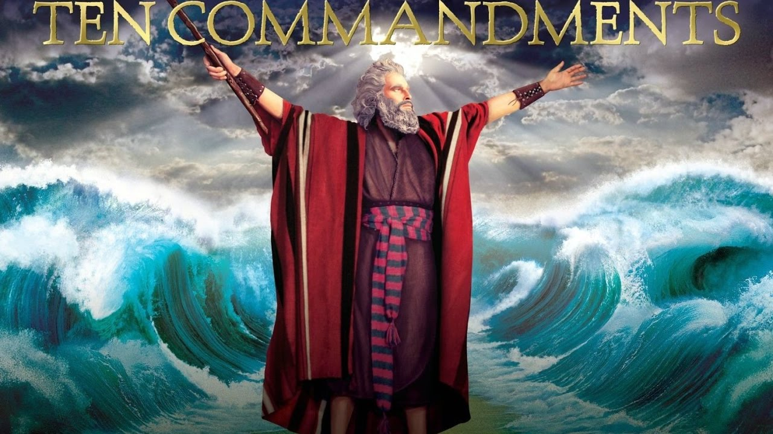
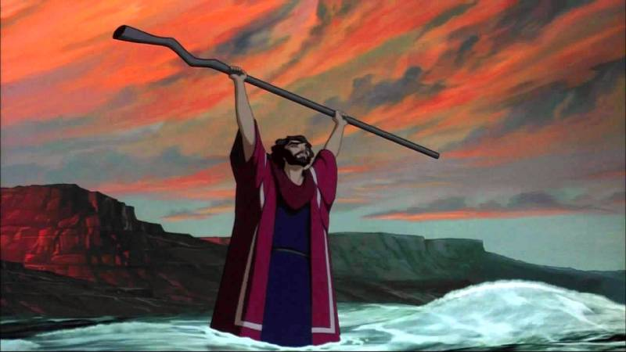

Slide 4
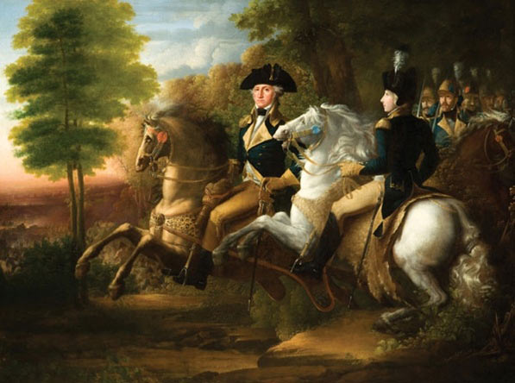

Slide 5
  Then the Lord said to Moses, ² “Tell the people of Israel to turn back and encamp in front of Pi-hahiroth, between Migdol and the sea, in front of Baal-zephon; you shall encamp facing it, by the sea.
  Exodus 1:15-17 ESV

Slide 6
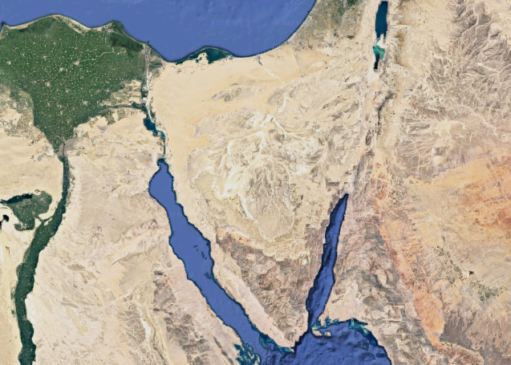

Slide 7
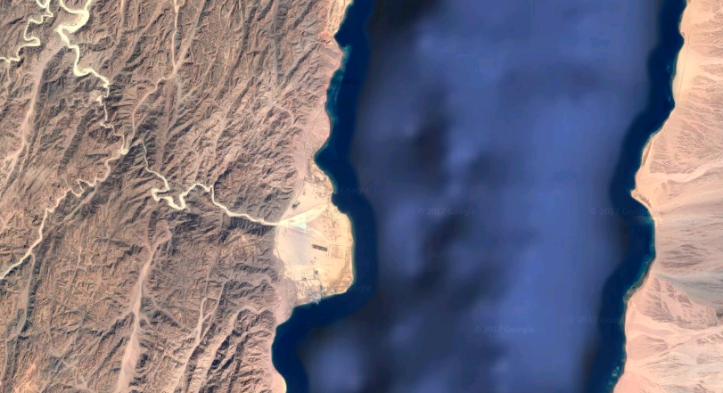
Nuweibaa

Slide 8
  ³ For Pharaoh will say of the people of Israel, ‘They are wandering in the land; the wilderness has shut them in.’ ⁴ And I will harden Pharaoh's heart, and he will pursue them, and I will get glory over Pharaoh and all his host, and the Egyptians shall know that I am the Lord.” And they did so.
  Exodus 14:3-4 ESV

Slide 9
  ¹⁰ When Pharaoh drew near, the people of Israel lifted up their eyes, and behold, the Egyptians were marching after them, and they feared greatly. And the people of Israel cried out to the Lord. ¹¹ They said to Moses, “Is it because there are no graves in Egypt that you have taken us away to die in the wilderness? What have you done to us in bringing us out of Egypt? ¹² Is not this what we said to you in Egypt: ‘Leave us alone that we may serve the Egyptians’? For it would have been better for us to serve the Egyptians than to die in the wilderness.”
  Exodus 14:10-12 ESV

Slide 10
  ¹³ And Moses said to the people, “Fear not, stand firm, and see the salvation of the Lord, which he will work for you today. For the Egyptians whom you see today, you shall never see again. ¹⁴ The Lord will fight for you, and you have only to be silent.”
  Exodus 14:13-14 ESV

