Slide 1
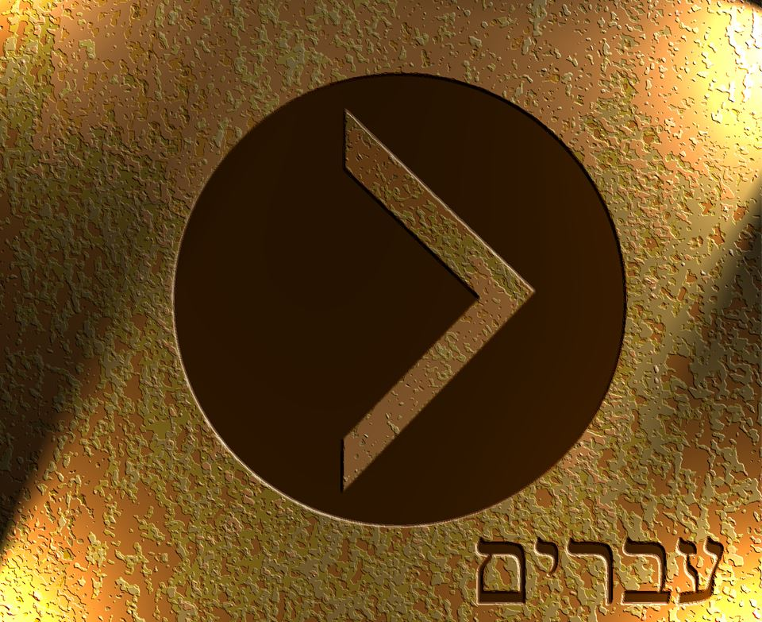

Slide 2
There is therefore now no condemnation for those who are in Christ Jesus.
Romans 8:1 ESV

Slide 3
²⁴ Wretched man that I am! Who will deliver me from this body of death? ²⁵ Thanks be to God through Jesus Christ our Lord!
Romans 7:24-25 ESV

Slide 4
²¹ But now the righteousness of God has been manifested apart from the law, although the Law and the Prophets bear witness to it— ²² the righteousness of God through faith in Jesus Christ for all who believe. For there is no distinction: ²³ for all have sinned and fall short of the glory of God, ²⁴ and are justified by his grace as a gift, through the redemption that is in Christ Jesus, ²⁵ whom God put forward as a propitiation by his blood, to be received by faith. This was to show God's righteousness, because in his divine forbearance he had passed over former sins. ²⁶ It was to show his righteousness at the present time, so that he might be just and the justifier of the one who has faith in Jesus
Romans 3:21-26 ESV

Slide 5
¹⁶ “For God so loved the world, that he gave his only Son, that whoever believes in him should not perish but have eternal life. ¹⁷ For God did not send his Son into the world to condemn the world, but in order that the world might be saved through him. ¹⁸ Whoever believes in him is not condemned, but whoever does not believe is condemned already, because he has not believed in the name of the only Son of God.
John 3:16-18 ESV

Slide 6
1 Peter 1:18-19 ESV - ¹⁸ knowing that you were ransomed from the futile ways inherited from your forefathers, not with perishable things such as silver or gold, ¹⁹ but with the precious blood of Christ, like that of a lamb without blemish or spot.
1 Peter 1:23 ESV - ²³ since you have been born again, not of perishable seed but of imperishable, through the living and abiding word of God

Slide 7
³ Blessed be the God and Father of our Lord Jesus Christ! According to his great mercy, he has caused us to be born again to a living hope through the resurrection of Jesus Christ from the dead, ⁴ to an inheritance that is imperishable, undefiled, and unfading, kept in heaven for you, ⁵ who by God's power are being guarded through faith for a salvation ready to be revealed in the last time.
1 Peter 1:3-5 ESV

Slide 8
¹¹ In him we have obtained an inheritance, having been predestined according to the purpose of him who works all things according to the counsel of his will, ¹² so that we who were the first to hope in Christ might be to the praise of his glory. ¹³ In him you also, when you heard the word of truth, the gospel of your salvation, and believed in him, were sealed with the promised Holy Spirit, ¹⁴ who is the guarantee of our inheritance until we acquire possession of it, to the praise of his glory.
Ephesians 1:11-14 ESV

Slide 9
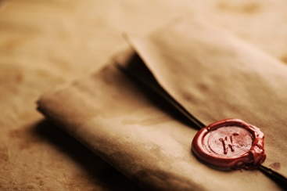

Slide 10
²⁸ I give them eternal life, and they will never perish, and no one will snatch them out of my hand. ²⁹ My Father, who has given them to me, is greater than all, and no one is able to snatch them out of the Father's hand. ³⁰ I and the Father are one.”
John 10:28-30 ESV

Slide 11
⁴ For we have become partakers of Christ, if we hold fast the beginning of our assurance firm until the end
Hebrews 3:14 NASB

Slide 12
⁴ For we have become partakers of Christ, if we hold fast the beginning of our assurance firm until the end
Hebrews 3:14 NASB

Slide 13
⁶ And I am sure of this, that he who began a good work in you will bring it to completion at the day of Jesus Christ
Philippians 1:6 ESV

Slide 14
⁴ For everyone who has been born of God overcomes the world. And this is the victory that has overcome the world—our faith.
1 John 5:4 ESV

Slide 15
¹⁹ Therefore, brothers, since we have confidence to enter the holy places by the blood of Jesus, ²⁰ by the new and living way that he opened for us through the curtain, that is, through his flesh, ²¹ and since we have a great priest over the house of God, ²² let us draw near with a true heart in full assurance of faith, with our hearts sprinkled clean from an evil conscience and our bodies washed with pure water. ²³ Let us hold fast the confession of our hope without wavering, for he who promised is faithful.
Hebrews 10:19-23 ESV

Slide 16
⁴ For it is impossible, in the case of those who have once been enlightened, who have tasted the heavenly gift, and have shared in the Holy Spirit, ⁵ and have tasted the goodness of the word of God and the powers of the age to come, ⁶ and then have fallen away, to restore them again to repentance, since they are crucifying once again the Son of God to their own harm and holding him up to contempt. ⁷ For land that has drunk the rain that often falls on it, and produces a crop useful to those for whose sake it is cultivated, receives a blessing from God. ⁸ But if it bears thorns and thistles, it is worthless and near to being cursed, and its end is to be burned.
Hebrews 6:4-8 ESV

Slide 17
²¹ “Not everyone who says to me, ‘Lord, Lord,’ will enter the kingdom of heaven, but the one who does the will of my Father who is in heaven. ²² On that day many will say to me, ‘Lord, Lord, did we not prophesy in your name, and cast out demons in your name, and do many mighty works in your name?’ ²³ And then will I declare to them, ‘I never knew you; depart from me, you workers of lawlessness.’’
Matthew 7:21-23 ESV

