Slide 1


Slide 2
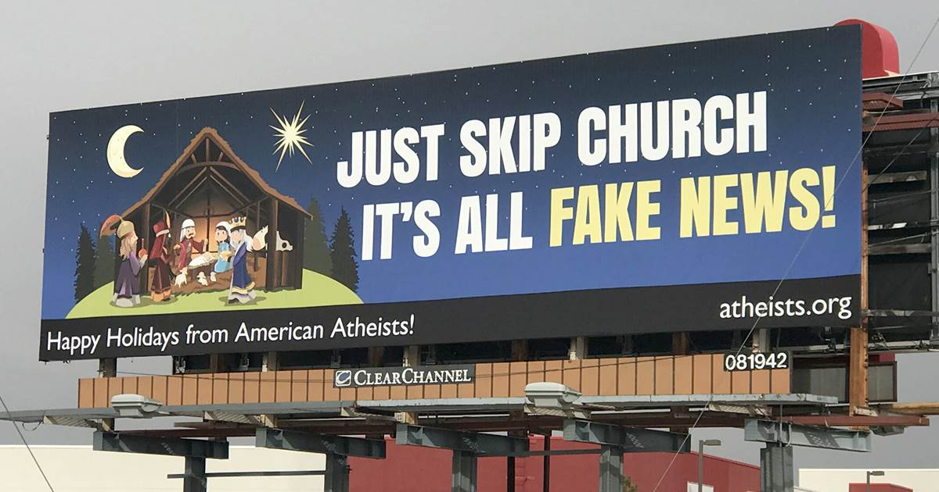

Slide 3

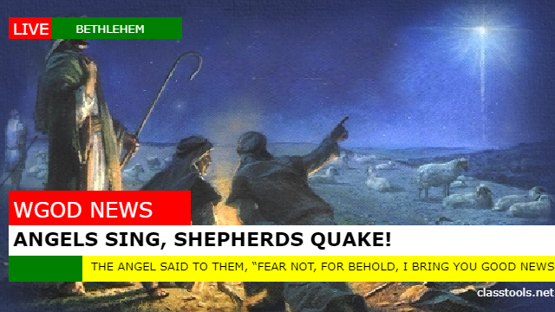
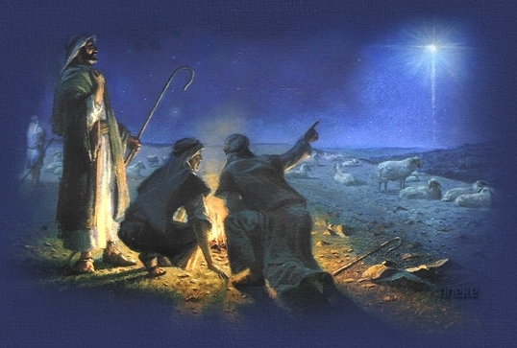

Slide 4
⁸ And in the same region there were shepherds out in the field, keeping watch over their flock by night. ⁹ And an angel of the Lord appeared to them, and the glory of the Lord shone around them, and they were filled with great fear. ¹⁰ And the angel said to them, “Fear not, for behold, I bring you good news of great joy that will be for all the people. ¹¹ For unto you is born this day in the city of David a Savior, who is Christ the Lord. ¹² And this will be a sign for you: you will find a baby wrapped in swaddling cloths and lying in a manger.” ¹³ And suddenly there was with the angel a multitude of the heavenly host praising God and saying, ¹⁴ “Glory to God in the highest, and on earth peace among those with whom he is pleased!” ¹⁵ When the angels went away from them into heaven, the shepherds said to one another, “Let us go over to Bethlehem and see this thing that has happened, which the Lord has made known to us.” ¹⁶ And they went with haste and found Mary and Joseph, and the baby lying in a manger. ¹⁷ And when they saw it, they made known the saying that had been told them concerning this child.
Luke 2:9-17 ESV

Slide 5
¹⁷ And if Christ has not been raised, your faith is futile and you are still in your sins. ¹⁸ Then those also who have fallen asleep in Christ have perished. ¹⁹ If in Christ we have hope in this life only, we are of all people most to be pitied.
1 Corinthians 15:17-19 ESV

Slide 6
Arise, shine, for your light has come, and the glory of the Lord has risen upon you. ² For behold, darkness shall cover the earth, and thick darkness the peoples; but the Lord will arise upon you, and is glory will be seen upon you. ³ And nations shall come to your light, and kings to the brightness of your rising.
Isaiah 60:1-3 ESV

Slide 7

