Slide 1
Great
Faithfulness
IS YOUR

Slide 2
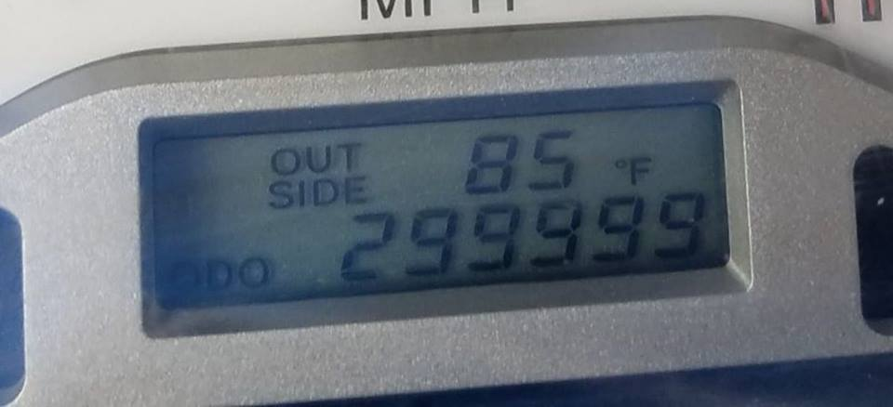

Slide 3
¹ O Lord, you are my God! I will exalt you in praise, I will extol your fame. For you have done extraordinary things, and executed plans made long ago exactly as you decreed. ⁶ The Lord who commands armies will hold a banquet for all the nations on this mountain. At this banquet there will be plenty of meat and aged wine— tender meat and choicest wine. ⁷ On this mountain he will swallow up the shroud that is over all the peoples, the woven covering that is over all the nations; ⁸ he will swallow up death permanently. The sovereign Lord will wipe away the tears from every face, and remove his people’s disgrace from all the earth. Indeed, the Lord has announced it! ⁹ At that time they will say, “Look, here is our God! We waited for him and he delivered us. Here is the Lord! We waited for him. Let’s rejoice and celebrate his deliverance!”
Isaiah 25:1, 6-9 NET

Slide 4
I will put enmity between you and the woman, and between your offspring and her offspring; he shall bruise your head, and you shall bruise his heel.”
Genesis 3:15 ESV

Slide 5
¹ O Lord, you are my God! I will exalt you in praise, I will extol your fame. For you have done extraordinary things, and executed plans made long ago exactly as you decreed. ⁶ The Lord who commands armies will hold a banquet for all the nations on this mountain. At this banquet there will be plenty of meat and aged wine— tender meat and choicest wine. ⁷ On this mountain he will swallow up the shroud that is over all the peoples, the woven covering that is over all the nations; ⁸ he will swallow up death permanently. The sovereign Lord will wipe away the tears from every face, and remove his people’s disgrace from all the earth. Indeed, the Lord has announced it! ⁹ At that time they will say, “Look, here is our God! We waited for him and he delivered us. Here is the Lord! We waited for him. Let’s rejoice and celebrate his deliverance!”
Isaiah 25:1, 6-9 NET

Slide 6
“Death is swallowed up in victory.” ⁵⁵ “O death, where is your victory? O death, where is your sting?” ⁵⁶ The sting of death is sin, and the power of sin is the law. ⁵⁷ But thanks be to God, who gives us the victory through our Lord Jesus Christ.
1 Corinthians 15:54b-57 ESV

Slide 7
¹ O Lord, you are my God! I will exalt you in praise, I will extol your fame. For you have done extraordinary things, and executed plans made long ago exactly as you decreed. ⁶ The Lord who commands armies will hold a banquet for all the nations on this mountain. At this banquet there will be plenty of meat and aged wine— tender meat and choicest wine. ⁷ On this mountain he will swallow up the shroud that is over all the peoples, the woven covering that is over all the nations; ⁸ he will swallow up death permanently. The sovereign Lord will wipe away the tears from every face, and remove his people’s disgrace from all the earth. Indeed, the Lord has announced it! ⁹ At that time they will say, “Look, here is our God! We waited for him and he delivered us. Here is the Lord! We waited for him. Let’s rejoice and celebrate his deliverance!”
Isaiah 25:1, 6-9 NET

Slide 8
⁴ He will wipe away every tear from their eyes, and death shall be no more, neither shall there be mourning, nor crying, nor pain anymore, for the former things have passed away.” ⁵ And he who was seated on the throne said, “Behold, I am making all things new.” Also he said, “Write this down, for these words are trustworthy and true.”
Revelation 21:4-5 ESV

Slide 9
¹ O Lord, you are my God! I will exalt you in praise, I will extol your fame. For you have done extraordinary things, and executed plans made long ago exactly as you decreed. ⁶ The Lord who commands armies will hold a banquet for all the nations on this mountain. At this banquet there will be plenty of meat and aged wine— tender meat and choicest wine. ⁷ On this mountain he will swallow up the shroud that is over all the peoples, the woven covering that is over all the nations; ⁸ he will swallow up death permanently. The sovereign Lord will wipe away the tears from every face, and remove his people’s disgrace from all the earth. Indeed, the Lord has announced it! ⁹ At that time they will say, “Look, here is our God! We waited for him and he delivered us. Here is the Lord! We waited for him. Let’s rejoice and celebrate his deliverance!”
Isaiah 25:1, 6-9 NET

Slide 10
Faithful
Romans 10:13 ESV - For “everyone who calls on the name of the Lord will be saved.”
Romans 10:9 ESV - ⁹ because, if you confess with your mouth that Jesus is Lord and believe in your heart that God raised him from the dead, you will be saved.
1 John 1:9 ESV - ⁹ If we confess our sins, he is faithful and just to forgive us our sins and to cleanse us from all unrighteousness.

Slide 11
Therefore, since we have been declared righteous by faith, we have peace with God through our Lord Jesus Christ, ² through whom we have also obtained access by faith into this grace in which we stand, and we rejoice in the hope of God’s glory. ³ Not only this, but we also rejoice in sufferings, knowing that suffering produces endurance, ⁴ and endurance, character, and character, hope. ⁵ And hope does not disappoint, because the love of God has been poured out in our hearts through the Holy Spirit who was given to us.
Romans 5:1-5 ESV

Slide 12
¹¹ For the Scripture says, “Everyone who believes in him will not be put to shame.”
Romans 10:11ESV

Slide 13
²² The steadfast love of the Lord never ceases; his mercies never come to an end; ²³ they are new every morning; great is your faithfulness. ²⁴ “The Lord is my portion,” says my soul, “therefore I will hope in him.”
Lamentations 3:22-23 ESV

