Slide 1
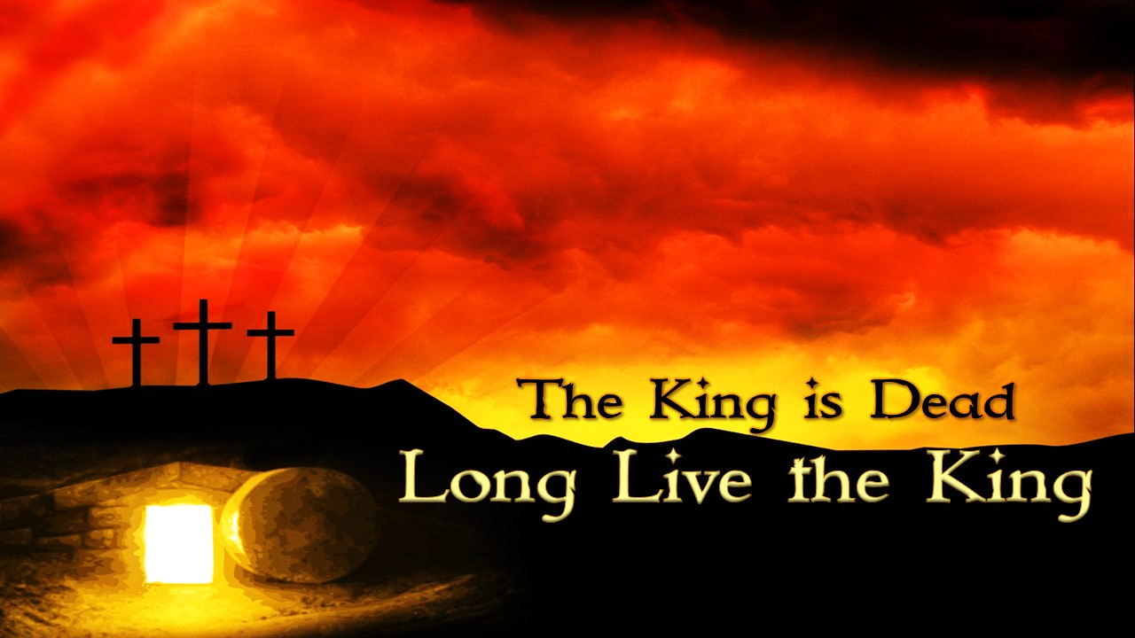

Slide 2
In the beginning was the Word, and the Word was with God, and the Word was God. ² He was in the beginning with God. ³ All things were made through him, and without him was not any thing made that was made.
John 1:1-3 ESV

Slide 3
    ⁹ And those who went before and those who followed were shouting, “Hosanna! Blessed is he who comes in the name of the Lord! ¹⁰ Blessed is the coming kingdom of our father David! Hosanna in the highest!”
    Mark 11:9-10 ESV
    ¹³ So they took branches of palm trees and went out to meet him, crying out, “Hosanna! Blessed is he who comes in the name of the Lord, even the King of Israel!”
    John 12:13 ESV

Slide 4
²⁷ Then the soldiers of the governor took Jesus into the governor's headquarters, and they gathered the whole battalion before him.²⁸ And they stripped him and put a scarlet robe on him, ²⁹ and twisting together a crown of thorns, they put it on his head and put a reed in his right hand. And kneeling before him, they mocked him, saying, “Hail, King of the Jews!” ³⁰ And they spit on him and took the reed and struck him on the head. ³¹ And when they had mocked him, they stripped him of the robe and put his own clothes on him and led him away to crucify him.
Matthew 27:27-31 ESV

Slide 5
³⁵ And when they had crucified him, they divided his garments among them by casting lots. ³⁶ Then they sat down and kept watch over him there. ³⁷ And over his head they put the charge against him, which read, “This is Jesus, the King of the Jews.” ³⁸ Then two robbers were crucified with him, one on the right and one on the left. ³⁹ And those who passed by derided him, wagging their heads ⁴⁰ and saying, “You who would destroy the temple and rebuild it in three days, save yourself! If you are the Son of God, come down from the cross.” ⁴¹ So also the chief priests, with the scribes and elders, mocked him, saying, ⁴² “He saved others; he cannot save himself. He is the King of Israel; let him come down now from the cross, and we will believe in him.
Matthew 27:35-42 ESV

Slide 6
¹ But on the first day of the week, at early dawn, they went to the tomb, taking the spices they had prepared. ² And they found the stone rolled away from the tomb, ³ but when they went in they did not find the body of the Lord Jesus. ⁴ While they were perplexed about this, behold, two men stood by them in dazzling apparel. ⁵ And as they were frightened and bowed their faces to the ground, the men said to them, “Why do you seek the living among the dead? ⁶ He is not here, but has risen. Remember how he told you, while he was still in Galilee, ⁷ that the Son of Man must be delivered into the hands of sinful men and be crucified and on the third day rise.”
John 24:1-7 ESV

Slide 7
“Death is swallowed up in victory.” ⁵⁵ “O death, where is your victory? O death, where is your sting?” ⁵⁶ The sting of death is sin, and the power of sin is the law. ⁵⁷ But thanks be to God, who gives us the victory through our Lord Jesus Christ.
1 Corinthians 15:55-57 ESV

Slide 8
⁹ We know that Christ, being raised from the dead, will never die again; death no longer has dominion over him. ¹⁰ For the death he died he died to sin, once for all, but the life he lives he lives to God.
Romans 6:9-10 ESV

Slide 9
¹⁵ Then the seventh angel blew his trumpet, and there were loud voices in heaven, saying, “The kingdom of the world has become the kingdom of our Lord and of his Christ, and he shall reign forever and ever.”
Revelation 11:15 ESV

