Slide 1
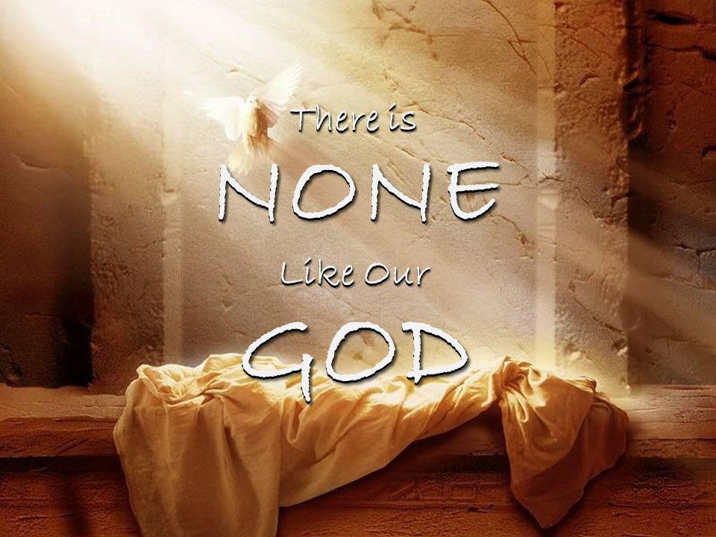

Slide 2

¹⁸ Then King David went in and sat before the Lord and said, “Who am I, O Lord God, and what is my house, that you have brought me thus far? ¹⁹ And yet this was a small thing in your eyes, O Lord God. You have spoken also of your servant's house for a great while to come, and this is instruction for mankind, O Lord God! ²⁰ And what more can David say to you? For you know your servant, O Lord God! ²¹ Because of your promise, and according to your own heart, you have brought about all this greatness, to make your servant know it. ²² Therefore you are great, O Lord God. For there is none like you, and there is no God besides you, according to all that we have heard with our ears. ²³ And who is like your people Israel, the one nation on earth whom God went to redeem to be his people, making himself a name and doing for them great and awesome things by driving out before your people, whom you redeemed for yourself from Egypt, a nation and its gods? ²⁴ And you established for yourself your people Israel to be your people forever. And you, O Lord, became their God. ²⁵ And now, O Lord God, confirm forever the word that you have spoken concerning your servant and concerning his house, and do as you have spoken. ²⁶ And your name will be magnified forever, saying, ‘The Lord of hosts is God over Israel,’ and the house of your servant David will be established before you. ²⁷ For you, O Lord of hosts, the God of Israel, have made this revelation to your servant, saying, ‘I will build you a house.’ Therefore your servant has found courage to pray this prayer to you. ²⁸ And now, O Lord God, you are God, and your words are true, and you have promised this good thing to your servant. ²⁹ Now therefore may it please you to bless the house of your servant, so that it may continue forever before you. For you, O Lord God, have spoken, and with your blessing shall the house of your servant be blessed forever.”
2 Samuel 7:18-29 ESV

Slide 3
⁶ There is none like you, O LORD; you are great, and your name is great in might.
¹⁰ But the LORD is the true God; he is the living God and the everlasting King. At his wrath the earth quakes, and the nations cannot endure his indignation.
Jeremiah 10:6, 10 ESV

Slide 4
⁵ Their idols are like scarecrows in a cucumber field, and they cannot speak; they have to be carried, for they cannot walk. Do not be afraid of them, for they cannot do evil, neither is it in them to do good.”
⁸ They are both stupid and foolish; the instruction of idols is but wood! ⁹ Beaten silver is brought from Tarshish, and gold from Uphaz. They are the work of the craftsman and of the hands of the goldsmith; their clothing is violet and purple; they are all the work of skilled men.
Jeremiah 10:5, 8-9 ESV

Slide 5
Psalms 86:8 ESV - There is none like you among the gods, O Lord, nor are there any works like yours.
1 Kings 8:23 ESV - “O Lord, God of Israel, there is no God like you, in heaven above or on earth beneath, keeping covenant and showing steadfast love to your servants who walk before you with all their heart
Isaiah 46:9-10 ESV - remember the former things of old; for I am God, and there is no other; I am God, and there is none like me, ¹⁰ declaring the end from the beginning and from ancient times things not yet done, saying, ‘My counsel shall stand, and I will accomplish all my purpose
Exodus 8:10b ESV - so that you may know that there is no one like the Lord our God.
Exodus 9:14 ESV - ¹⁴ For this time I will send all my plagues on you yourself, and on your servants and your people, so that you may know that there is none like me in all the earth.

Slide 6
For my thoughts are not your thoughts, neither are your ways my ways, declares the LORD.
Isaiah 55:8 ESV

Slide 7
¹⁴ And the Word became flesh and dwelt among us, and we have seen his glory, glory as of the only Son from the Father, full of grace and truth.
John 1:14 ESV

Slide 8
¹⁹ Or do you not know that your body is a temple of the Holy Spirit within you, whom you have from God? You are not your own, ²⁰ for you were bought with a price. So glorify God in your body.
1 Corinthians 6:19-20 ESV

Slide 9
¹¹ If the Spirit of him who raised Jesus from the dead dwells in you, he who raised Christ Jesus from the dead will also give life to your mortal bodies through his Spirit who dwells in you.
Romans 8:11 ESV

