Slide 1
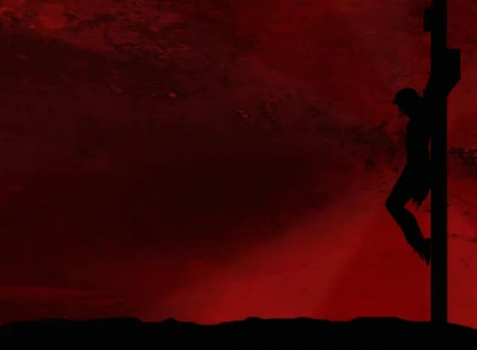
CHRIST OUR PROPITIATION AND OUR EXPIATION
TO HIM BE GLORY FOREVER
Leviticus 16

Slide 2
⁵ And he shall take from the congregation of the children of Israel two kids of the goats as a sin offering, and one ram as a burnt offering. ⁶ “Aaron shall offer the bull as a sin offering, which is for himself, and make atonement for himself and for his house. ⁷ He shall take the two goats and present them before the Lord at the door of the tabernacle of meeting. ⁸ Then Aaron shall cast lots for the two goats: one lot for the Lord and the other lot for the scapegoat.
Leviticus 16:5-8 NKJV

Slide 3
¹⁵ “Then he shall kill the goat of the sin offering, which is for the people, bring its blood inside the veil, do with that blood as he did with the blood of the bull, and sprinkle it on the mercy seat and before the mercy seat.¹⁶ So he shall make atonement for the Holy Place, because of the uncleanness of the children of Israel, and because of their transgressions, for all their sins; and so he shall do for the tabernacle of meeting which remains among them in the midst of their uncleanness. ¹⁷ There shall be no man in the tabernacle of meeting when he goes in to make atonement in the Holy Place, until he comes out, that he may make atonement for himself, for his household, and for all the assembly of Israel. ¹⁸ And he shall go out to the altar that is before the Lord, and make atonement for it, and shall take some of the blood of the bull and some of the blood of the goat, and put it on the horns of the altar all around. ¹⁹ Then he shall sprinkle some of the blood on it with his finger seven times, cleanse it, and consecrate it from the uncleanness of the children of Israel. ²⁰ “And when he has made an end of atoning for the Holy Place, the tabernacle of meeting, and the altar, he shall bring the live goat.²¹ Aaron shall lay both his hands on the head of the live goat, confess over it all the iniquities of the children of Israel, and all their transgressions, concerning all their sins, putting them on the head of the goat, and shall send it away into the wilderness by the hand of a suitable man. ²² The goat shall bear on itself all their iniquities to an uninhabited land; and he shall release the goat in the wilderness. ²³ “Then Aaron shall come into the tabernacle of meeting, shall take off the linen garments which he put on when he went into the Holy Place, and shall leave them there.
Leviticus 16:15-23 NKJV

Slide 4
I. UNDERSTANDING THE SHADOW MINISTRY OF THE OLD TESTAMENT
Hebrews 10:1 - For the law, having a shadow of the good things to come, and not the very image of the things, can never with these same sacrifices, which they offer continually year by year, make those who approach perfect.

Slide 5
II. UNDERSTANDING THE TWO GOATS IN THE DAY OF ATONEMENT
The Slain Goat—for uncleanness and for sins of the people. (vs. 15-20)
The Live Goat—the Scapegoat—carried away the sins. (vs. 21-23)

Slide 6
III. THE SHADOW AND THE SUBSTANCE
Hebrews 9: 9-12 It was symbolic for the present time in which both gifts and sacrifices are offered which cannot make him who performed the service perfect in regard to the conscience. 11 But Christ came as High Priest of the good things to come, with the greater and more perfect tabernacle not made with hands, that is, not of this creation. 12 Not with the blood of goats and calves, but with His own blood He entered the Most Holy Place once for all, having obtained eternal redemption.
Hebrews 9:24-26 For Christ has not entered the holy places made with hands, which are copies of the true, but into heaven itself, now to appear in the presence of God for us; 25 not that He should offer Himself often, as the high priest enters the Most Holy Place every year with blood of another. 26 He then would have had to suffer often since the foundation of the world; but now, once at the end of the ages, He has appeared to put away sin by the sacrifice of Himself.
Hebrews 10:11-14; 17-18 And every priest stands ministering daily and offering repeatedly the same sacrifices, which can never take away sins. 12 But this Man, after He had offered one sacrifice for sins forever, sat down at the right hand of God, 13 from that time waiting till His enemies are made His footstool. 14 For by one offering He has perfected forever those who are being sanctified. 17 then He adds, "Their sins and their lawless deeds I will remember no more." 18 Now where there is remission of these, there is no longer an offering for sin.

Slide 7
IV. REJOICING IN PROPITIATION AND EXPIATION
PROPITIATION—Christ exhausted God’s wrath against us.
1 John 4:10 - In this is love, not that we loved God, but that He loved us and sent His Son to be the propitiation for our sins.
Think of Isaiah 53:4-5. What happened to Jesus?
  Stricken by God
  Smitten by Him
  Afflicted
  Pierced for our transgressions
  Crushed for our iniquities

Slide 8
IV. REJOICING IN PROPITIATION AND EXPIATION
EXPIATION—Christ removed and put away our sin—once for all!
4 Pictures of Expiation:
  Ps 103:12 As far as the east is from the west, So far has He removed our transgressions from us.
  Isa 43:2 "I, even I, am He who blots out your transgressions for My own sake; And I will not remember your sins.
  Isa 38:17 For You have cast all my sins behind Your back.
  Mic 7:19 You will cast all our sins Into the depths of the sea.

Slide 9
V. CONCLUSION—HOW DOES ALL THIS AFFECT ME IN MY DAY TO DAY LIFE NOW?
At least three ways…
It gives me total confidence—my sin and God’s wrath are gone forever!
It propels me to go and broadcast Christ the Propitiator and the Expiator!
It becomes my rock: God is forever for me!

