Slide 1


Slide 2
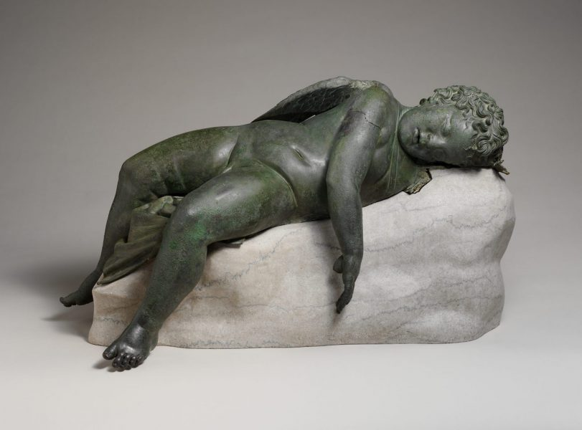

Slide 3
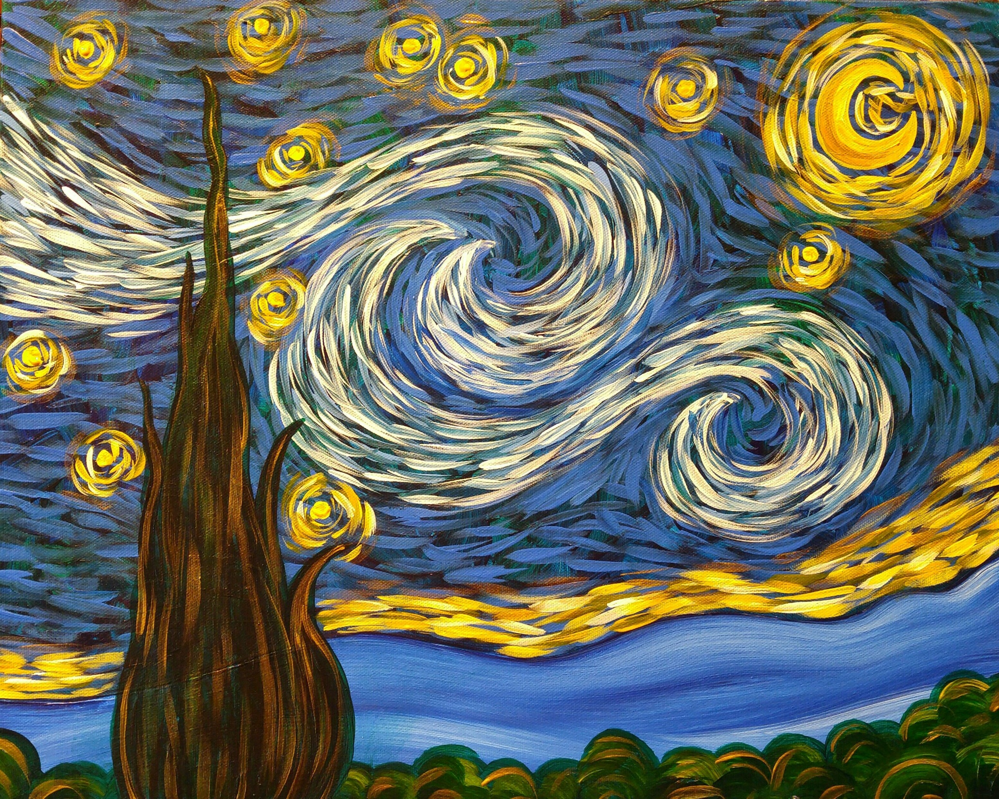
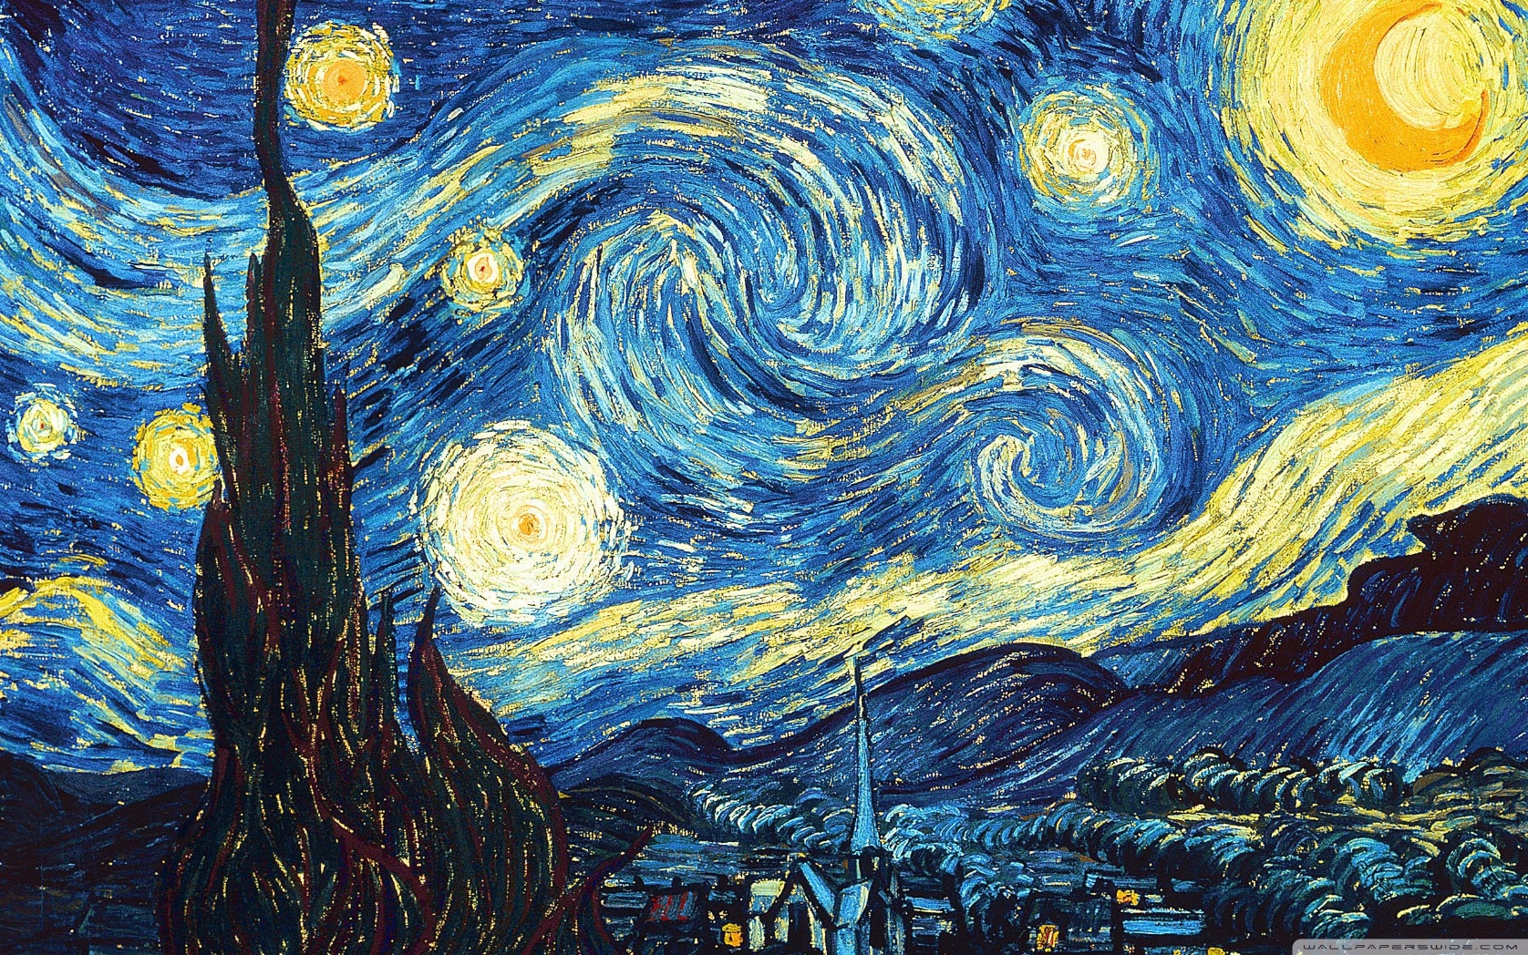

Slide 4
¹⁸ We know that everyone fathered by God does not sin, but God protects the one he has fathered, and the evil one cannot touch him. ¹⁹ We know that we are from God, and the whole world lies in the power of the evil one. ²⁰ And we know that the Son of God has come and has given us insight to know him who is true, and we are in him who is true, in his Son Jesus Christ. This one is the true God and eternal life. ²¹ Little children, guard yourselves from idols.
1 John 5:18-21 NET

Slide 5
¹⁸ We know that everyone fathered by God does not sin, but God protects the one he has fathered, and the evil one cannot touch him. ¹⁹ We know that we are from God, and the whole world lies in the power of the evil one. ²⁰ And we know that the Son of God has come and has given us insight to know him who is true, and we are in him who is true, in his Son Jesus Christ. This one is the true God and eternal life. ²¹ Little children, guard yourselves from idols.
1 John 5:18-21 NET

Slide 6
¹⁸ We know that everyone fathered by God does not sin, but God protects the one he has fathered, and the evil one cannot touch him. ¹⁹ We know that we are from God, and the whole world lies in the power of the evil one. ²⁰ And we know that the Son of God has come and has given us insight to know him who is true, and we are in him who is true, in his Son Jesus Christ. This one is the true God and eternal life. ²¹ Little children, guard yourselves from idols.
1 John 5:18-21 NET

Slide 7
³¹ “Simon, Simon, behold, Satan demanded to have you, that he might sift you like wheat, ³² but I have prayed for you that your faith may not fail. And when you have turned again, strengthen your brothers.”
Luke 22:31-32 ESV

Slide 8
¹⁸ We know that everyone fathered by God does not sin, but God protects the one he has fathered, and the evil one cannot touch him. ¹⁹ We know that we are from God, and the whole world lies in the power of the evil one. ²⁰ And we know that the Son of God has come and has given us insight to know him who is true, and we are in him who is true, in his Son Jesus Christ. This one is the true God and eternal life. ²¹ Little children, guard yourselves from idols.
1 John 5:18-21 NET

Slide 9
¹⁸ We know that everyone fathered by God does not sin, but God protects the one he has fathered, and the evil one cannot touch him. ¹⁹ We know that we are from God, and the whole world lies in the power of the evil one. ²⁰ And we know that the Son of God has come and has given us insight to know him who is true, and we are in him who is true, in his Son Jesus Christ. This one is the true God and eternal life. ²¹ Little children, guard yourselves from idols.
1 John 5:18-21 NET

Slide 10
² He is the propitiation for our sins, and not for ours only but also for the sins of the whole world
1 John 2:2 ESV

Slide 11
¹⁸ We know that everyone fathered by God does not sin, but God protects the one he has fathered, and the evil one cannot touch him. ¹⁹ We know that we are from God, and the whole world lies in the power of the evil one. ²⁰ And we know that the Son of God has come and has given us insight to know him who is true, and we are in him who is true, in his Son Jesus Christ. This one is the true God and eternal life. ²¹ Little children, guard yourselves from idols.
1 John 5:18-21 NET

Slide 12
¹⁸ We know that everyone fathered by God does not sin, but God protects the one he has fathered, and the evil one cannot touch him. ¹⁹ We know that we are from God, and the whole world lies in the power of the evil one. ²⁰ And we know that the Son of God has come and has given us insight to know him who is true, and we are in him who is true, in his Son Jesus Christ. This one is the true God and eternal life. ²¹ Little children, guard yourselves from idols.
1 John 5:18-21 NET

Slide 13
¹⁸ We know that everyone fathered by God does not sin, but God protects the one he has fathered, and the evil one cannot touch him. ¹⁹ We know that we are from God, and the whole world lies in the power of the evil one. ²⁰ And we know that the Son of God has come and has given us insight to know him who is true, and we are in him who is true, in his Son Jesus Christ. This one is the true God and eternal life. ²¹ Little children, guard yourselves from idols.
1 John 5:18-21 NET

Slide 14
³ And this is eternal life, that they know you, the only true God, and Jesus Christ whom you have sent.
John 17:3 ESV

Slide 15
¹⁸ We know that everyone fathered by God does not sin, but God protects the one he has fathered, and the evil one cannot touch him. ¹⁹ We know that we are from God, and the whole world lies in the power of the evil one. ²⁰ And we know that the Son of God has come and has given us insight to know him who is true, and we are in him who is true, in his Son Jesus Christ. This one is the true God and eternal life. ²¹ Little children, guard yourselves from idols.
1 John 5:18-21 NET

Slide 16
¹⁸ We know that everyone fathered by God does not sin, but God protects the one he has fathered, and the evil one cannot touch him. ¹⁹ We know that we are from God, and the whole world lies in the power of the evil one. ²⁰ And we know that the Son of God has come and has given us insight to know him who is true, and we are in him who is true, in his Son Jesus Christ. This one is the true God and eternal life. ²¹ Little children, guard yourselves from idols.
1 John 5:18-21 NET

