Slide 1



Slide 2
²⁰ If anyone says “I love God” and yet hates his fellow Christian, he is a liar, because the one who does not love his fellow Christian whom he has seen cannot love God whom he has not seen. ²¹ And the commandment we have from him is this: that the one who loves God should love his fellow Christian too. ¹ Everyone who believes that Jesus is the Christ has been fathered by God, and everyone who loves the father loves the child fathered by him. ² By this we know that we love the children of God: whenever we love God and obey his commandments. ³ For this is the love of God: that we keep his commandments. And his commandments do not weigh us down, ⁴ because everyone who has been fathered by God conquers the world.
1 John 4:20 – 5:4 NET

Slide 3
²⁰ If anyone says “I love God” and yet hates his fellow Christian, he is a liar, because the one who does not love his fellow Christian whom he has seen cannot love God whom he has not seen. ²¹ And the commandment we have from him is this: that the one who loves God should love his fellow Christian too. ¹ Everyone who believes that Jesus is the Christ has been fathered by God, and everyone who loves the father loves the child fathered by him. ² By this we know that we love the children of God: whenever we love God and obey his commandments. ³ For this is the love of God: that we keep his commandments. And his commandments do not weigh us down, ⁴ because everyone who has been fathered by God conquers the world.
1 John 4:20 – 5:4 NET

Slide 4
It is a false boast when anyone says he loves God but neglects His image which is before his eyes.
John Calvin

Slide 5
²⁰ If anyone says “I love God” and yet hates his fellow Christian, he is a liar, because the one who does not love his fellow Christian whom he has seen cannot love God whom he has not seen. ²¹ And the commandment we have from him is this: that the one who loves God should love his fellow Christian too. ¹ Everyone who believes that Jesus is the Christ has been fathered by God, and everyone who loves the father loves the child fathered by him. ² By this we know that we love the children of God: whenever we love God and obey his commandments. ³ For this is the love of God: that we keep his commandments. And his commandments do not weigh us down, ⁴ because everyone who has been fathered by God conquers the world.
1 John 4:20 – 5:4 NET

Slide 6
²³ Now this is his commandment: that we believe in the name of his Son Jesus Christ and love one another, just as he gave us the commandment.
1 John 3:23 NET

Slide 7
³⁴ “I give you a new commandment—to love one another. Just as I have loved you, you also are to love one another.
John 13:34 ESV

Slide 8
²⁰ If anyone says “I love God” and yet hates his fellow Christian, he is a liar, because the one who does not love his fellow Christian whom he has seen cannot love God whom he has not seen. ²¹ And the commandment we have from him is this: that the one who loves God should love his fellow Christian too. ¹ Everyone who believes that Jesus is the Christ has been fathered by God, and everyone who loves the father loves the child fathered by him. ² By this we know that we love the children of God: whenever we love God and obey his commandments. ³ For this is the love of God: that we keep his commandments. And his commandments do not weigh us down, ⁴ because everyone who has been fathered by God conquers the world.
1 John 4:20 – 5:4 NET

Slide 9
²⁰ If anyone says “I love God” and yet hates his fellow Christian, he is a liar, because the one who does not love his fellow Christian whom he has seen cannot love God whom he has not seen. ²¹ And the commandment we have from him is this: that the one who loves God should love his fellow Christian too. ¹ Everyone who believes that Jesus is the Christ has been fathered by God, and everyone who loves the father loves the child fathered by him. ² By this we know that we love the children of God: whenever we love God and obey his commandments. ³ For this is the love of God: that we keep his commandments. And his commandments do not weigh us down, ⁴ because everyone who has been fathered by God conquers the world.
1 John 4:20 – 5:4 NET

Slide 10
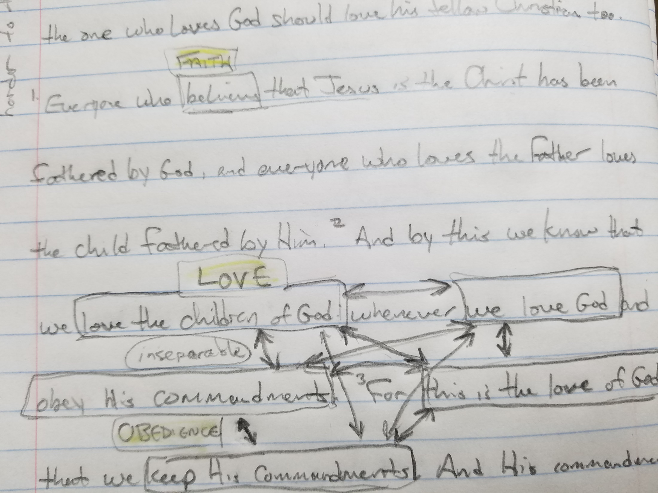

Slide 11
²⁰ If anyone says “I love God” and yet hates his fellow Christian, he is a liar, because the one who does not love his fellow Christian whom he has seen cannot love God whom he has not seen. ²¹ And the commandment we have from him is this: that the one who loves God should love his fellow Christian too. ¹ Everyone who believes that Jesus is the Christ has been fathered by God, and everyone who loves the father loves the child fathered by him. ² By this we know that we love the children of God: whenever we love God and obey his commandments. ³ For this is the love of God: that we keep his commandments. And his commandments do not weigh us down, ⁴ because everyone who has been fathered by God conquers the world.
1 John 4:20 – 5:4 NET

