Slide 1
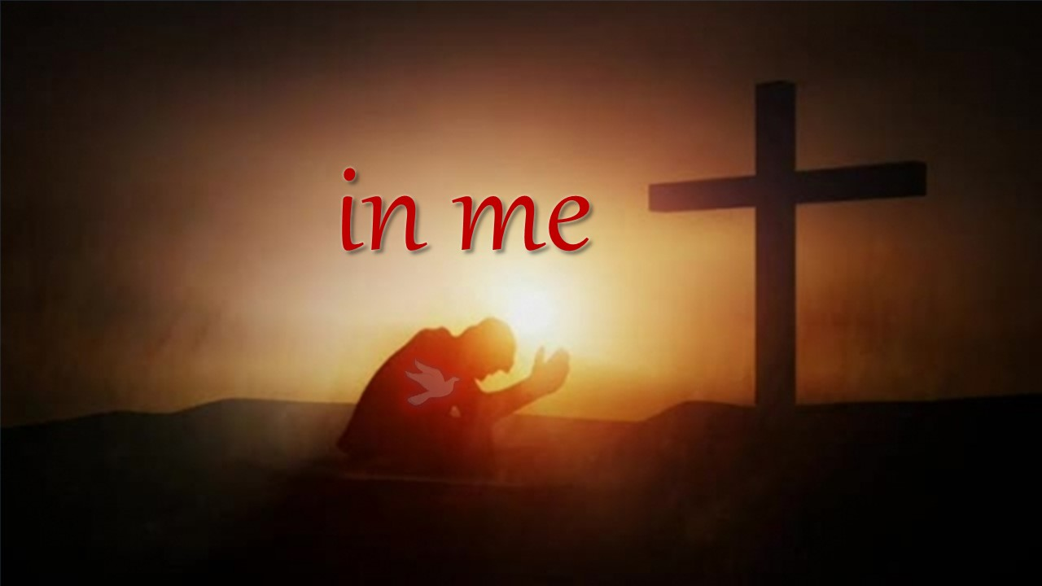

Slide 2
¹³ By this we know that we abide in him and he in us, because he has given us of his Spirit. ¹⁴ And we have seen and testify that the Father has sent his Son to be the Savior of the world. ¹⁵ Whoever confesses that Jesus is the Son of God, God abides in him, and he in God. ¹⁶ So we have come to know and to believe the love that God has for us. God is love, and whoever abides in love abides in God, and God abides in him.
1 John 4:13-16 ESV

Slide 3
¹⁵ “If you love me, you will keep my commandments. ¹⁶ And I will ask the Father, and he will give you another Helper, to be with you forever, ¹⁷ even the Spirit of truth, whom the world cannot receive, because it neither sees him nor knows him. You know him, for he dwells with you and will be in you. ¹⁸ “I will not leave you as orphans; I will come to you. ¹⁹ Yet a little while and the world will see me no more, but you will see me. Because I live, you also will live. ²⁰ In that day you will know that I am in my Father, and you in me, and I in you. ²¹ Whoever has my commandments and keeps them, he it is who loves me. And he who loves me will be loved by my Father, and I will love him and manifest myself to him.” ²² Judas (not Iscariot) said to him, “Lord, how is it that you will manifest yourself to us, and not to the world?” ²³ Jesus answered him, “If anyone loves me, he will keep my word, and my Father will love him, and we will come to him and make our home with him. ²⁴ Whoever does not love me does not keep my words. And the word that you hear is not mine but the Father's who sent me. ²⁵ “These things I have spoken to you while I am still with you. ²⁶ But the Helper, the Holy Spirit, whom the Father will send in my name, he will teach you all things and bring to your remembrance all that I have said to you.
John 14:15:25 ESV

Slide 4
²⁶ “But when the Helper comes, whom I will send to you from the Father, the Spirit of truth, who proceeds from the Father, he will bear witness about me. ²⁷ And you also will bear witness, because you have been with me from the beginning.
John 15:26-27 ESV

Slide 5
⁴ But I have said these things to you, that when their hour comes you may remember that I told them to you. “I did not say these things to you from the beginning, because I was with you. ⁵ But now I am going to him who sent me, and none of you asks me, ‘Where are you going?’ ⁶ But because I have said these things to you, sorrow has filled your heart. ⁷ Nevertheless, I tell you the truth: it is to your advantage that I go away, for if I do not go away, the Helper will not come to you. But if I go, I will send him to you.
John 16:4-7 ESV

Slide 6
³ He presented himself alive to them after his suffering by many proofs, appearing to them during forty days and speaking about the kingdom of God. ⁴ And while staying with them he ordered them not to depart from Jerusalem, but to wait for the promise of the Father, which, he said, “you heard from me; ⁵ for John baptized with water, but you will be baptized with the Holy Spirit not many days from now.”
⁸ But you will receive power when the Holy Spirit has come upon you, and you will be my witnesses in Jerusalem and in all Judea and Samaria, and to the end of the earth.”
Acts 1:3-5, 8 ESV

Slide 7
³⁷ Now when they heard this they were cut to the heart, and said to Peter and the rest of the apostles, “Brothers, what shall we do?” ³⁸ And Peter said to them, “Repent and be baptized every one of you in the name of Jesus Christ for the forgiveness of your sins, and you will receive the gift of the Holy Spirit.
Acts 2:37-38 ESV

Slide 8
¹³ By this we know that we abide in him and he in us, because he has given us of his Spirit. ¹⁴ And we have seen and testify that the Father has sent his Son to be the Savior of the world. ¹⁵ Whoever confesses that Jesus is the Son of God, God abides in him, and he in God. ¹⁶ So we have come to know and to believe the love that God has for us. God is love, and whoever abides in love abides in God, and God abides in him.
1 John 4:13-16 ESV

Slide 9
¹³ And we impart this in words not taught by human wisdom but taught by the Spirit, interpreting spiritual truths to those who are spiritual. ¹⁴ The natural person does not accept the things of the Spirit of God, for they are folly to him, and he is not able to understand them because they are spiritually discerned.
1 Corinthians 2:13-14 ESV

Slide 10
¹³ By this we know that we abide in him and he in us, because he has given us of his Spirit. ¹⁴ And we have seen and testify that the Father has sent his Son to be the Savior of the world. ¹⁵ Whoever confesses that Jesus is the Son of God, God abides in him, and he in God. ¹⁶ So we have come to know and to believe the love that God has for us. God is love, and whoever abides in love abides in God, and God abides in him.
1 John 4:13-16 ESV

Slide 11


Slide 12
⁸ For by grace you have been saved through faith. And this is not your own doing; it is the gift of God, ⁹ not a result of works, so that no one may boast.
Ephesians 2:8-9 ESV

