Slide 1



Slide 2
⁷ Beloved, let us love one another, for love is from God, and whoever loves has been born of God and knows God. ⁸ Anyone who does not love does not know God, because God is love. ⁹ In this the love of God was made manifest among us, that God sent his only Son into the world, so that we might live through him. ¹⁰ In this is love, not that we have loved God but that he loved us and sent his Son to be the propitiation for our sins. ¹¹ Beloved, if God so loved us, we also ought to love one another. ¹² No one has ever seen God; if we love one another, God abides in us and his love is perfected in us.
1 John 4:7-12 ESV

Slide 3
See what kind of love the Father has given to us, that we should be called children of God; and so we are.
1 John 1:3 ESV

Slide 4
⁷ Beloved, let us love one another, for love is from God, and whoever loves THAT WAY has been born of God and knows God. ⁸ Anyone who does not love THAT WAY does not know God, because God is love.
1 John 4:7-8 ESV emphasis added

Slide 5
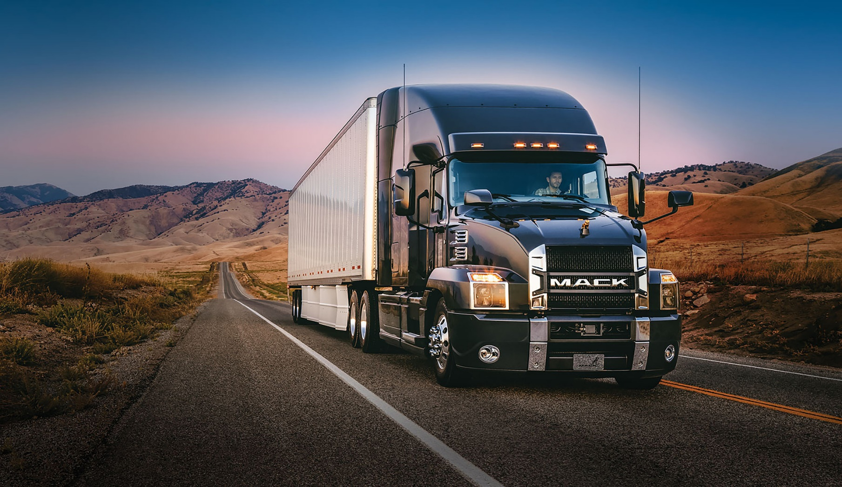

Slide 6
⁴ Love is patient and kind; love does not envy or boast; it is not arrogant ⁵ or rude. It does not insist on its own way; it is not irritable or resentful; ⁶ it does not rejoice at wrongdoing, but rejoices with the truth. ⁷ Love bears all things, believes all things, hopes all things, endures all things. ⁸ Love never ends.
1 Corinthians 13:4-8 ESV

Slide 7
⁷ Beloved, let us love one another, for love is from God, and whoever loves has been born of God and knows God. ⁸ Anyone who does not love does not know God, because God is love. ⁹ In this the love of God was made manifest among us, that God sent his only Son into the world, so that we might live through him. ¹⁰ In this is love, not that we have loved God but that he loved us and sent his Son to be the propitiation for our sins. ¹¹ Beloved, if God so loved us, we also ought to love one another. ¹² No one has ever seen God; if we love one another, God abides in us and his love is perfected in us.
1 John 4:7-12 ESV

Slide 8
And you were dead in the trespasses and sins ² in which you once walked, following the course of this world, following the prince of the power of the air, the spirit that is now at work in the sons of disobedience— ³ among whom we all once lived in the passions of our flesh, carrying out the desires of the body and the mind, and were by nature children of wrath, like the rest of mankind.
Ephesians 2:1-3 ESV

Slide 9
⁷ Beloved, let us love one another, for love is from God, and whoever loves has been born of God and knows God. ⁸ Anyone who does not love does not know God, because God is love. ⁹ In this the love of God was made manifest among us, that God sent his only Son into the world, so that we might live through him. ¹⁰ In this is love, not that we have loved God but that he loved us and sent his Son to be the propitiation for our sins. ¹¹ Beloved, if God so loved us, we also ought to love one another. ¹² No one has ever seen God; if we love one another, God abides in us and his love is perfected in us.
1 John 4:7-12 ESV

Slide 10
⁷ Beloved, let us love one another, for love is from God, and whoever loves has been born of God and knows God. ⁸ Anyone who does not love does not know God, because God is love. ⁹ In this the love of God was made manifest among us, that God sent his only Son into the world, so that we might live through him. ¹⁰ In this is love, not that we have loved God but that he loved us and sent his Son to be the propitiation for our sins. ¹¹ Beloved, if God so loved us, we also ought to love one another. ¹² No one has ever seen God; if we love one another, God abides in us and his love is perfected in us.
1 John 4:7-12 ESV

Slide 11
⁴ But God, being rich in mercy, because of the great love with which he loved us, ⁵ even when we were dead in our trespasses, made us alive together with Christ—by grace you have been saved
Ephesians 2:4-5 ESV

Slide 12
⁷ Beloved, let us love one another, for love is from God, and whoever loves has been born of God and knows God. ⁸ Anyone who does not love does not know God, because God is love. ⁹ In this the love of God was made manifest among us, that God sent his only Son into the world, so that we might live through him. ¹⁰ In this is love, not that we have loved God but that he loved us and sent his Son to be the propitiation for our sins. ¹¹ Beloved, if God so loved us, we also ought to love one another. ¹² No one has ever seen God; if we love one another, God abides in us and his love is perfected in us.
1 John 4:7-12 ESV

Slide 13
⁷ For one will scarcely die for a righteous person—though perhaps for a good person one would dare even to die— ⁸ but God shows his love for us in that while we were still sinners, Christ died for us.
Romans 5:7-8 ESV

Slide 14
  He who is love is light and fire as well. Far from condoning sin, His love has found a way to expose it (because He is light) and to consume it (because He is a fire) without destroying the sinner, but rather saving him.
  John Stott – The Letters of John

Slide 15
⁷ Beloved, let us love one another, for love is from God, and whoever loves has been born of God and knows God. ⁸ Anyone who does not love does not know God, because God is love. ⁹ In this the love of God was made manifest among us, that God sent his only Son into the world, so that we might live through him. ¹⁰ In this is love, not that we have loved God but that he loved us and sent his Son to be the propitiation for our sins. ¹¹ Beloved, if God so loved us, we also ought to love one another. ¹² No one has ever seen God; if we love one another, God abides in us and his love is perfected in us.
1 John 4:7-12 ESV

