Slide 1


Slide 2
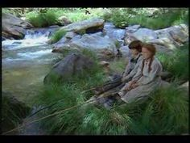

Slide 3
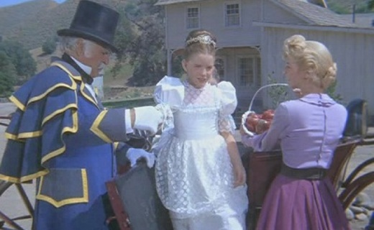
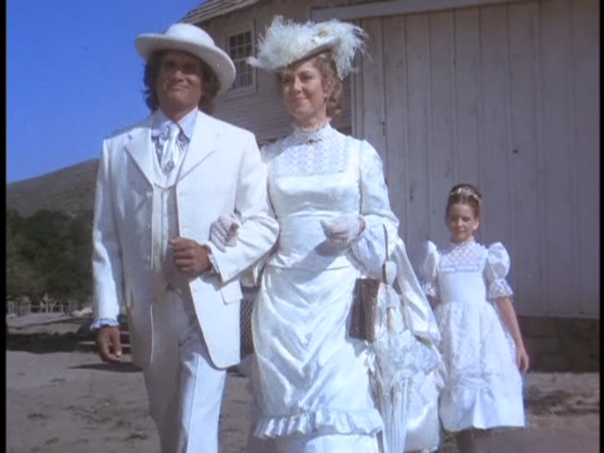

Slide 4
Beloved, do not believe every spirit, but test the spirits to see whether they are from God, for many false prophets have gone out into the world. ² By this you know the Spirit of God: every spirit that confesses that Jesus Christ has come in the flesh is from God, ³ and every spirit that does not confess Jesus is not from God. This is the spirit of the antichrist, which you heard was coming and now is in the world already. ⁴ Little children, you are from God and have overcome them, for he who is in you is greater than he who is in the world. ⁵ They are from the world; therefore they speak from the world, and the world listens to them. ⁶ We are from God. Whoever knows God listens to us; whoever is not from God does not listen to us. By this we know the Spirit of truth and the spirit of error.
1 John 4:1-6 ESV

Slide 5
Beloved, do not believe every spirit, but test the spirits to see whether they are from God, for many false prophets have gone out into the world. ² By this you know the Spirit of God: every spirit that confesses that Jesus Christ has come in the flesh is from God, ³ and every spirit that does not confess Jesus is not from God. This is the spirit of the antichrist, which you heard was coming and now is in the world already. ⁴ Little children, you are from God and have overcome them, for he who is in you is greater than he who is in the world. ⁵ They are from the world; therefore they speak from the world, and the world listens to them. ⁶ We are from God. Whoever knows God listens to us; whoever is not from God does not listen to us. By this we know the Spirit of truth and the spirit of error.
1 John 4:1-6 ESV

Slide 6
Beloved, do not believe every spirit, but test the spirits to see whether they are from God, for many false prophets have gone out into the world. ² By this you know the Spirit of God: every spirit that confesses that Jesus Christ has come in the flesh is from God, ³ and every spirit that does not confess Jesus is not from God. This is the spirit of the antichrist, which you heard was coming and now is in the world already. ⁴ Little children, you are from God and have overcome them, for he who is in you is greater than he who is in the world. ⁵ They are from the world; therefore they speak from the world, and the world listens to them. ⁶ We are from God. Whoever knows God listens to us; whoever is not from God does not listen to us. By this we know the Spirit of truth and the spirit of error.
1 John 4:1-6 ESV

Slide 7
²⁰ I have been crucified with Christ. It is no longer I who live, but Christ who lives in me. And the life I now live in the flesh I live by faith in the Son of God, who loved me and gave himself for me.
Galatians 2:20 ESV

Slide 8
Beloved, do not believe every spirit, but test the spirits to see whether they are from God, for many false prophets have gone out into the world. ² By this you know the Spirit of God: every spirit that confesses that Jesus Christ has come in the flesh is from God, ³ and every spirit that does not confess Jesus is not from God. This is the spirit of the antichrist, which you heard was coming and now is in the world already. ⁴ Little children, you are from God and have overcome them, for he who is in you is greater than he who is in the world. ⁵ They are from the world; therefore they speak from the world, and the world listens to them. ⁶ We are from God. Whoever knows God listens to us; whoever is not from God does not listen to us. By this we know the Spirit of truth and the spirit of error.
1 John 4:1-6 ESV

Slide 9
Beloved, do not believe every spirit, but test the spirits to see whether they are from God, for many false prophets have gone out into the world. ² By this you know the Spirit of God: every spirit that confesses that Jesus Christ has come in the flesh is from God, ³ and every spirit that does not confess Jesus is not from God. This is the spirit of the antichrist, which you heard was coming and now is in the world already. ⁴ Little children, you are from God and have overcome them, for he who is in you is greater than he who is in the world. ⁵ They are from the world; therefore they speak from the world, and the world listens to them. ⁶ We are from God. Whoever knows God listens to us; whoever is not from God does not listen to us. By this we know the Spirit of truth and the spirit of error.
1 John 4:1-6 ESV

Slide 10
⁴² And they devoted themselves to the apostles' teaching and the fellowship, to the breaking of bread and the prayers.
Acts 2:42 ESV

Slide 11
Beloved, do not believe every spirit, but test the spirits to see whether they are from God, for many false prophets have gone out into the world. ² By this you know the Spirit of God: every spirit that confesses that Jesus Christ has come in the flesh is from God, ³ and every spirit that does not confess Jesus is not from God. This is the spirit of the antichrist, which you heard was coming and now is in the world already. ⁴ Little children, you are from God and have overcome them, for he who is in you is greater than he who is in the world. ⁵ They are from the world; therefore they speak from the world, and the world listens to them. ⁶ We are from God. Whoever knows God listens to us; whoever is not from God does not listen to us. By this we know the Spirit of truth and the spirit of error.
1 John 4:1-6 ESV

Slide 12
⁶ If anyone does not abide in me he is thrown away like a branch and withers; and the branches are gathered, thrown into the fire, and burned.
John 15:6 ESV

