Slide 1
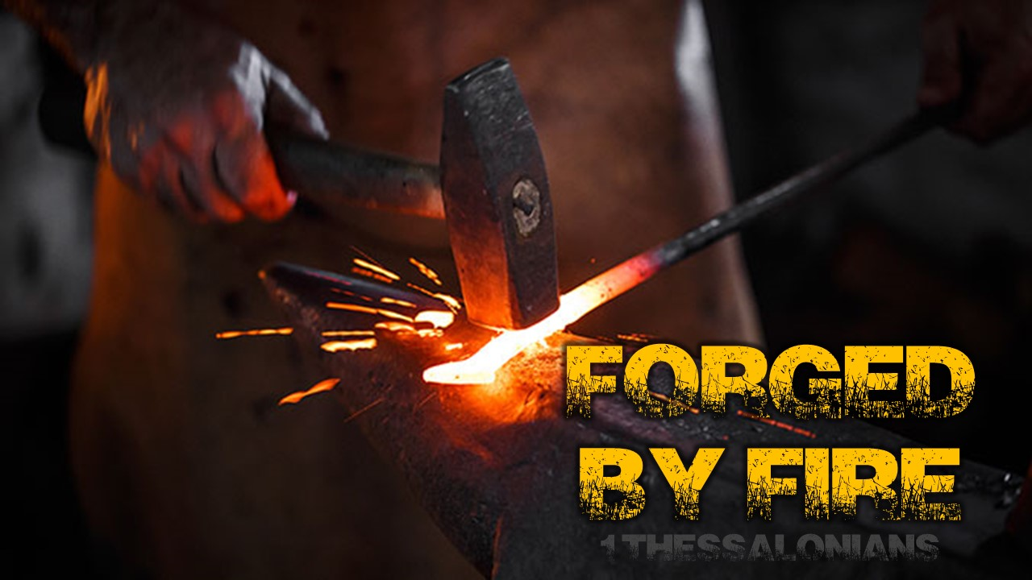

Slide 2
So when we could bear it no longer, we decided to stay on in Athens alone. ² We sent Timothy, our brother and fellow worker for God in the gospel of Christ, to strengthen you and encourage you about your faith… ⁵ So when I could bear it no longer, I sent to find out about your faith, for fear that the tempter somehow tempted you and our toil had proven useless.
1 Thessalonians 3:1-2, 5 NET

Slide 3
From Paul and Silvanus and Timothy, to the church of the Thessalonians in God the Father and the Lord Jesus Christ. Grace and peace to you! ² We thank God always for all of you as we mention you constantly in our prayers, ³ because we recall in the presence of our God and Father your work of faith and labor of love and endurance of hope in our Lord Jesus Christ. ⁴ We know, brothers and sisters loved by God, that he has chosen you, ⁵ in that our gospel did not come to you merely in words, but in power and in the Holy Spirit and with deep conviction (surely you recall the character we displayed when we came among you to help you). ⁶ And you became imitators of us and of the Lord, when you received the message with joy that comes from the Holy Spirit, despite great affliction. ⁷ As a result you became an example to all the believers in Macedonia and in Achaia. ⁸ For from you the message of the Lord has echoed forth not just in Macedonia and Achaia, but in every place reports of your faith in God have spread, so that we do not need to say anything. ⁹ For people everywhere report how you welcomed us and how you turned to God from idols to serve the living and true God ¹⁰ and to wait for his Son from heaven, whom he raised from the dead, Jesus our deliverer from the coming wrath.
1 Thessalonians 1:1-10 NET

Slide 4
From Paul and Silvanus and Timothy, to the church of the Thessalonians in God the Father and the Lord Jesus Christ. Grace and peace to you! ² We thank God always for all of you as we mention you constantly in our prayers, ³ because we recall in the presence of our God and Father your work of faith and labor of love and endurance of hope in our Lord Jesus Christ. ⁴ We know, brothers and sisters loved by God, that he has chosen you, ⁵ in that our gospel did not come to you merely in words, but in power and in the Holy Spirit and with deep conviction (surely you recall the character we displayed when we came among you to help you). ⁶ And you became imitators of us and of the Lord, when you received the message with joy that comes from the Holy Spirit, despite great affliction. ⁷ As a result you became an example to all the believers in Macedonia and in Achaia. ⁸ For from you the message of the Lord has echoed forth not just in Macedonia and Achaia, but in every place reports of your faith in God have spread, so that we do not need to say anything. ⁹ For people everywhere report how you welcomed us and how you turned to God from idols to serve the living and true God ¹⁰ and to wait for his Son from heaven, whom he raised from the dead, Jesus our deliverer from the coming wrath.
1 Thessalonians 1:1-10 NET

Slide 5
Trouble’s Coming…
John 15:18-19 ESV - ¹⁸ “If the world hates you, know that it has hated me before it hated you.¹⁹ If you were of the world, the world would love you as its own; but because you are not of the world, but I chose you out of the world, therefore the world hates you.
John 16:33 ESV - ³³ I have said these things to you, that in me you may have peace. In the world you will have tribulation. But take heart; I have overcome the world.”
1 Peter 4:12 ESV - Beloved, do not be surprised at the fiery trial when it comes upon you to test you, as though something strange were happening to you.
1 Peter 1:6 ESV - In this you rejoice, though now for a little while, if necessary, you have been grieved by various trials
James 1:2 ESV - ²Count it all joy, my brothers, when you meet trials of various kinds

Slide 6
Trouble’s Purpose…
James 1:2-3 ESV - ² Count it all joy, my brothers, when you meet trials of various kinds,³ for you know that the testing of your faith produces steadfastness. ⁴ And let steadfastness have its full effect, that you may be perfect and complete, lacking in nothing.
Romans 5:3-5 ESV - ³ Not only that, but we rejoice in our sufferings, knowing that suffering produces endurance, ⁴ and endurance produces character, and character produces hope, ⁵ and hope does not put us to shame, because God's love has been poured into our hearts through the Holy Spirit who has been given to us.

Slide 7
⁸ Three times I pleaded with the Lord about this, that it should leave me. ⁹ But he said to me, “My grace is sufficient for you, for my power is made perfect in weakness.” Therefore I will boast all the more gladly of my weaknesses, so that the power of Christ may rest upon me. ¹⁰ For the sake of Christ, then, I am content with weaknesses, insults, hardships, persecutions, and calamities. For when I am weak, then I am strong.
2 Corinthians 12:9-10 ESV

