Slide 1


Slide 2
⁵ In the same way, you who are younger, be subject to the elders. And all of you, clothe yourselves with humility toward one another, because God opposes the proud but gives grace to the humble. ⁶ And God will exalt you in due time, if you humble yourselves under his mighty hand ⁷ by casting all your cares on him because he cares for you. ⁸ Be sober and alert. Your enemy the devil, like a roaring lion, is on the prowl looking for someone to devour. ⁹ Resist him, strong in your faith, because you know that your brothers and sisters throughout the world are enduring the same kinds of suffering. ¹⁰ And, after you have suffered for a little while, the God of all grace who called you to his eternal glory in Christ will himself restore, confirm, strengthen, and establish you.¹¹ To him belongs the power forever. Amen.
1 Peter 5:5-11 NET

Slide 3
  Obey your leaders and submit to them, for they are keeping watch over your souls, as those who will have to give an account. Let them do this with joy and not with groaning, for that would be of no advantage to you.
  Hebrews 13:17 ESV

Slide 4
⁵ In the same way, you who are younger, be subject to the elders. And all of you, clothe yourselves with humility toward one another, because God opposes the proud but gives grace to the humble. ⁶ And God will exalt you in due time, if you humble yourselves under his mighty hand ⁷ by casting all your cares on him because he cares for you. ⁸ Be sober and alert. Your enemy the devil, like a roaring lion, is on the prowl looking for someone to devour. ⁹ Resist him, strong in your faith, because you know that your brothers and sisters throughout the world are enduring the same kinds of suffering. ¹⁰ And, after you have suffered for a little while, the God of all grace who called you to his eternal glory in Christ will himself restore, confirm, strengthen, and establish you.¹¹ To him belongs the power forever. Amen.
1 Peter 5:5-11 NET

Slide 5


Slide 6
⁵ In the same way, you who are younger, be subject to the elders. And all of you, clothe yourselves with humility toward one another, because God opposes the proud but gives grace to the humble. ⁶ And God will exalt you in due time, if you humble yourselves under his mighty hand ⁷ by casting all your cares on him because he cares for you. ⁸ Be sober and alert. Your enemy the devil, like a roaring lion, is on the prowl looking for someone to devour. ⁹ Resist him, strong in your faith, because you know that your brothers and sisters throughout the world are enduring the same kinds of suffering. ¹⁰ And, after you have suffered for a little while, the God of all grace who called you to his eternal glory in Christ will himself restore, confirm, strengthen, and establish you.¹¹ To him belongs the power forever. Amen.
1 Peter 5:5-11 NET

Slide 7
Therefore, since we are surrounded by such a great cloud of witnesses, we must get rid of every weight and the sin that clings so closely, and run with endurance the race set out for us, ² keeping our eyes fixed on Jesus, the pioneer and perfecter of our faith.
Hebrews 12:1-2a ESV

Slide 8
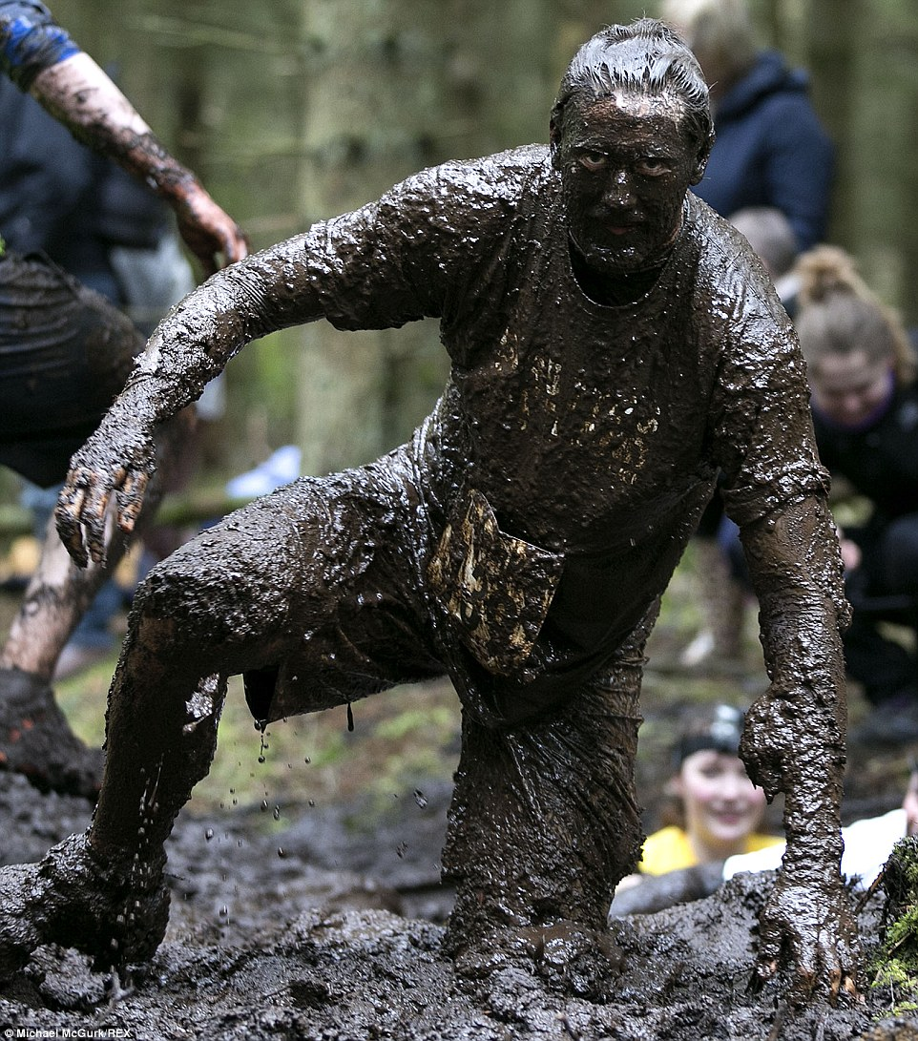
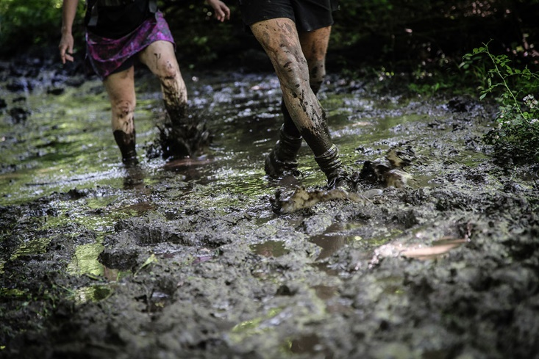
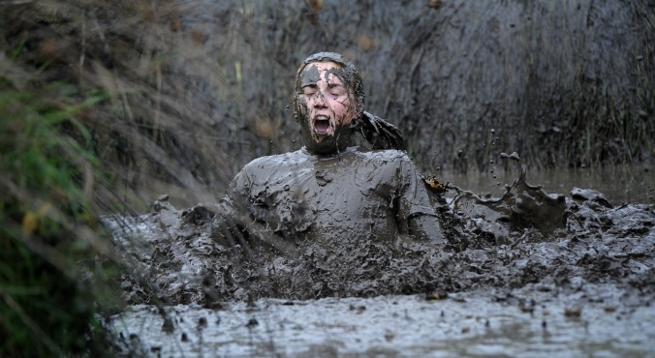

Slide 9
⁵ In the same way, you who are younger, be subject to the elders. And all of you, clothe yourselves with humility toward one another, because God opposes the proud but gives grace to the humble. ⁶ And God will exalt you in due time, if you humble yourselves under his mighty hand ⁷ by casting all your cares on him because he cares for you. ⁸ Be sober and alert. Your enemy the devil, like a roaring lion, is on the prowl looking for someone to devour. ⁹ Resist him, strong in your faith, because you know that your brothers and sisters throughout the world are enduring the same kinds of suffering. ¹⁰ And, after you have suffered for a little while, the God of all grace who called you to his eternal glory in Christ will himself restore, confirm, strengthen, and establish you.¹¹ To him belongs the power forever. Amen.
1 Peter 5:5-11 NET

Slide 10
²⁵ “Therefore I tell you, do not be anxious about your life, what you will eat or what you will drink, nor about your body, what you will put on. Is not life more than food, and the body more than clothing? ²⁶ Look at the birds of the air: they neither sow nor reap nor gather into barns, and yet your heavenly Father feeds them. Are you not of more value than they? ²⁷ And which of you by being anxious can add a single hour to his span of life? ²⁸ And why are you anxious about clothing? Consider the lilies of the field, how they grow: they neither toil nor spin, ²⁹ yet I tell you, even Solomon in all his glory was not arrayed like one of these. ³⁰ But if God so clothes the grass of the field, which today is alive and tomorrow is thrown into the oven, will he not much more clothe you, O you of little faith? ³¹ Therefore do not be anxious, saying, ‘What shall we eat?’ or ‘What shall we drink?’ or ‘What shall we wear?’ ³² For the Gentiles seek after all these things, and your heavenly Father knows that you need them all. ³³ But seek first the kingdom of God and his righteousness, and all these things will be added to you. ³⁴ “Therefore do not be anxious about tomorrow, for tomorrow will be anxious for itself. Sufficient for the day is its own trouble.
Matthew 6:25-34 ESV

