Slide 1
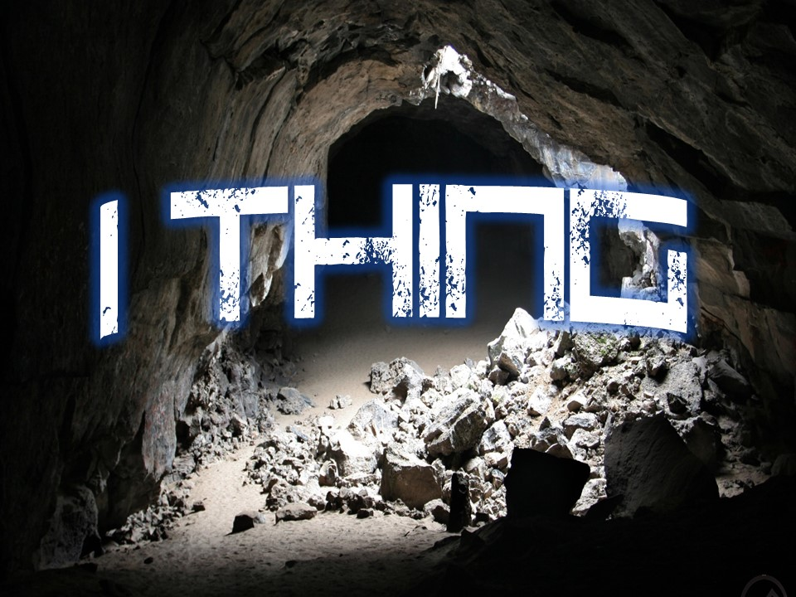

Slide 2
The Lord is my light and my salvation; whom shall I fear? The Lord is the stronghold of my life; of whom shall I be afraid? ² When evildoers assail me to eat up my flesh, my adversaries and foes, it is they who stumble and fall. ³ Though an army encamp against me, my heart shall not fear; though war arise against me, yet I will be confident. ⁴ One thing have I asked of the Lord, that will I seek after: that I may dwell in the house of the Lord all the days of my life, to gaze upon the beauty of the Lord and to inquire in his temple. ⁵ For he will hide me in his shelter in the day of trouble; he will conceal me under the cover of his tent; he will lift me high upon a rock. ⁶ And now my head shall be lifted up above my enemies all around me, and I will offer in his tent sacrifices with shouts of joy; I will sing and make melody to the Lord. ⁷ Hear, O Lord, when I cry aloud; be gracious to me and answer me! ⁸ You have said, “Seek my face.” My heart says to you, “Your face, Lord, do I seek.” ⁹ Hide not your face from me. Turn not your servant away in anger, O you who have been my help. Cast me not off; forsake me not, O God of my salvation! ¹⁰ For my father and my mother have forsaken me, but the Lord will take me in. ¹¹ Teach me your way, O Lord, and lead me on a level path because of my enemies. ¹² Give me not up to the will of my adversaries; for false witnesses have risen against me, and they breathe out violence. ¹³ I believe that I shall look upon the goodness of the Lord in the land of the living! ¹⁴ Wait for the Lord; be strong, and let your heart take courage; wait for the Lord!
Psalm 27 ESV

Slide 3
⁴ One thing have I asked of the Lord, that will I seek after: that I may dwell in the house of the Lord all the days of my life, to gaze upon the beauty of the Lord and to inquire in his temple.
Psalm 27:4 ESV

Slide 4
⁸ You have said, “Seek my face.” My heart says to you, “Your face, Lord, do I seek.”
Psalm 27:8 ESV

Slide 5
And this is the confidence that we have toward him, that if we ask anything according to his will he hears us.
1 John 5:14 ESV

Slide 6
² When evildoers assail me to eat up my flesh, my adversaries and foes, it is they who stumble and fall.
³ Though an army encamp against me, my heart shall not fear
though war arise against me, yet I will be confident.
¹⁰ For my father and my mother have forsaken me, but the Lord will take me in.
false witnesses have risen against me, and they breathe out violence. ¹³ I believe that I shall look upon the goodness of the Lord in the land of the living!
⁵ For he will hide me in his shelter in the day of trouble; he will conceal me under the cover of his tent; he will lift me high upon a rock. ⁶ And now my head shall be lifted up above my enemies all around me, and I will offer in his tent sacrifices with shouts of joy; I will sing and make melody to the Lord.

Slide 7
The Lord is my light and my salvation; whom shall I fear? The Lord is the stronghold of my life; of whom shall I be afraid?
Psalm 27:1 ESV

